Slide 1
Extreme Classroom Makeover
Carolina Classrooms Designed to Promote Active Learning
Ritchie Kendall, English and Comparative Literature Duane Deardorff, Physics and Astronomy

Slide 2
Students learn more and retain more information when they collaborate.
Seminal literature:
Cueso, 1992
Johnson et al., 1991
Johnson, Johnson, & Stanne, 2000
Millis & Cottell, 1998
Natasi & Clements, 1991
Slavin, 1990
Springer, Stanne, & Donovan, 1998

Slide 3
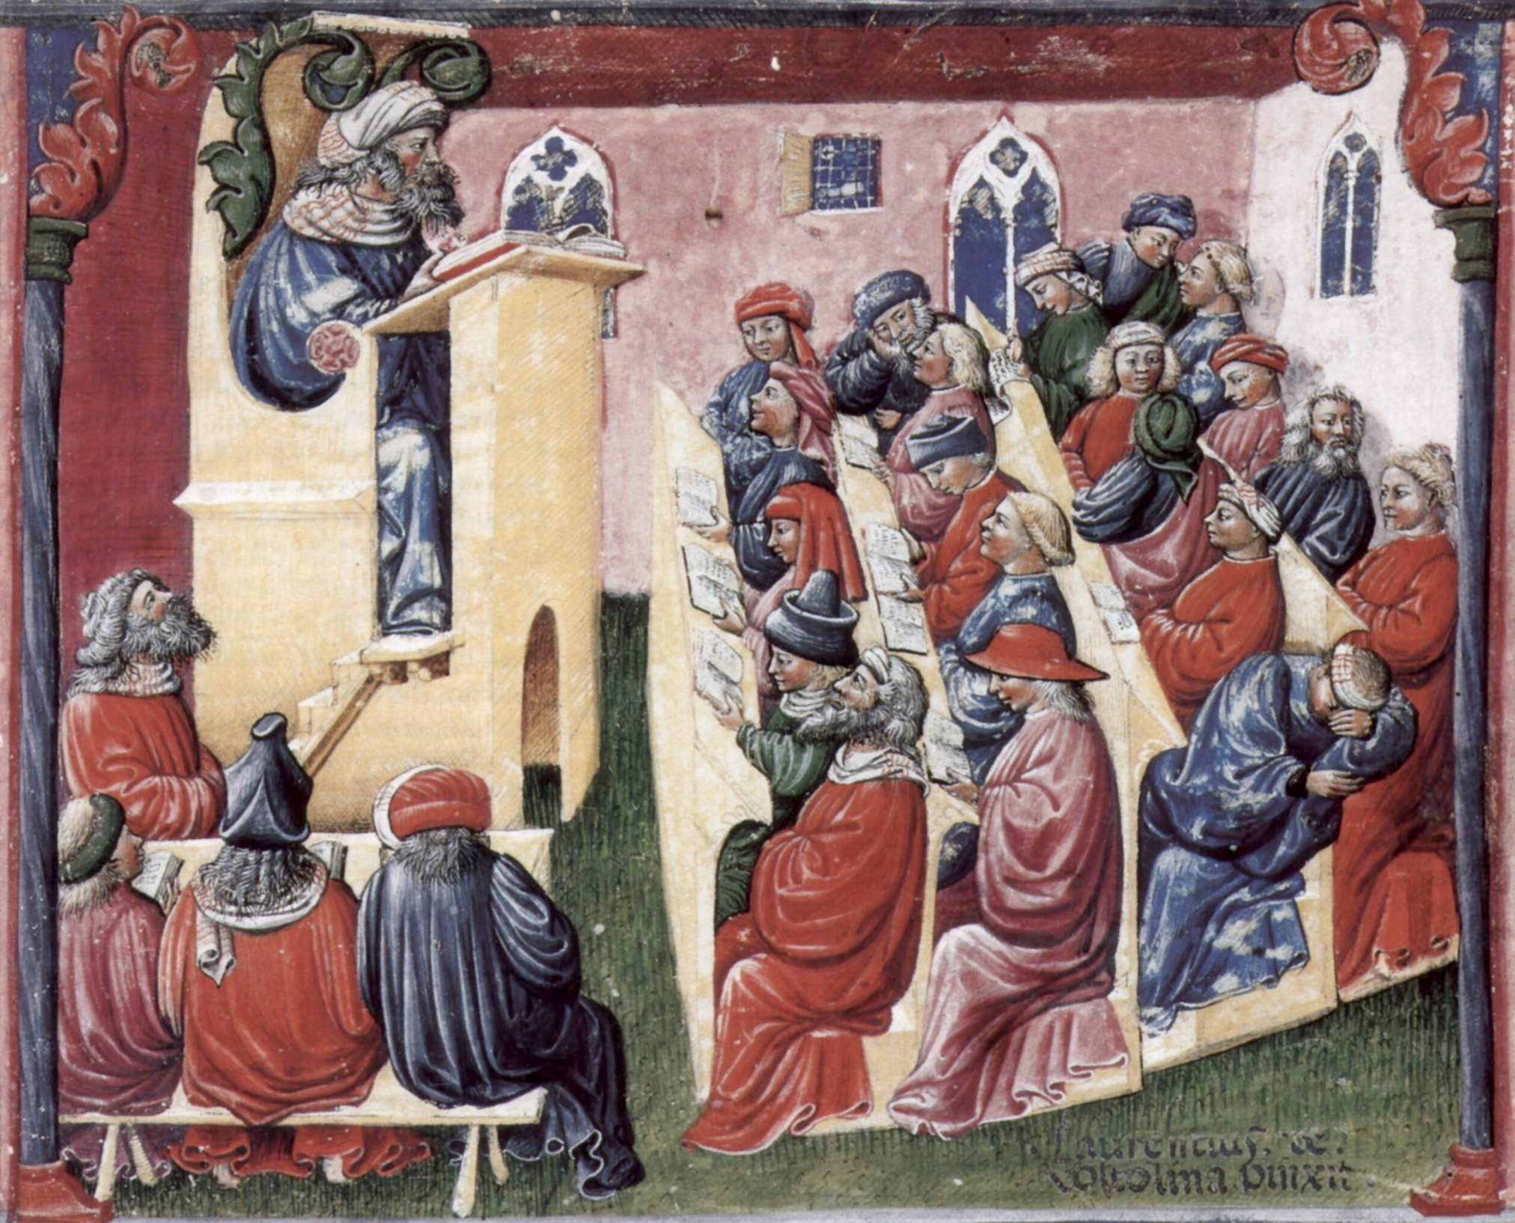
The modern lecture

Slide 4
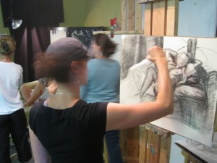
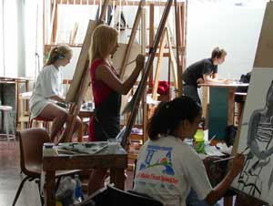
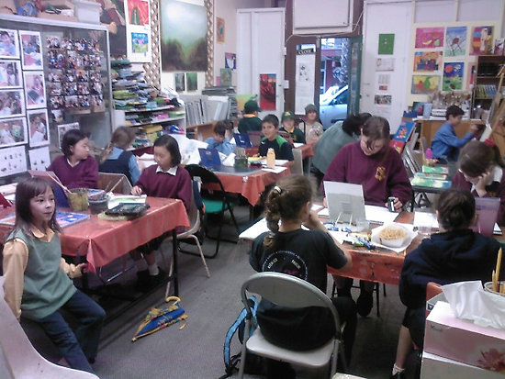
There are other approaches.
For example:
SCALE-UP*
(Student-Centered Active Learning Environment for Undergraduate Programs)
*Designed by physics education research group at NC State

Slide 5
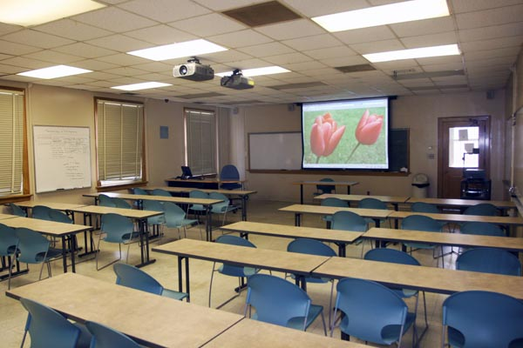
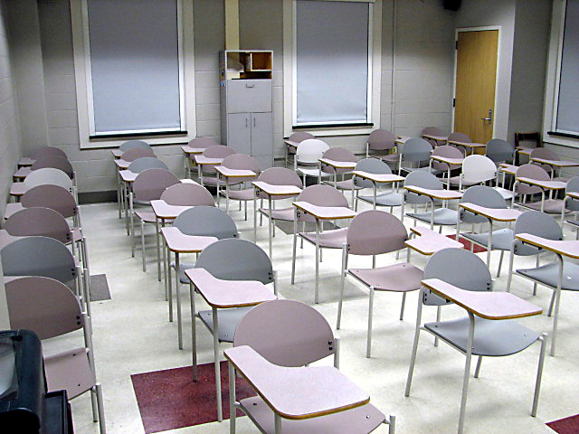
Classroom design and pedagogy
Traditional designs
Notes:
25-49: Mid-sized are hard more challenging. Generally very little eye contact among students. But group are especially challenging if you want to do anything more than just “lean over and talk to your neighbor”. JUST LIKE YOU ALL SAID, moving furniture around was time-consuming and disruptive. Sounds like a discouragement to using that particular technique.

Slide 6
Re-thinking classroom design
Goals
Student engagement and active learning
Collaboration and teamwork
Challenges
Eye contact
Movement between instructional techniques
Student proximity to instructors
Notes:
Past five years at UNC has seen an increase in the number of departments who are interested in improving the instructional experience. Some departments in our general college, some are professional schools. In some cases it’s a dean with a vision, other times it’s a fixed term faculty member teaching large sections who wants to make a difference.
Third and fourth are really constraints to how we can address the first two, will talk about these more.
But what’s really driving our work in this area is the first two. So the over-arching question that we went into this with was: If you make it easier for instructors to use interactive teaching techniques in the classroom, will they be more likely to use them?

Slide 7
Reach Carolina (new Academic Plan) Theme 3 Recommendations 1.a.
Rather than following traditional classroom models in which the instructor occupies a position of focus and students are arranged as an audience, we need to design teaching space so as to promote active learning, critical thinking, collaboration, and knowledge creation.

Slide 8
Faculty input on classroom innovation
Classroom Innovation Subcommittee reports to Classroom Policy and Steering Committee (CPSC) chaired by Associate Provost Carol Tresolini.
Subcommittee charge:
Identify emerging classroom designs, uses and supporting technologies that would further the instructional goals of the University
Make recommendations to the CPSC about classroom innovations that it feels are worthy of further exploration
Report back to the CPSC on the results of classroom innovation pilots

Slide 9
Interactive classroom designs
Fixed swivel seats
Uses fixed seats that swivel 360 degrees; aisle space allows instructor access to student groups.
Studio
Uses tables, multiple displays.
Alternative tablet arm chairs
New classroom furniture designed to facilitate interaction.

Slide 10
Steelcase Node Genome Sciences Building, Fall 2012

Slide 11
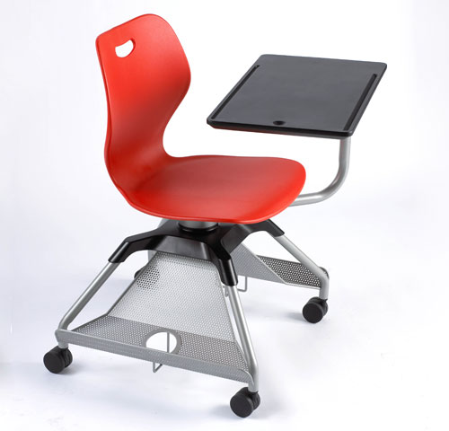
KI Learn2 Dey Hall, Spring 2012

Slide 12
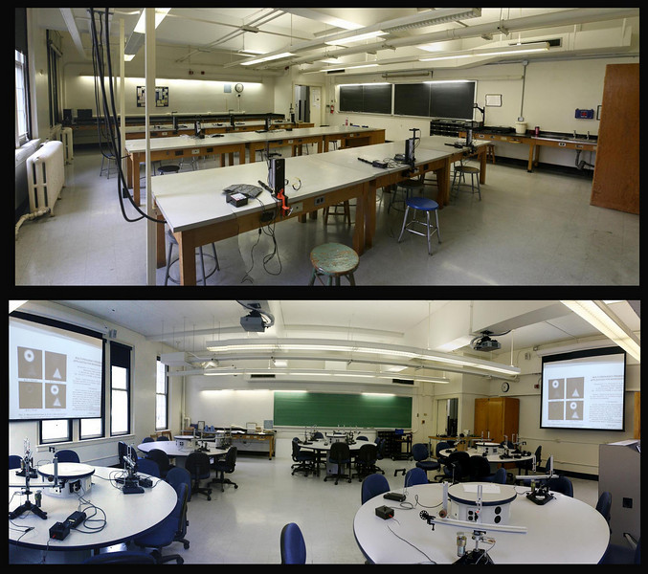
Phillips Hall - traditional bench lab

Slide 13
Studio Classrooms
208 Phillips Hall
Fall 2010 interim report: http://cfe.unc.edu/pdfs/SCALE-UP_fall2010_interimRPT.pdf

Slide 14
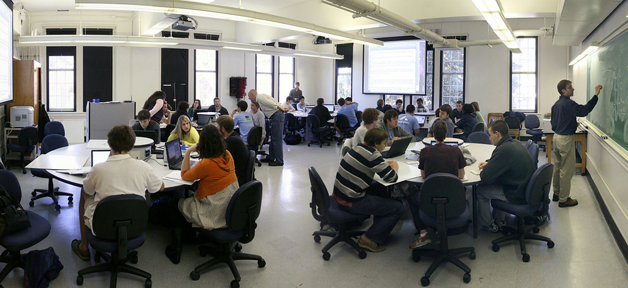

Slide 15
What we learned – Peer collaboration
Over half the students (57.9%) in the experimental classroom reported often or sometimes working with classmates outside of class on assigned work or studying, compared to 35.1% of students in the control classroom.
86.8% of students in the experimental classroom strongly agreed/agreed with the statement that students in their class help one another, compared to 56.2% of students in the control classroom.

Slide 16
What we learned – Student engagement
Over half the students (60.5%) in the experimental classroom reported spending 11 to 15 hours on coursework; whereas, over half the students (52.6%) in the control classroom reported spending 6 to 10 hours on coursework.
Over half the students (63.8%) in the experimental classroom reported often/sometimes contributing to class discussions. For the control group, 21.0% reported often/sometimes contributing to class discussions.

Slide 17
Student comments - Likes
The structure of the class worked much much better for me than the traditional 116 section that I took.
Engaging learning by working in small groups, demonstrations, and labs daily.
The teachers and TAs being available in a small classroom setting to help with individual understanding…it made me feel like they were really invested in my learning and understanding.
Ability to work in class with other students.

Slide 18
Student comments - Dislikes
The almost nonexistent lecture.
Not much lecturing to develop concepts.
Often felt I didn’t know what was expected of our group when doing short form lab reports.
Not working through problems on the board or sharing how to solve problems after completing recitation problems.

Slide 19
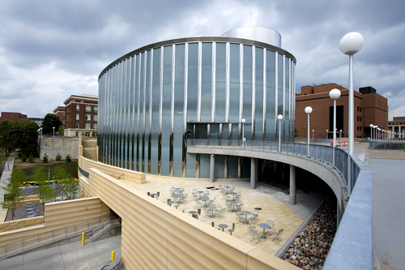
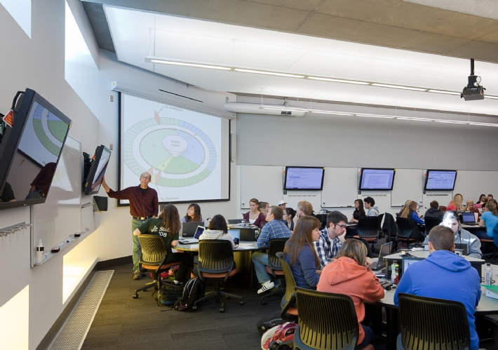
Pros:
Tracking of 16,000 students:
1. Ability to solve problems is improved
2. Conceptual understanding is increased
3. Attitudes are improved
4. Failure rates are drastically reduced,
especially for women and minorities
5. Studio approach in upper-level courses
6. SCALE-UP is not just for physics
Cons:
1. About 15% of our students want a
lecture
2. Faculty buy-in
There are >100 SCALE-UP sites in the U.S.
Minnesota Science Education Resource Center (20 SCALE-UP rooms)

Slide 20
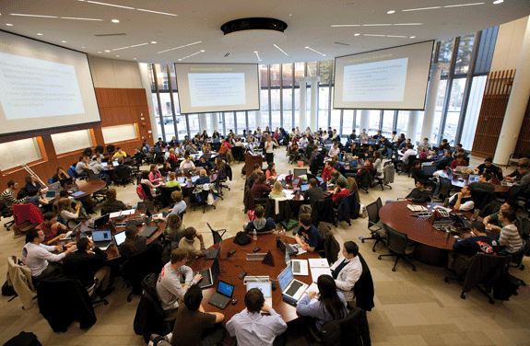
UVa. Medical Education Center

Slide 21
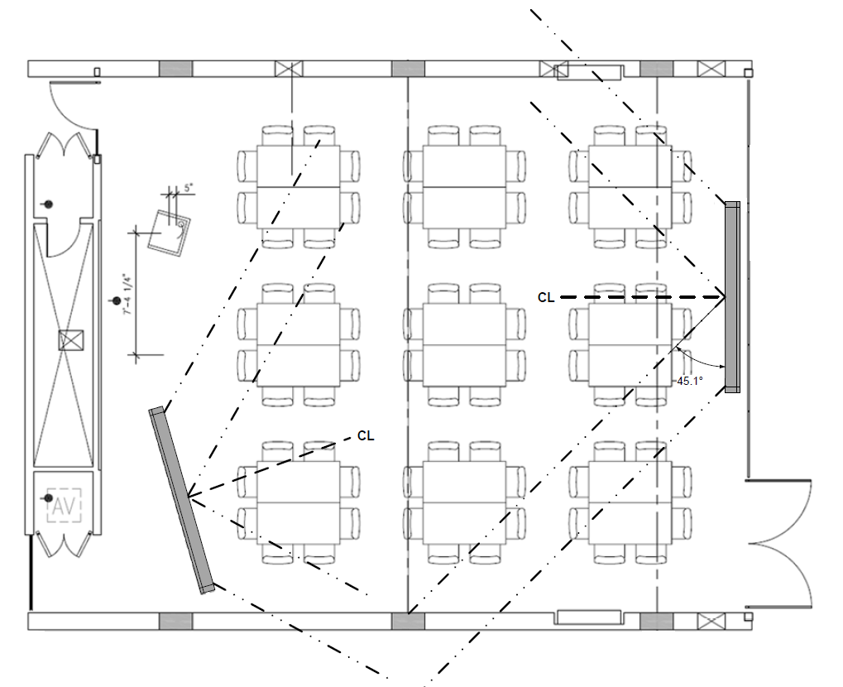
72-seat classroom (Genome Sciences Building)

Slide 22
LeBaron Hall – Iowa State U
Notes:
I had seen article in an EDUCAUSE paper on learning spaces about this design at Iowa State U.
So my immediate question was, how can we apply this to a mid-sized classroom?

Slide 23
Presentation
Notes:
So here’s our standard configuration. All students facing the front of the classroom.
Now I’m going to reveal the technology that makes our design possible.

Slide 24
Discussion
Notes:
So getting back to our mock-up classroom…..

Slide 25
Small Groups

Slide 26
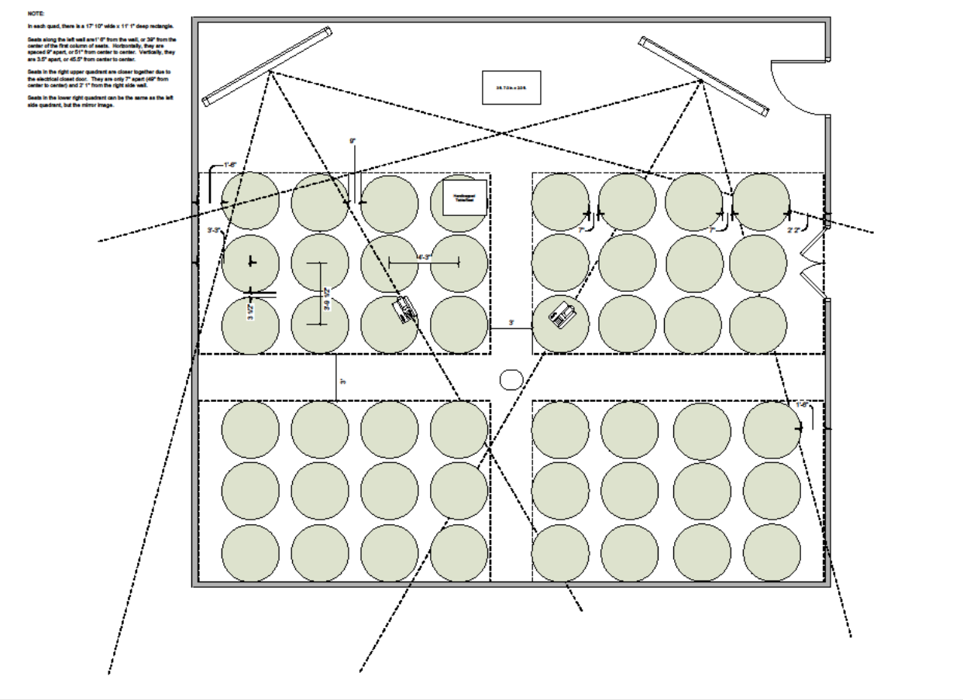

Slide 27
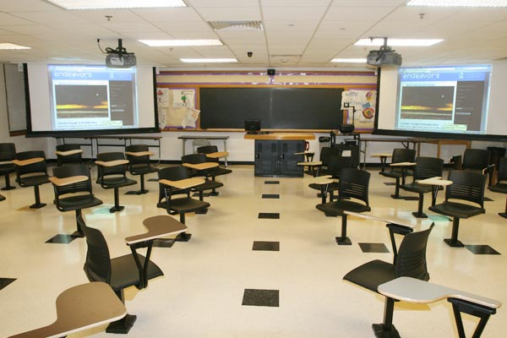
Swivel seat quadrants (311 Peabody) Facing front of room

Slide 28
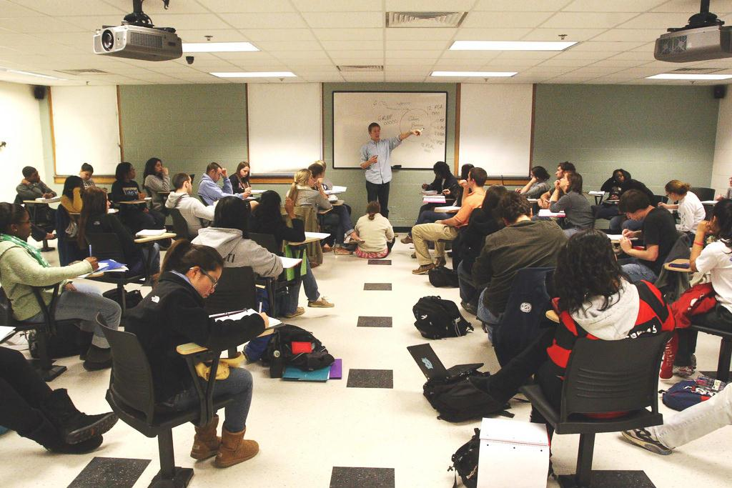
Swivel seat quadrants (311 Peabody)
Facing rear of room

Slide 29
Swivel seat quadrants (311 Peabody) Small group work

Slide 30
English 225 (Shakespeare)
Enrollment: 40
Teaching methods
Move often between lecture, discussion, and small group work
Group work often leads to informal student presentations

Slide 31
Room Arrangement

Slide 32
My experience in 311 Peabody
Easier to engage students in small groups
Group work techniques with document camera
Facilitates formal and informal student debate
Ideal for editing exercises
Eliminates need to restore seating at end of class

Slide 33
Impact on student participation Source: Spring 2011 student survey (n=215)
Themes
Felt more engaged
No barrier between instructor and students
Easier (forced) to pay attention
Liked being able to see everyone who contributed

Slide 34
Impact on student focus Source: Spring 2011 student survey (n=215)
Themes
Easy to follow conversation and professor
Focus more when I look at people
Focus more when people are looking at me
Helps me to be able to move a little bit
Sometimes I moved too much
I worried about things falling of the desk sometimes

Slide 35
Impact on student interactions Source: Spring 2011 student survey (n=215)
Themes
Eye contact
Switch between lecture and small groups with less time and trouble
Experience felt more collaborative
More general conversation w/ those around me

Slide 36
Suggestions for improving design Source: Spring 2011 student survey (n=215)
Tablets too small (11%)
Remove auto return on swivel desks (28%)
More power outlets (8%)

Slide 37
Interactive classrooms at UNC
Fixed swivel design
48-seat room (311 Peabody)
36-seat room (location TBD)
Studio design
23-seat room using round tables of five (202 Murphey)
45-seat room using round tables of nine (206 Phillips)
45-seat room using round tables of nine (208 Phillips)
72-seat room using square tables of eight (Genome Sciences Building)
Alternative tablet arm chairs
35-seat room using Steelcase Nodes (Genome Sciences Building)
25-seat language instruction classroom using KI Learn2 (TBD)

Slide 38
More information on interactive classrooms: Classroom pilot reports http://cfe.unc.edu/reports/ Contact Bob Henshaw, ITS Liaison to the CFE bhenshaw@email.unc.edu / 962-9969

