Slide 1
Now What ?!?
Faculty Technology Showcase
November 3, 2011
Todd Zakrajsek, Executive Director
Center for Faculty Excellence
The University of North Carolina – Chapel Hill

Slide 2
Titles NOT making the Cut
The Teacher as Alchemist
Terms of Engagement
Engaged Learning
Technology and Teaching: The Good, The Bad and the Really Ugly

Slide 3
in·no·va·tion [in-uh-vey-shuh n]
noun
1. something new or different introduced: numerous innovations in the high-school curriculum.
2. the act of innovating; introduction of new things or methods.

Slide 4
On the Other Side of the Door by Jeff Moss
On the other side of the door
I can be a different me,
As smart and as brave and as funny or strong
As a person could want to be.

Slide 5
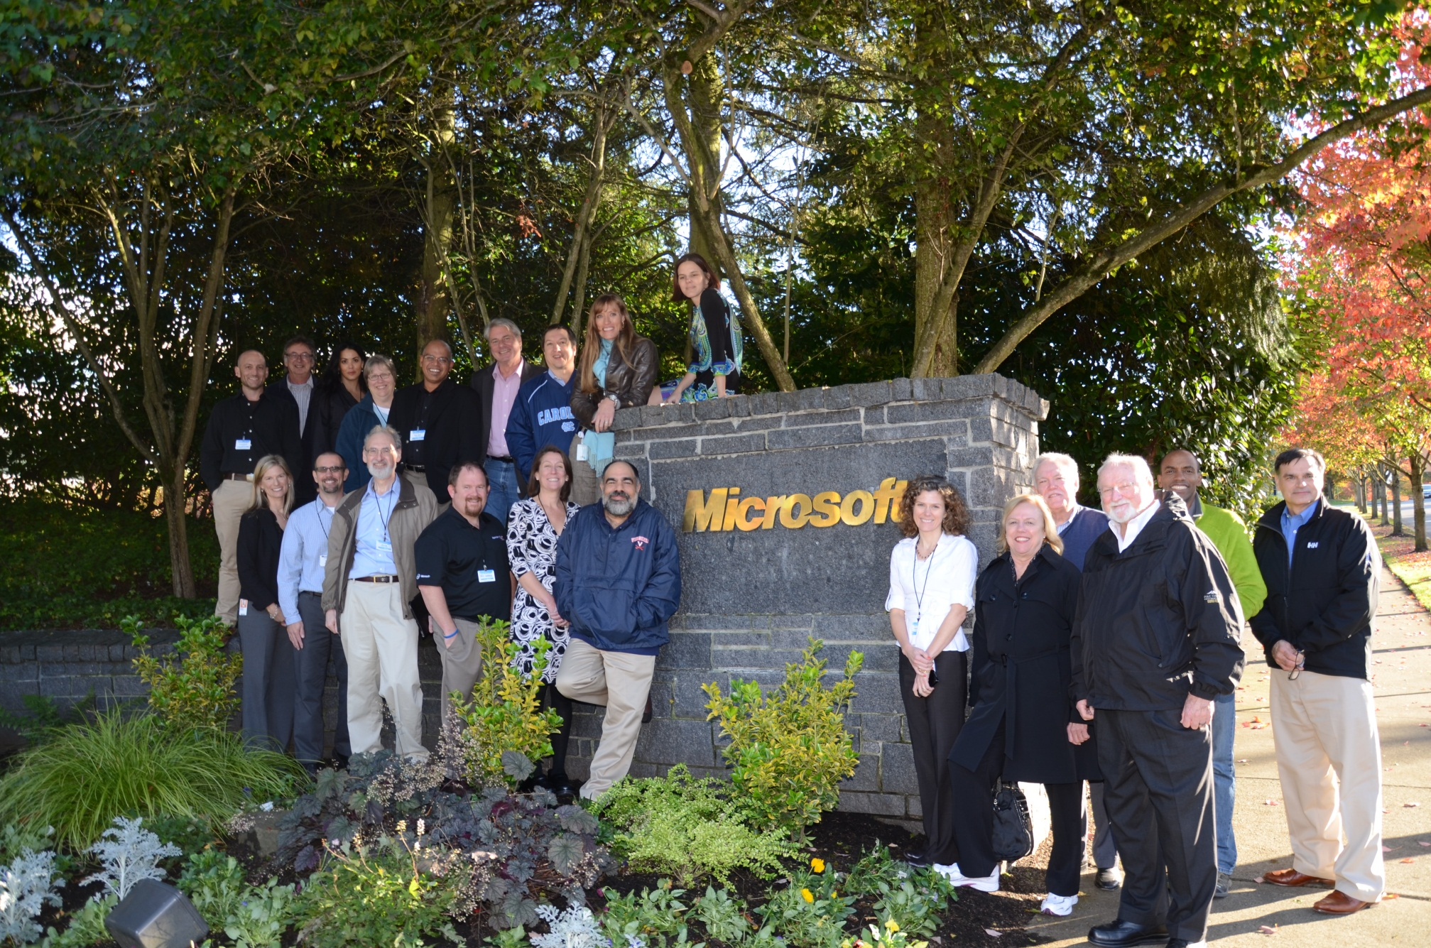

Slide 7
There’s nothing too hard for me to do,
There’s no place I can’t explore
Because everything can happen
On the other side of the door.

Slide 8
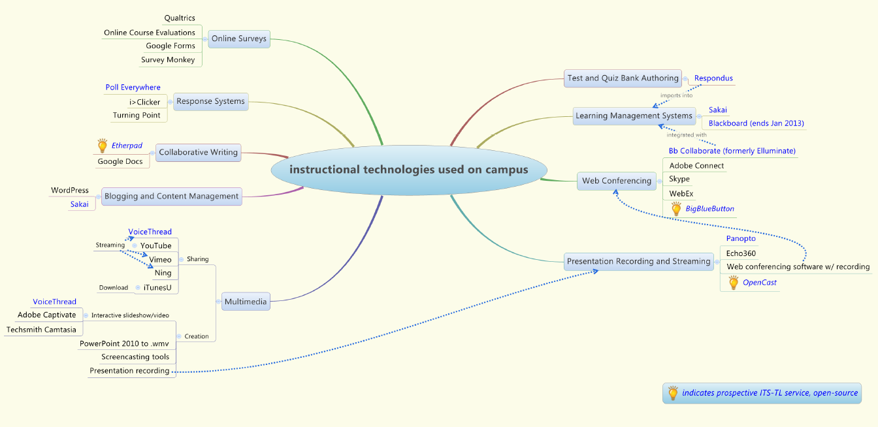

Slide 9
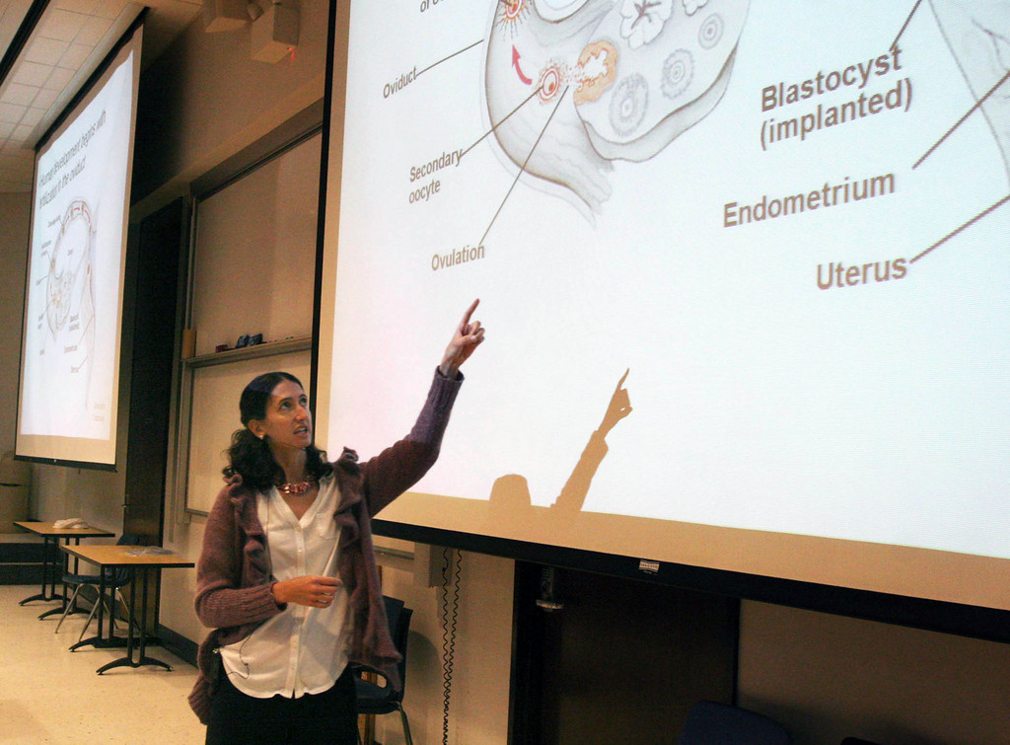
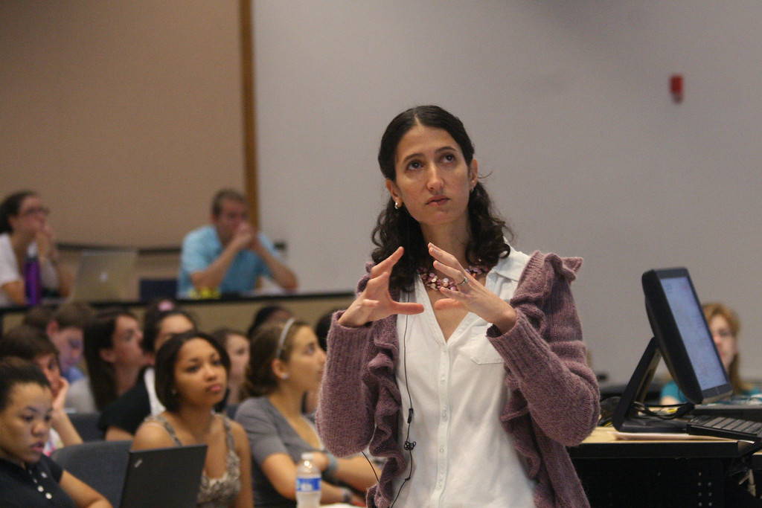

Slide 10
Hogan Biology 101 Class
Caucasian
African American
Latino
.80
.70
Score on Exam 1
.60
.50
Spring 2010
Spring 2011

Slide 11
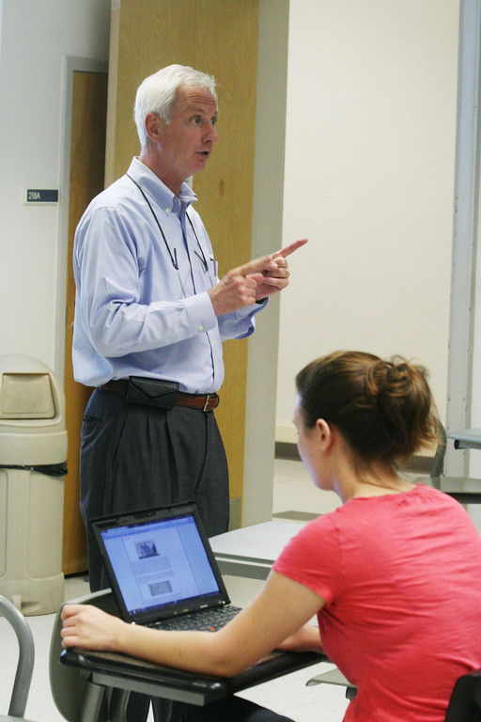
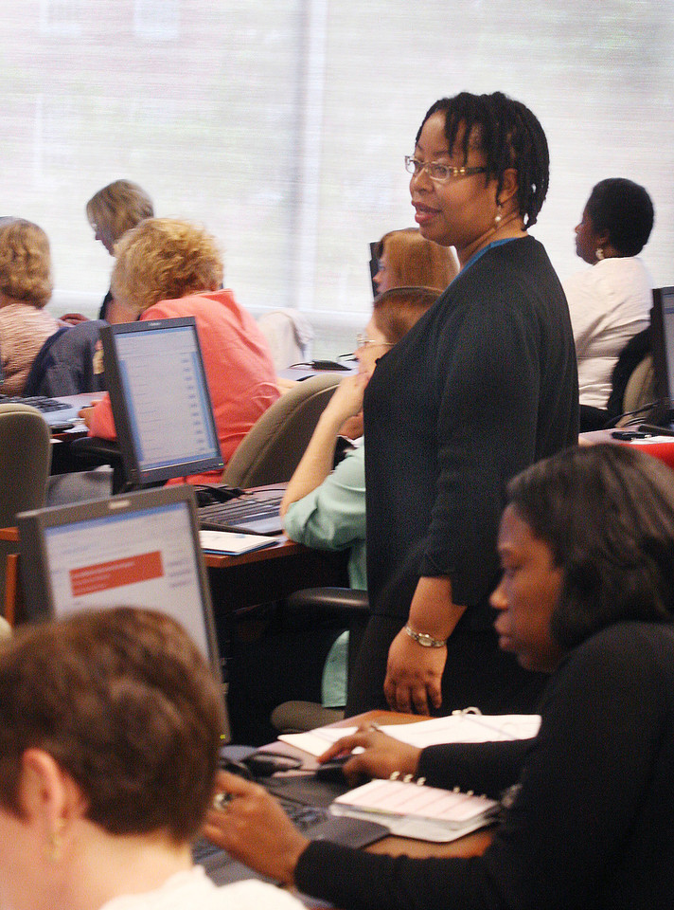
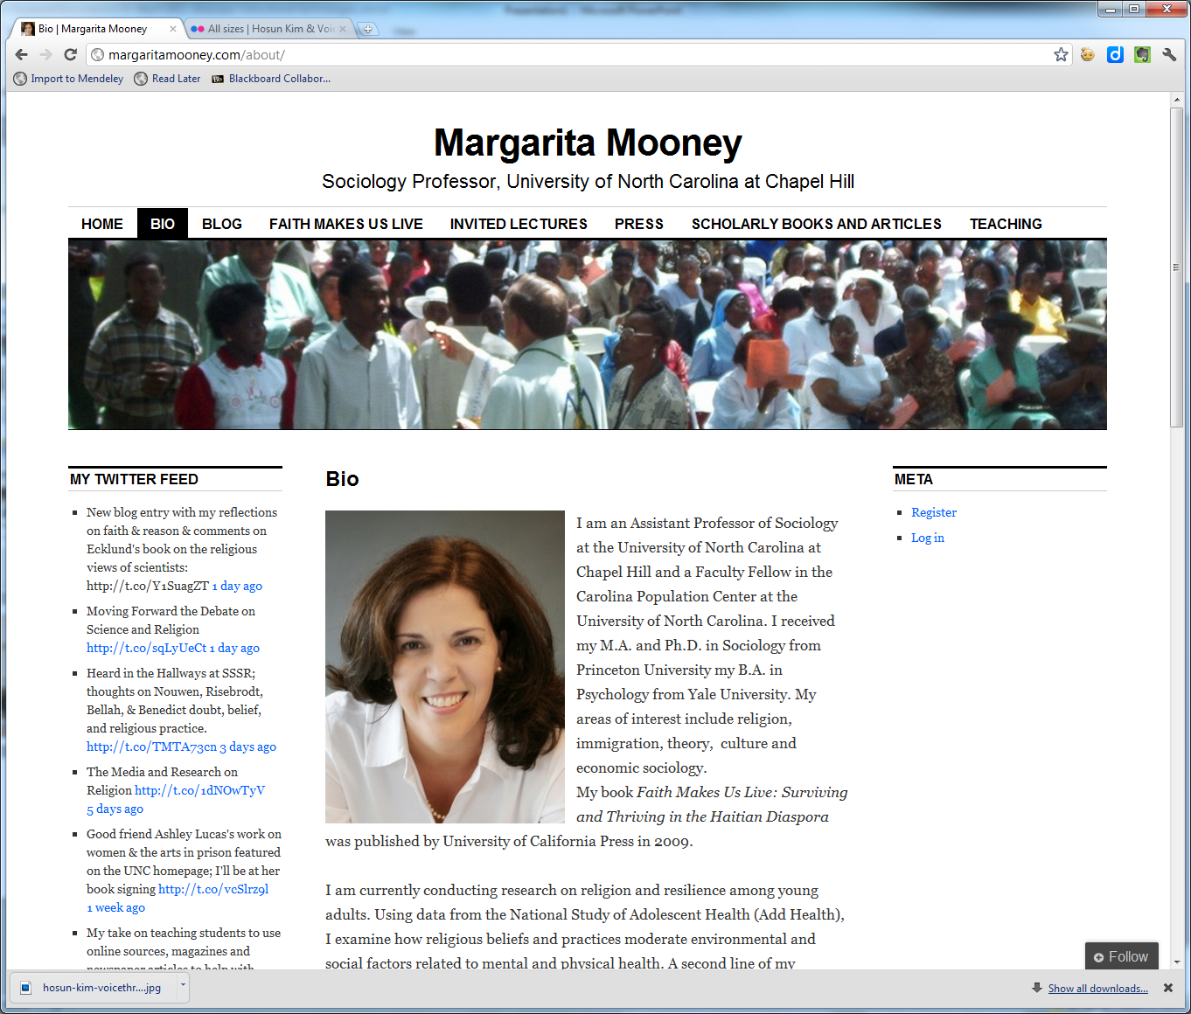
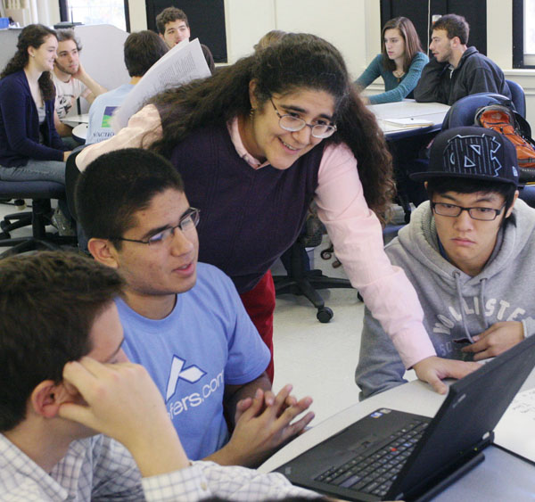
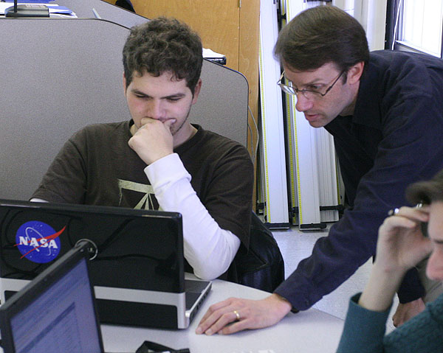
On the other side of the door
I don’t have to go alone.
If you come, too, we can sail tall ships
And fly where the wind has flown.

Slide 12
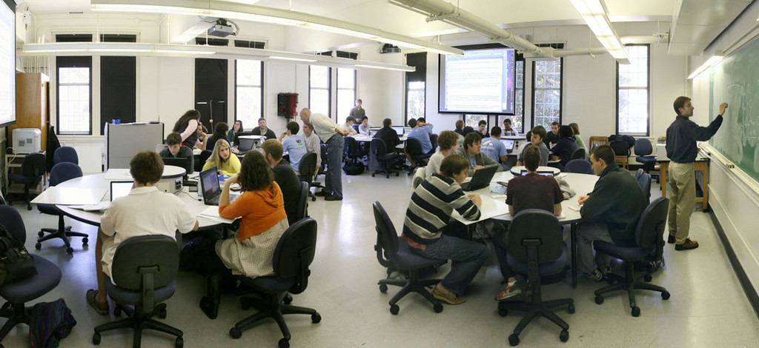
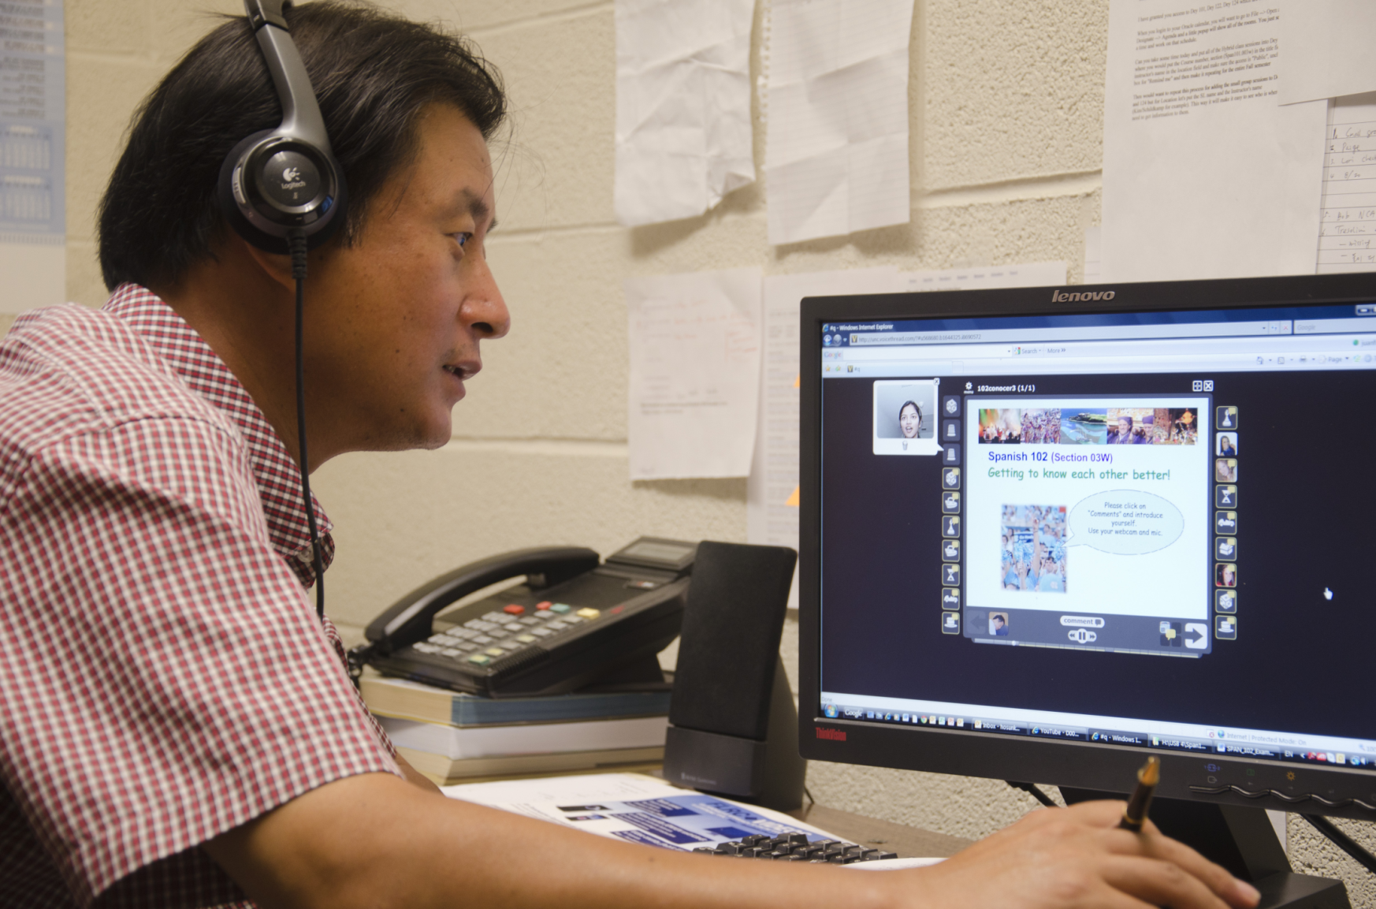
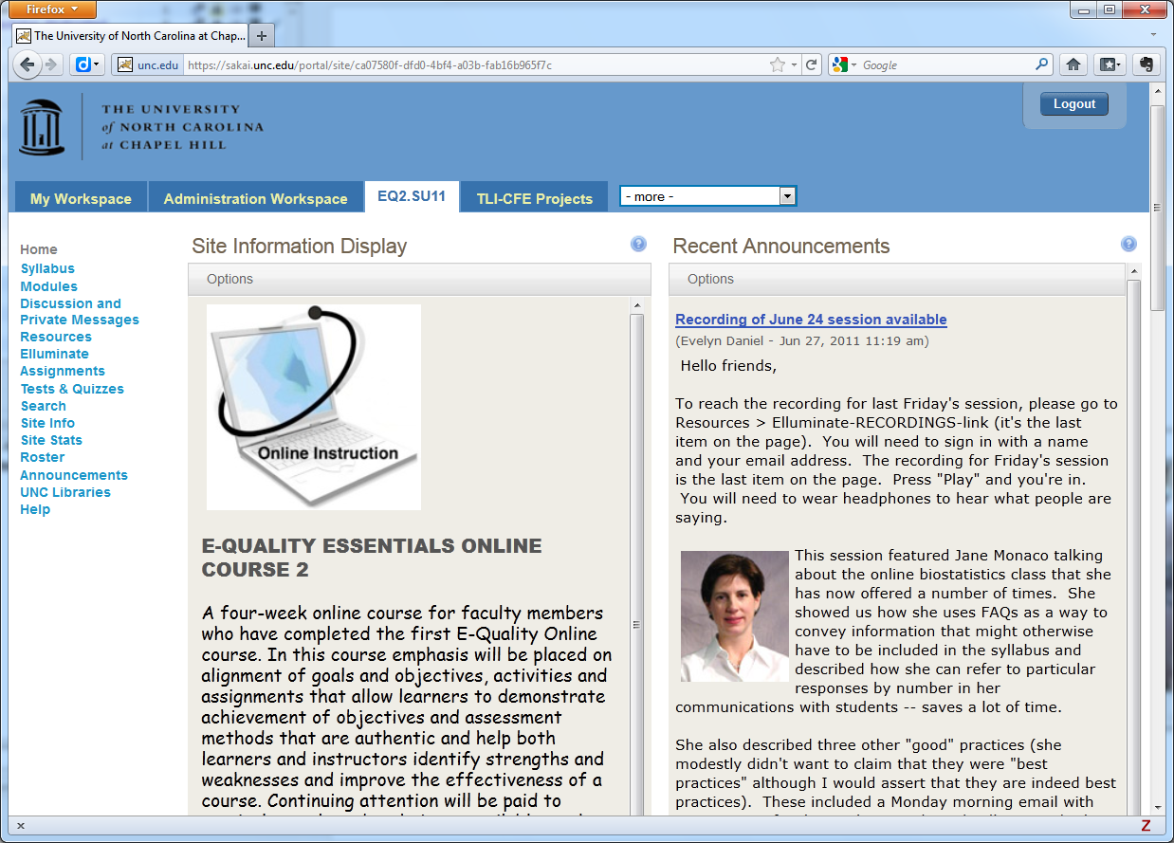
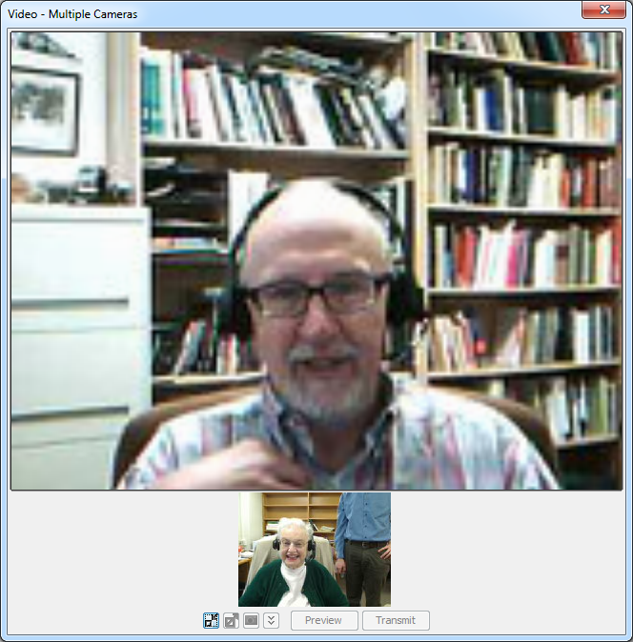
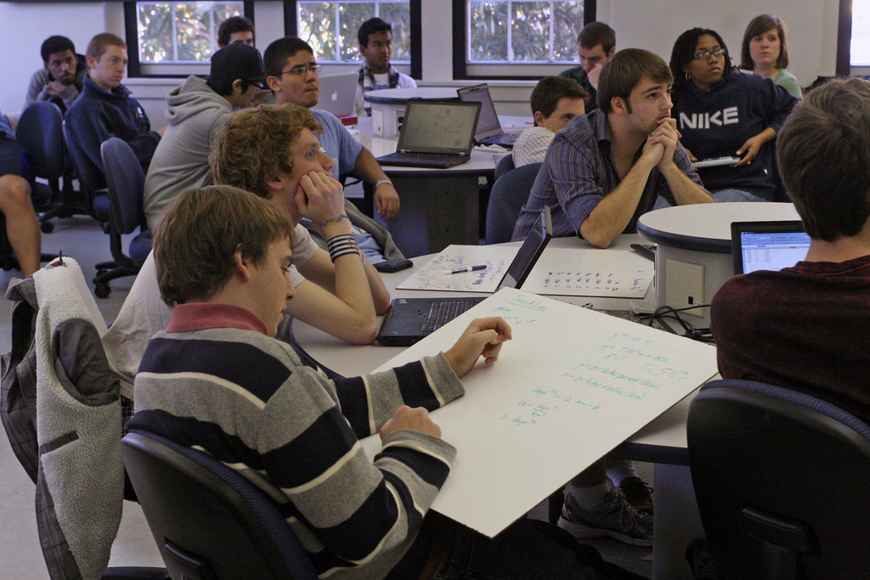
And whenever we go, it is almost sure
We’ll find what we’re looking for
Because everything can happen
On the other side of the door.

Slide 13
So….Now What?
On the Other Side of the Door
by Jeff Moss
On the other side of the door
I can be a different me,
As smart and as brave and as funny or strong
As a person could want to be.
There’s nothing too hard for me to do,
There’s no place I can’t explore
Because everything can happen
On the other side of the door.
On the other side of the door
I don’t have to go alone.
If you come, too, we can sail tall ships
And fly where the wind has flown.
And whenever we go, it is almost sure
We’ll find what we’re looking for
Because everything can happen
On the other side of the door.

