Slide 1
eLectures
“Video Thrilled the Lecturing Star?”

Slide 2
eLectures
eRecitations
eLectures
Video Solution Keys
Technology

Slide 3
eLectures
Topic 1
Topic 2
Topic 3
Class
Recitation
M
T
W
H
F

Slide 4
eLectures
Topic 1
Topic 2
Topic 3
Class
Recitation
M
T
W
H
F
M
T
W
H
F

Slide 5
eLectures

Slide 6
eLectures

Slide 7
eLectures
Lesson
Example(s)
Self-Quiz

Slide 8
eLectures

Slide 9
eLectures
Remove
Methodical Material
Rote Material
Heterogeneous Material

Slide 10
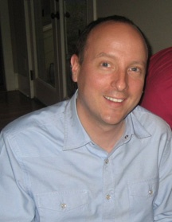
eLectures
Access
Consistency
Specialization

Slide 11
eLectures

Slide 12
eLectures
eRecitations
eLectures
Video Solution Keys
Technology

Slide 13
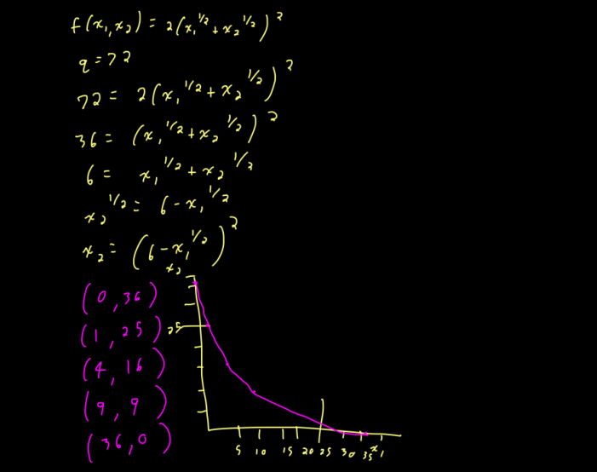
eLectures

Slide 14
eLectures
Single Concept
Example(s)
Self-Quiz

Slide 15
eLectures

Slide 16
eLectures
Consistency
No Duplication

Slide 17
eLectures
Class Problem

Slide 18
eLectures
Consistency
Recall

Slide 19
eLectures
eRecitations
eLectures
Video Solution Keys
Technology

Slide 20
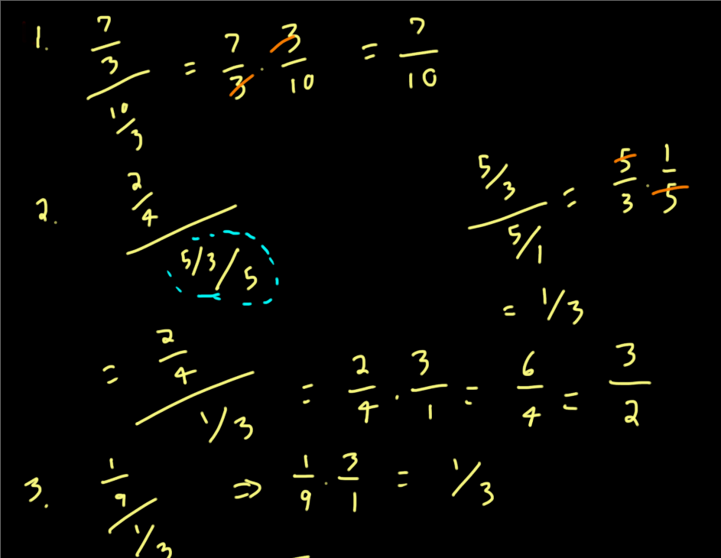
eLectures

Slide 21
eLectures
Solutions

Slide 22
eLectures

Slide 23
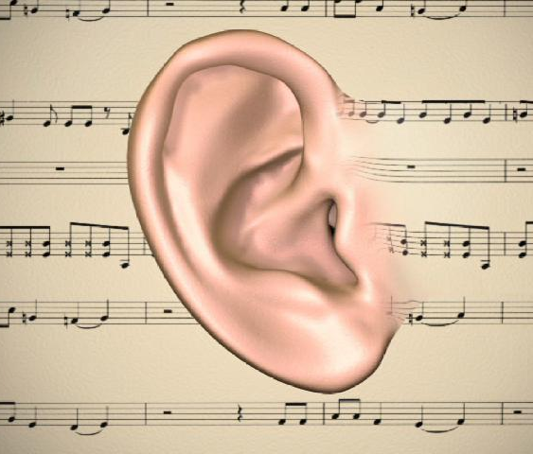
eLectures

Slide 24
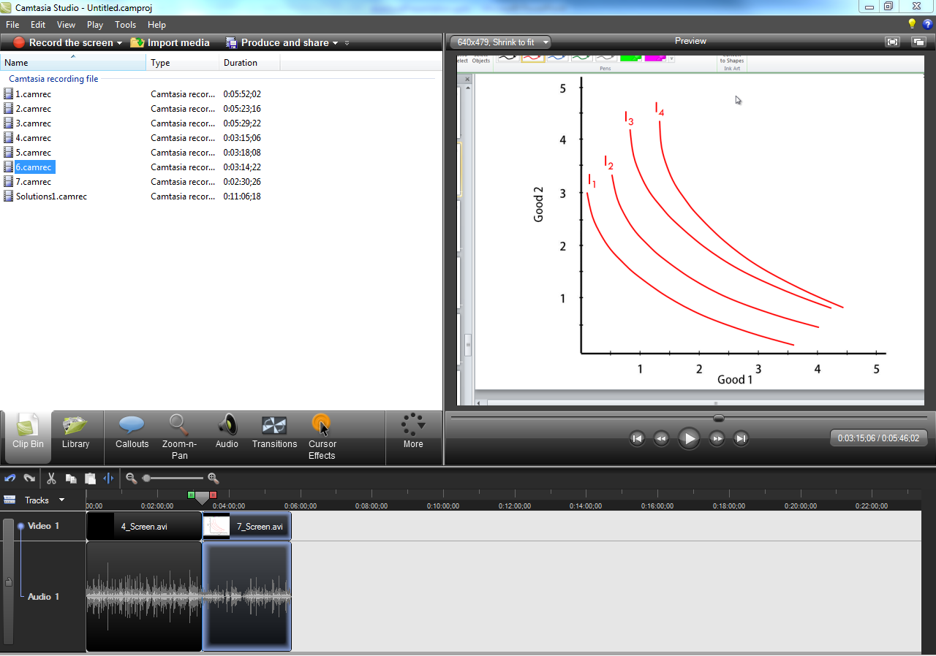
eLectures

Slide 25
eLectures
eRecitations
eLectures
Video Solution Keys
Technology

Slide 26
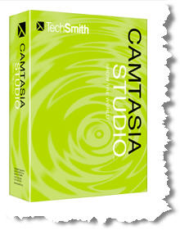
eLectures
$200-$300

Slide 27
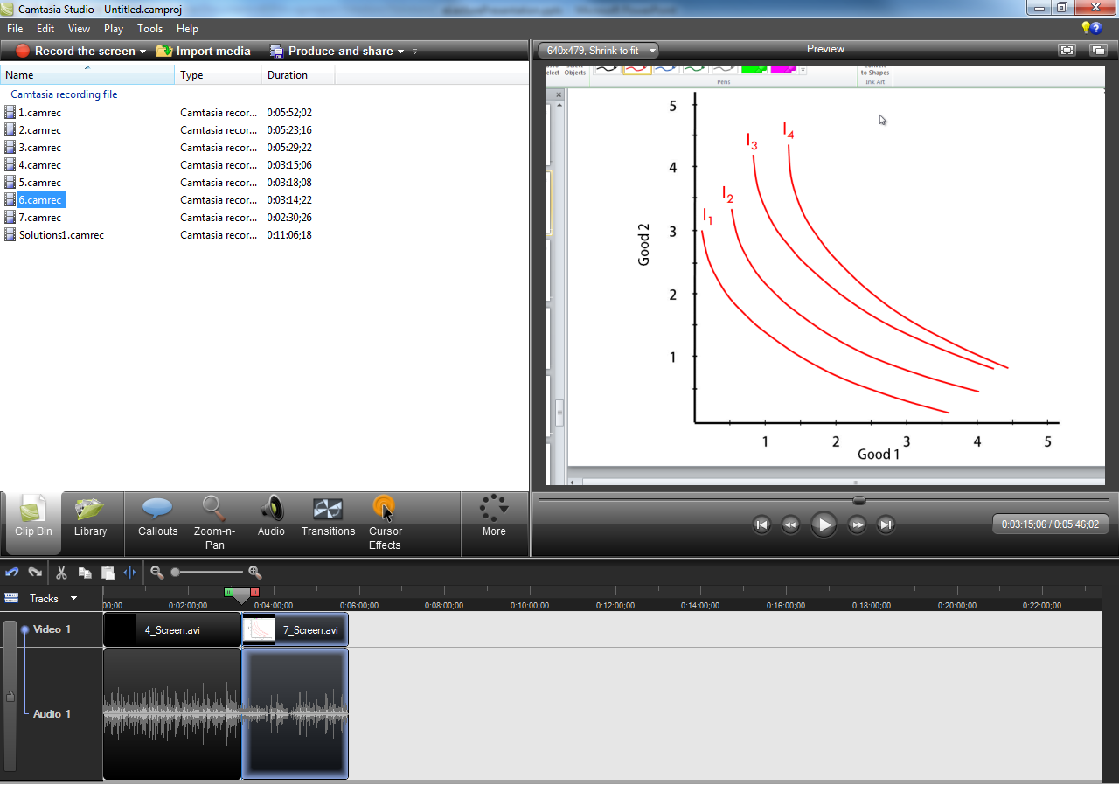
eLectures

Slide 28
eLectures
Jing: Free
Jing-Pro: $14.95/year

Slide 29
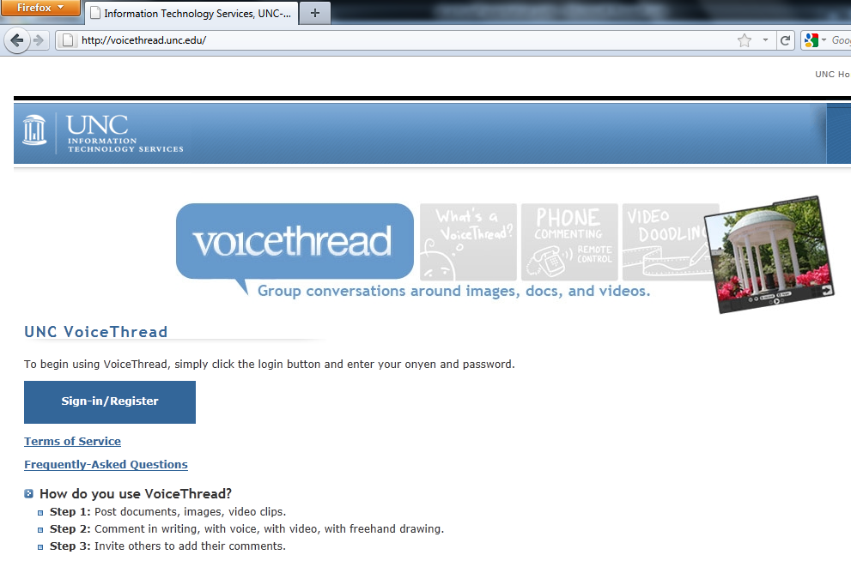
eLectures
UNC VoiceThread: Free (http://voicethread.unc.edu)

Slide 30
eLectures
Adobe Captivate: ~$150?

Slide 31
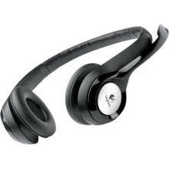
eLectures
Logitech ClearChat Comfort/USB Headset H390: $30

Slide 32
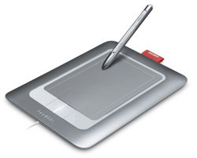
eLectures
Bamboo Fun Tablet: $150-$200

Slide 33
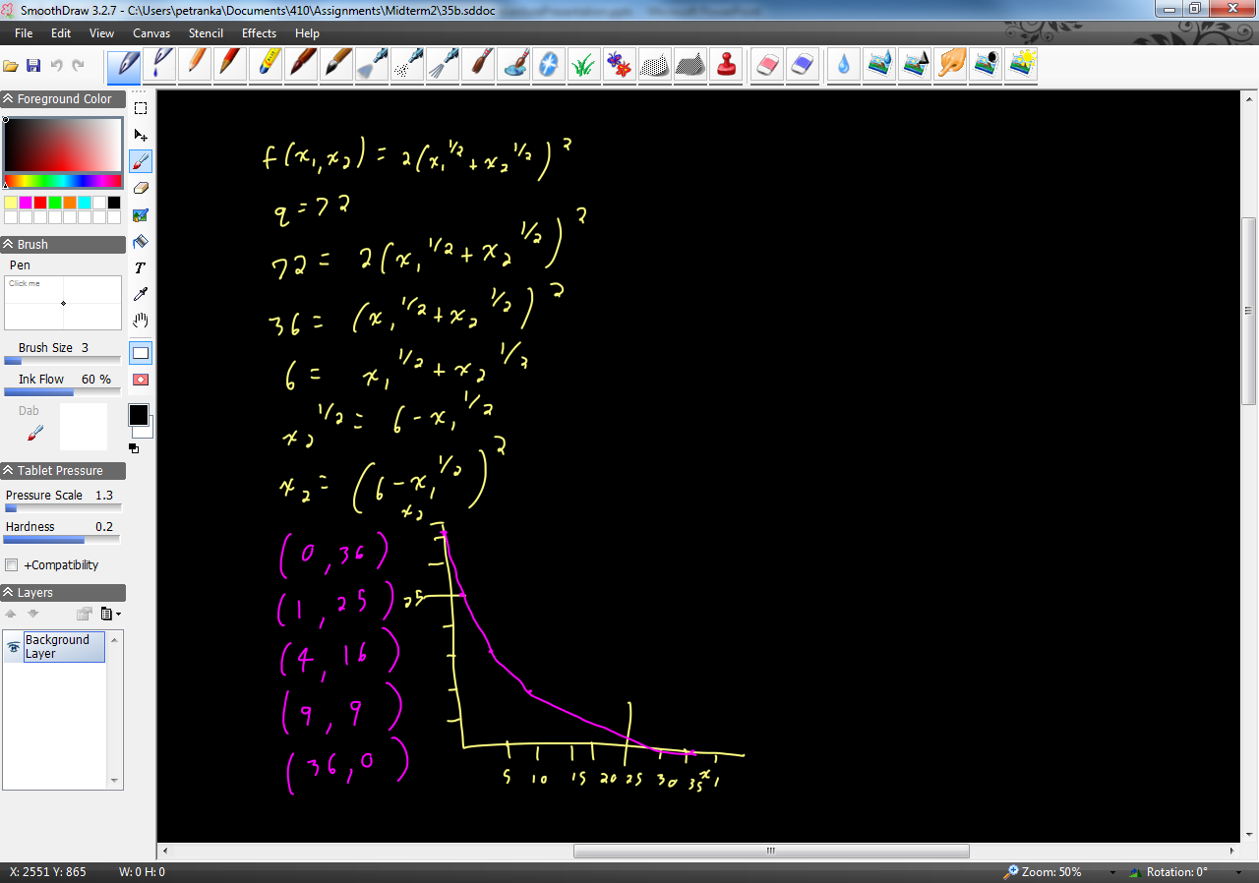
eLectures
SmoothDraw: Free

Slide 34
eLectures
AutoDesk Sketchbook Pro: $50-$60

