Slide 1
Engaging Students in Large Classes
Kelly A. Hogan
Department of Biology

Slide 2
Overheard on a professor rating site…
“She is very nice and her notes are in outline form and very organized. You don't even need to open the book. If you study her notes for the exams, you can ace all of them. Three semester exams with about 36 multiple choice questions. If you memorize her notes front to back, you can get a 100 on all of them. “

Slide 3
Was I really doing any better than this?
How can I?
Teach students to use scientific reasoning– not memorization.
Encourage all students to take responsibility for their learning.

Slide 4
I needed to:
Lecture less (5-10 min at a time)
Have students come to class with base-level content via reading and online homework.
Give students lots of PRACTICE with the higher level thinking skills that aligned with my expectations on exams.
Increase student engagement.

Slide 5
Traditional, Low Structure Biol 101
Attend Class
and Fill
In Outlines
Review:
SI, Tutoring

Slide 6
Reformed, High Structure Biol 101
Textbook & Guided Reading Qs
Mastering Biology online HW (2X per week)
Attend Class, Fill in Outlines, “Clickers” and Activities
Review:
SI, Tutoring,

Slide 7
Animal Tissues and Organ Systems
Guided Reading Qs
(Reading Chapter 20)
1. What major concept in biology is illustrated by the gecko’s feet?
2. Draw a chart or graphic that illustrates your understanding of the hierarchy of the animal body:
3. How would you respond to this statement if you heard someone say it:
“A squid’s eye has been perfectly designed to see in the dark depths of the ocean.” Any words make you uncomfortable here? What concept might you find yourself teaching this person?

Slide 8
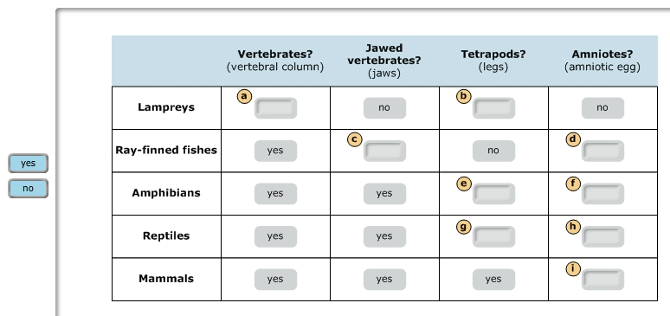
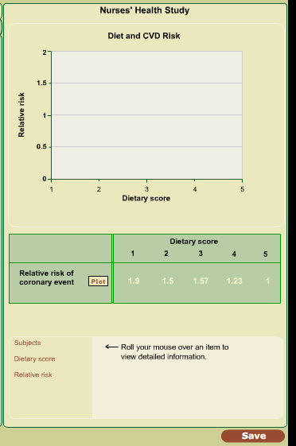
Mastering Biology: students “master” through practice.
Study skill activities. (Ex: drag and drop)
Teaching data interpretation and graphing through step through activities.
High Bloom’s level multiple choice questions.

Slide 9
In Class Activities:
Actions:
Materials:(can’t pass out papers to 400 students efficiently)
Case studies/Guided Inquiry
Demonstrations/role plays with students guiding students
Brainstorming
Write a question/Write an analogy
Draw models
Write figure legends for visuals
Make predictions/Design experiments/Draw graphs
Quizzing/Competitive games
Pre-printed skeleton notes (may include extensive data or case studies)
Index cards: easily passed, can be anonymous, easily collected
Classroom response system: problem solving, data collection for in-class experiments, collecting misconceptions, pair and share

Slide 10
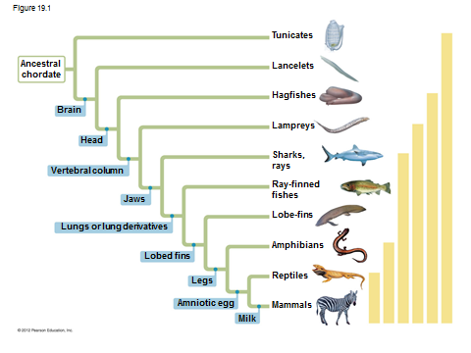
Objective: Read and Interpret Phylogenetic Evolutionary Trees.
Homework: Textbook reading and online questions related to the tree below.
In class:
1. (Low level thinking) Fill in partially blank tree they had previously seen in homework.
2. (Intermediate thinking) Interpretation of tree via clicker typical test question (TTQ).
3. (High level thinking/synthesis) Construction of their own tree applied to different groups.

Slide 11
Session/Year | Key course components
 | Face-to-Face Lecture | Mastering Biology homework | Interactive class activities | Guided reading questions |  | Class response system | Early outreach to students scoring low on first exam
Spring 2010 (Traditional, Low Structure) | 3/wk | No | No | No |  | No | No
Spring 2011 (Reformed, High structure) | 3/wk | Yes | Yes | Yes |  | Yes | Yes

Slide 12
Some Results…

Slide 13
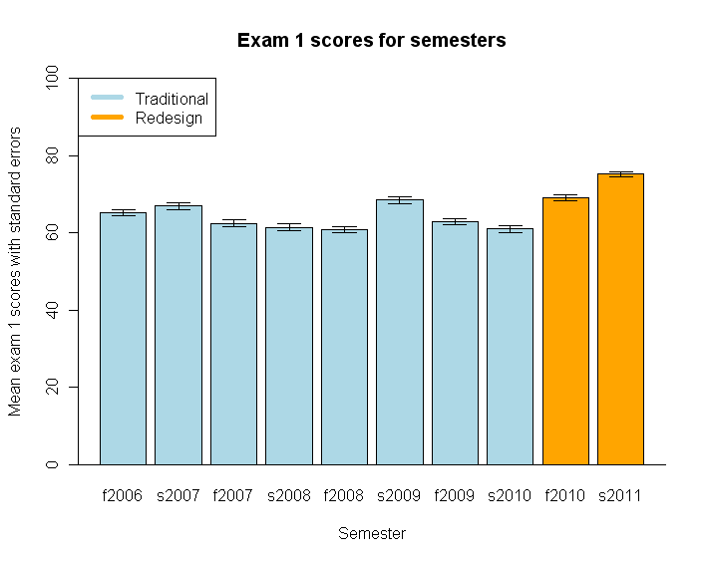
*
*
Performance on exam 1 was significantly better in reformed semesters (Fall 2010 and Spring 2011 ) than the traditional semesters (Fall 2006 through Spring 2010)
All students were better prepared!?

Slide 14
Maybe exam 1 was just “easier” in the reformed semesters.

Slide 15
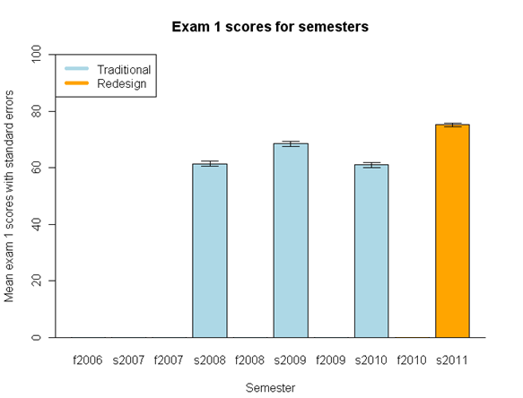
% of questions per exam that were application or synthesis type questions.
*
A
33%
D
B
36%
A
B
C
C
50%
D
36%
Comparison of multiple spring semesters based on Exam 1 scores and Blooms analysis.

Slide 16
% of questions per exam that were application or synthesis type questions.
*
33%
D
36%
A
B
C
50%
36%
Comparison of multiple spring semesters based on Exam 1 scores and Blooms analysis.
Conclusion: Data suggests that students were better prepared for their first exam with the high structure format.

Slide 17
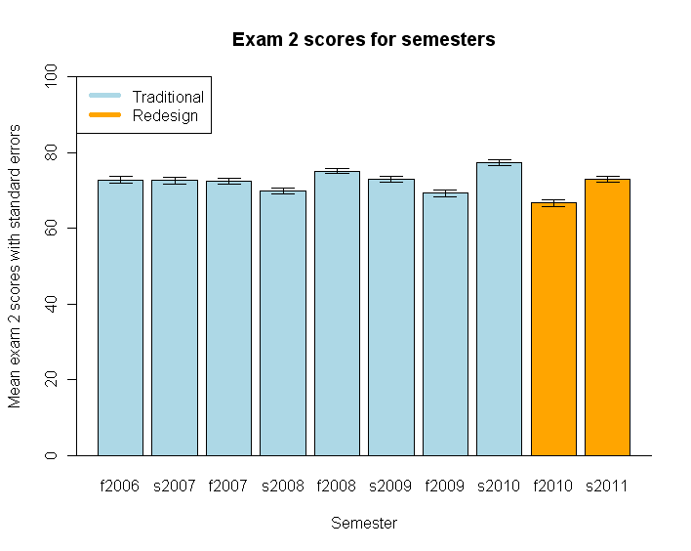
% of questions per exam that were application or synthesis type questions.
58%
58%
61%
57%
That “better preparation” does not continue through the semester, however.
(Exam difficulty was similar between the redesigned and previous exams.)

Slide 18
Only exam 1 was correlating with “better” performance for students in the reformed course compared to students in the traditional class.
There were no performance differences with Exam 2, 3, or the Final Exam
This led us to question…might certain subgroups of the population be benefiting more than others with the high structure? Might subgroup differences persist long term?

Slide 19
Nationally, what percentage of under-represented minority (URM) students receive a D or F in their introductory courses?

Slide 20
Why is performance from URM students lower?
URM students are more likely to come from socioeconomically disadvantaged backgrounds and lower-quality schools than their non-URM peers.
URM students come from backgrounds where they are less likely to have access to the knowledge and skills necessary for navigating the college environment. (“First generation”.)
Because of internalization of stereotypes, URM students often believe that they are not likely to succeed, regardless of their ability level.
URM students are less able to find a niche for themselves.
Rath et al. (2007); Massey et al. (2002)

Slide 21
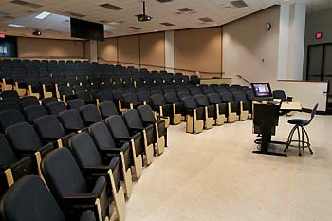
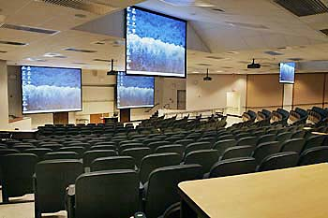
What about UNC? What about my class?
Hamilton 100 (Location of Biology 101). Seats > 400 students.

Slide 22
Proportion of URM College Students in BIOL 101 Receiving D/F Grades Source: UNC University Registrar
Term | # Students completed course | % Black students | % of D/F grades given to Black students | % Hispanic students | % of D/F grades given to Hispanic students | % White students | % of D/F grades given to white students
Fall 2006 | 358 | 10.3 % | 35.1 % | 5 % | 50% | 72.1 % | 18.2 %
Fall 2006 | 392 | 18.6% | 27.4 % | 6.4 % | 12 % | 62.0 % | 8.2 %
Spring 2007 | 361 | 13.6 % | 40.8 % | 4.7 % | 11.8 % | 68.1 % | 7.7 %
Spring 2007 | 331 | 17.5 % | 24.1 % | 4.5 % | 13.3 % | 66.5 % | 8.2 %
Fall 2007 | 335 | 14.3 % | 37.5 % | 4.5 % | 20.0 % | 66.0 % | 8.1 %
Fall 2007 | 360 | 18.9 % | 25.0 % | 8.6 % | 3.2 % | 62.2 % | 5.8 %
Spring 2008 | 363 | 19.3 % | 35.7 % | 5.7 % | 23.8 % | 61.7 % | 6.7 %
Spring 2008 | 314 | 11.8 % | 24.3 % | 5.0 % | 23.0 % | 73.6 % | 6.9 %
8 semester average:
31%
20%
9%

Slide 23
Subgroup Comparison Four-Exam Comparison Before and After Redesign; * p value < 0.05
Spring 2010 (Traditional) |  | Spring 2011 (Reformed)
 | 4-exam Average |  | 4-exam Average
Caucasian (n=241) | 74.49% | Caucasian (n=238) | 75.57%
African American (n=51) | 57.17% | African American (n=47) | 67.84%*
Asian (n=31) | 74.33% | Asian (n=37) | 75.80%
Latino (n=17) | 65.22% | Latino (n=23) | 75.80%*
Other (n=28) | 67.36% | Other (n=38) | 73.03%
What do you conclude?
African American and Latino students performed better in the reformed course.

Slide 24
Performance gaps for each exam: Traditional Spring 2010

Slide 25
Traditional 2010
The gap lessens for African Americans but disappears for Latinos? Why?
Reformed
2011

Slide 26
First Generation Students:
 | Exam I | Exam II | Exam III | Final Exam | 4-exam average
NON- First Gen | 62.75% | 78.44% | 73.39% | 71.33% | 71.48%
First generation | 55.98% | 69.15% | 69.81% | 64.31% | 64.81%
 | Exam I | Exam II | Exam III | Final Exam | 4-exam average
NON- First Gen | 74.90% | 74.44% | 79.24% | 72.98% | 75.39%
First generation | 75.31% | 69.01% | 73.74% | 65.48% | 70.89%*
A significant difference was also noted in 4-exam average scores between first-generation students in the Spring 2011 course (70.9%) and those in the Spring 2010 course (64.81%).

Slide 27
What is happening?
Leveling of playing field before class/increased course structure
What do I know, what don’t I know?
Addresses issue of being underprepared by highschool
Measurable increase in engagement

Slide 28
“I learned so much from her! She uses Mastering Biology, which I really appreciated because it included so many study resources. Her lectures are interesting, and she provides an outline for you to fill out as she teaches. She also provides guided reading questions to complete before lectures, which I strongly recommend you doing. They are very helpful. SI sessions are available, and I have been told that they are very helpful (though I never went to one). Dr. Hogan REALLY cares about her students and provides tons of opportunities to get help if you need it. I loved her class and would recommend it to anyone.”
Overheard on a professor rating site…

Slide 29
Personalizing the Biol 101 experience, how do they know I CARE?
Transparency about my philosophy and my reasoning for each course component.
Emails: sent after exams to high and low scorers and students that make big leaps.
Invitation (nurturing tone) for low scorers to come do a “Self Assessment” survey with me.
Heavily advertising and endorsing resources throughout the semester:
Basic peer tutoring (advertised as for those “who think they may fail the course”)
Learning Center Tutoring (Extremely high quality!)
Supplemental Instructor with peer TA
Office hours

Slide 30
Students take responsibility when they respect you and think you care about their learning and their grade.
Students accept responsibility
Transparency about pedagogy
set high expectations, but practice the expectations
Be nurturing
and “on their side”
Rules are rules
Treat students as adults
Invitations and interventions

Slide 31
What next?
Resources to continue improvement:
A T.A. dedicated to helping me personalize the course (i.e. identifying students who fit into “bins”)
More support for Supplemental Instruction which correlate with better student performance
Rath et. al, CBE LIFE SCIENCES EDUCATION. Sept 2007 “Supplemental Instruction in Introductory Biology I: Enhancing the Performance and Retention of Underrepresented Minority Students”.
Classroom coaching on ways to better align my activities with learning outcomes.

Slide 32
What next?
More statistical analysis to validate our findings with URM and first generation students in other reformed semesters.
Haak et. al, SCIENCE, June 2011 “Increased Structure and Active Learning Reduce the Achievement Gap in Introductory Biology”.
Identify the course components that have the biggest impact on reducing the performance gap.
Learn what barriers the African American students face that may have disappeared in Latinos.
Measure learning gains, not just performance.

Slide 33
Thanks to…
Lenovo
Pearson
Bob Henshaw
Erika Bagley
Suzanne Cadwell
Jean DeSaix
Center for Faculty Excellence
IRB exempt: 11-1752

Slide 34
Spring 2010 (Traditional)
 | Exam I | Exam II | Exam III | Final Exam | 4-exam Average
Caucasian (n=241) | 64.67% | 81.17% | 77.23% | 74.92% | 74.49%
African American (n=51) | 49.85% -14.8 | 62.97% -18.2 | 61.43% -15.8 | 60.22% -14.7 | 57.17% -17.32
Asian (n=31) | 66.05% | 81.54% | 76.37% | 73.37% | 74.33%
Latino (n=17) | 56.21% -8.5 | 74.07% -7.1 | 68.17% -9.06 | 62.41% -12.51 | 65.22% -9.27
Other (n=28) | 57.37% | 72.91% | 71.15% | 67.99% | 67.36%

Slide 35
Performance Gaps for each exam: Reformed Spring 2011

Slide 36
Spring 2011 (Reformed)
 | Exam I | Exam II | Exam III | Final Exam | 4-exam Average
Caucasian (n=238) | 75.54% | 74.17% | 79.27% | 73.21% | 75.57%
African American (n=47) | 73.35% -2.2 | 66.76% -7.41 | 70.81% -8.46 | 60.43% -12.8 | 67.84%* -7.7
Asian (n=37) | 74.15% | 78.32% | 78.95% | 71.78% | 75.80%
Latino (n=23) | 72.41% -3.13 | 73.92% -0.3 | 80.55% +1.3 | 75.91% +2.7 | 75.80%* +0.2
Other (n=38) | 78.31% | 65.34% | 76.67% | 71.78% | 73.03%

