Slide 1
Simulating Poverty: An Experiential Method for Increasing Student Understanding of the Challenges Faced by Low Income Families
Lewis N. Lampiris DDS, MPH
CFE Faculty Showcase on Teaching
November 2, 2018

Slide 2
Dentistry in Service to Communities (DISC)
Program established in 1970
All DDS students spend 8 weeks in community based settings over the summer between 3rd and 4th year
Required for graduation
Well accepted by faculty, students, and alumni
2
Notes:
Read the slide.

Slide 3
2018 DISC Rotation Sites by County
Ashe
Alleghany
Surry
Warren
Northampton
Gates
Camden
Stokes
Rockingham
Caswell
Person
Vance
Hertford
Currituck
Watauga
Wilkes
Granville
Halifax
Pasquotank
15
Yadkin
8
Perquimans
Forsyth
1
Avery
Guilford
Franklin
Bertie
Chowan
Mitchell
9
Orange
Alamance
Durham
Yancey
Caldwell
Alexander
Davie
11
Nash
Edgecombe
Madison
10
12
Martin
Tyrrell
Burke
Iredell
Davidson
Randolph
Wake
Washington
Dare
2
McDowell
14
Catawba
Rowan
Chatham
Wilson
Haywood
Buncombe
Lincoln
Johnston
Greene
Pitt
Beaufort
Hyde
Swain
4
Cabarrus
Lee
13
Graham
Jackson
Henderson
Polk
Rutherford
Cleveland
Gaston
Stanly
Montgomery
Moore
Harnett
Wayne
Transylvania
Mecklenburg
17
16
Lenoir
Cherokee
Macon
5
7
Craven
Pamlico
Clay
Union
Anson
Richmond
Hoke
Cumberland
Sampson
Jones
Scotland
Duplin
6
Carteret
Robeson
Bladen
Onslow
48 NC DISC Sites
37 Blue Counties indicate presence of DISC Sites
Pender
New
Hanover
Columbus
3
Brunswick

Slide 4
Student site evaluation narratives
Weekly journals
Critical incident essays
Post-rotation reflective sessions
6
Notes:
Students are asked to write about a significant incident that occurred during one of their rotations. The “critical incidents” could be events that challenged them professionally or personally, something that caused them great difficulty, discomfort, or pressure.
They then come together in the fall for two hour small group seminars where they share these experiences with each other. The stories at times are quite powerful and moving.
At the same time: NEXT SLIDE

Slide 5
Blaming the patient/parenting behavior
Brought entire family to the visit
Poor parenting skills
Poor food choices
Unreliable – didn’t cancel appointments, rather simply did not show up
Apathetic
Entitled - did not express appreciation for the care they received
Notes:
During the reflective sessions I participated in the fall of 2013 and the fall of 2014 I found that certain themes emerged during the conversations. Some students spoke about patients brining their entire families along to the dental visit; they questioned parenting skills & the poor food choice made. Others described patients as apathetic and unreliable. They didn’t cancel appointments. Patients were described as not being appreciative of the care they received.

Slide 6
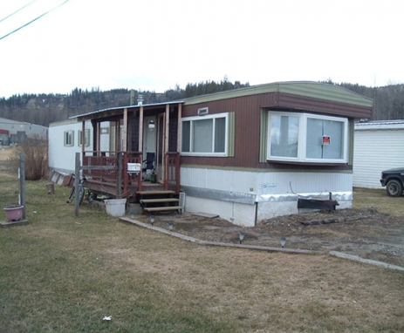
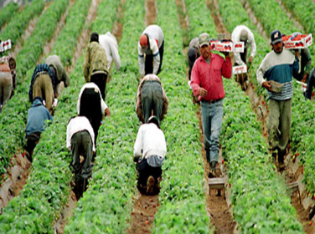
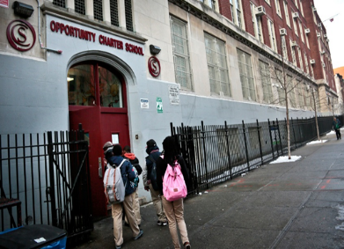
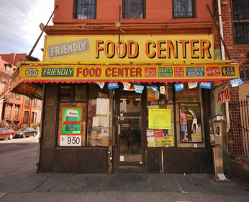
Pedagogical Failures (Rivkin-Fish 2011)
Realities of poverty & challenges faced by low-income families
Relationship of oral health disparities to social determinants of health
Pragmatic tactics for providing care to underserved populations
Lack of focus on social justice and health equity
Notes:
What was clear to her, and became clear to me were signs of pedagogical failure in preparing students to go out into the community and provide care to
low income families..
UNC was doing a great job in technically preparing students to provide quality dental care. What we had not been doing though was preparing students to understand:
Realities of poverty
Causes of oral health disparities
Pragmatic tactics for providing care to underserved populations
Lack of focus on social justice and health equity
Accepting a commodified health care system

Slide 7
Bridges the gap between misconceptions to understanding
Interactive immersion experience
Sensitized students to the realities of poverty
http://www.povertysimulation.net/
Notes:
Aan experiential learning modality to increase student understanding of poverty has been used with undergraduate students and with graduate students in social work, nursing and public health. All have utilized the Missouri Community Action Poverty Simulation (CAPS).

Slide 8
Experiencing Poverty
Students assume the roles different families facing poverty
Family task during simulation: provide for basic necessities and shelter for one month
Simulated community is a large room
Chairs are homes in the center
Services (banks, schools, grocery stores) line the perimeter
9
Notes:
Students are randomly assigned a role to play as a member of a low-income family. Students received a packet which described the family, its individual members, the family’s sources of income, the monthly bills that needed to be paid and various other items the family would need to survive. These family groups varied and ranged from single parents trying to care for their children, the newly unemployed, homeless individuals and families, senior citizens living on Social Security, grandparents raising their grandchildren along with other scenarios.
At the various tables around the room are volunteers acting as the community resources that could provide assistance to the families. These resources included a bank, a Community Action Agency, an employer, the utility company, a pawn broker, a grocery, a social service agency, a faith-based agency, a payday and title loan facility, a mortgage company, a school, a community health center, and a child care center and a jail. Families interacted with these various resources during each work week minutes. Often there were long lines, bureaucratic hurdles, or limitations to the quality and types of services available to the families through the various community resources.
The task of each family is to provide food, shelter and other basic necessities for four 15 -minute weeks, representing one month in life of the family.

Slide 10
Evaluation and Impact
Retrospective pre-test/post test: before vs. after simulation
No understanding
Little understanding
Moderate understanding
Quite a bit of understanding
Almost complete understanding
Notes:
Immediately following the debriefing session, a confidential retrospective pre-test and post-test questionnaire was administered. In 2015, 2016 and 2017, students assessed their level of understanding before and then after the simulation (no understanding, little understanding, moderate understanding, quite a bit of understanding, complete understanding) specific to each of the following five domains: (a) the financial pressures experienced by low-income families when attempting to meet basic needs (b) the difficult choices people with low resources must make each month when stretching limited income (c) the difficulties in improving one’s situation and becoming more self-sufficient on a limited income (d) the emotional stressors and frustrations created by having limited resources and (e) the positive and negative impact of obtaining community resources for people with limited resources.

Slide 11
Evaluation and Impact
On a scale from 1 to 10 how would you rate the value of this simulation exercise in preparing you to understand the challenges faced by patients who have limited incomes/resources that you will be seeing during you’re DISC rotation?
In your opinion what do you think was the best part of the activity?
Please list any suggestions you have to improve this activity
No value |  |  |  |  |  |  |  |  | Extremely valuable
1 | 2 | 3 | 4 | 5 | 6 | 7 | 8 | 9 | 10
Notes:
We also asked students to score the value of the simulation, as well as asking them open ended questions.

Slide 12
Percent Change in Understanding by Domain and Year
2015
2016
2017
NO CHANGE INCREASE

Slide 13
Value of Simulation
(scale of 1= no value; 10 = extremely valuable )
2%
28%
70%
2016
2017
8 – 10 very valuable 6 – 7 somewhat valuable 4 – 5 not very valuable 1 – 3 not valuable
Notes:
Its become quite clear that the reframing as well as the experience of leading a simulation made a difference over time

Slide 14
How much effect, if any, did the Poverty Simulation have on your ability to be MORE EMPATHETIC toward the low-income patients you served during your DISC rotations?
2016
2017
62%
65%
Notes:
This is what we were really looking for, did the simulation make a difference. For well over half of the class it appears to have had a difference on the degree of empathy students showed toward the patients they saw during their extramural rotations.

Slide 15
How much effect, if any, did the Poverty Simulation have on your ability to be LESS JUDGMENTAL toward the low-income patients you served during your DISC rotations?
2016
2017
58%
70%
Notes:
The simulation appears to have helped students be more self-aware and less judgmental toward the patients they treated during the summer. It would appear that the impact of the simulation is indeed sticky.

Slide 16
Resources
Missouri Community Action Network http://www.communityaction.org/povertysimulations/
Community Action Poverty Simulation http://www.povertysimulation.net/
SPENT http://playspent.org/
Spent is an online game about surviving poverty and homelessness.
Lampiris LN, White A, Sams LD, White T, Weintraub JA. Enhancing Dental Students' Understanding of Poverty Through Simulation. J Dent Educ. 2017 Sep;81(9):1053-1061
Yang K, Woomer GR, Agbemenu K, Williams L Relate better and judge less: poverty simulation promoting culturally competent care in community health nursing. Nurse Educ Pract. 2014 Nov;14(6):680-5
Vandsburger E, Duncan-Daston R, Kerson E, Dillon T. The Effect of poverty Simulation, an Experiential Learning Modality on Students’ Understanding of Life in Poverty. J Teaching in Social Work 2010 30:300-316
Nickols SY, Nielsen RB. “So many People are struggling”: Developing Social Empathy Through a Poverty Simulation. J Poverty 2011 15:22-42.
Strasser S, Smith MO, Denney DP, Jackson MC, Buckmaster P. A Poverty Simulation to Inform Public Health Practice. American Journal of Health Education 2013 44(5):259-264

Slide 17
THANK YOU!
Lewis_Lampiris@unc.edu

