Slide 1
Contract grading, from our correspondent in the field…
Anna Agbe-Davies (ANTH)

Slide 2
Who could contract grading be for?
Students
ANTH 392 = advanced undergraduates
Faculty
I like working on process, development
I hate reducing student work to a single number or letter
The “real world”
Products are evaluated…
…however, there’s often more than one way into the woods.

Slide 3
Professional Development and Career Exploration ANTH 392 Fall 2022 W 4:40-7:10pm Prof. Agbe-Davies
Do people ask you “What are you going to do with that?” when they find out what you’re studying in college? This class is designed to help you develop a vision for your future that draws on your training.
Contrary to popular belief, a degree in anthropology or archaeology is a great preparation for life after college. In this course, we’ll explore your options and develop additional tools to make the most of your degree.

Slide 4
What is contract grading?
“a form of grading which results from cooperation between an instructor and their student(s), and entails completion of a contracted number of assignments of specified* quality that correspond to specific letter grades.”
Often
1 “there are no finite amount of, say, "A" grades given in the class. Any student who completes the work that corresponds to a "B" grade will receive a "B".
2 “instructors and students know exactly what is expected from them to receive a certain letter grade.”
--Wikipedia “Contract grading” 28 Feb 2023

Slide 5
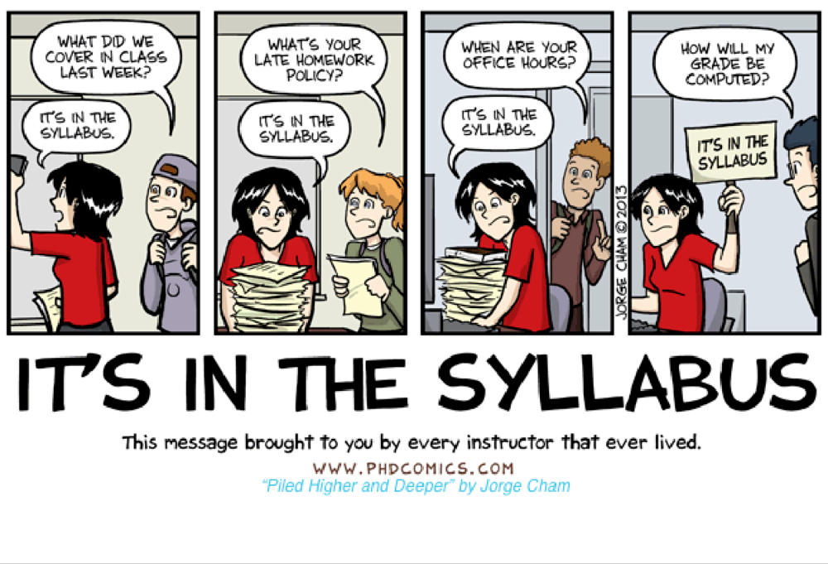
Where might one apply contract grading?
In a rubric for an individual assignment
ANTH 101 projects
“An A project contains 1, 2, 3. A B project contains 1 and 2…”
In a syllabus for an entire course
ANTH 392
“A student submitting # assignments with # attendance will receive an A…”

Slide 6
When is contract grading helpful?
For giving critical feedback (without the threat of a “bad grade”)
To encourage experimentation and creativity
When there is no single correct answer or ideal product
To draw attention to an important process (such as revision)
For allocating instructor time to the places where it matters

Slide 7
How could one implement contract grading?
Be clear on what you want students to take with them from the assignment or class
Be clear about what criteria really matter to you
Prepare for a looooooooong discussion with your students!

Slide 8
Why (on earth) would one try contract grading?
Some say it is more authentic¹
Some say it is more equitable²
For me, it restores joy
1 https://ii.library.jhu.edu/2018/04/11/what-is-specifications-grading-and-why-should-you-consider-using-it/
2 https://jeffreyaustin.org/2020/04/17/labor-based-grading/

