Slide 1
It’s a Process: Writing Program Responses to ChatGPT
Daniel Anderson
March 23rd 2023

Slide 2
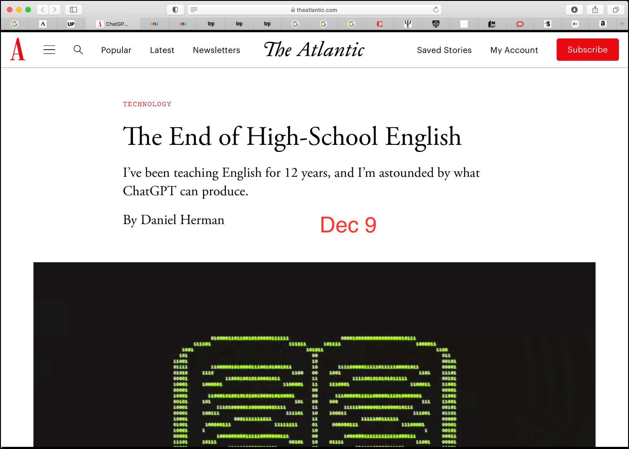
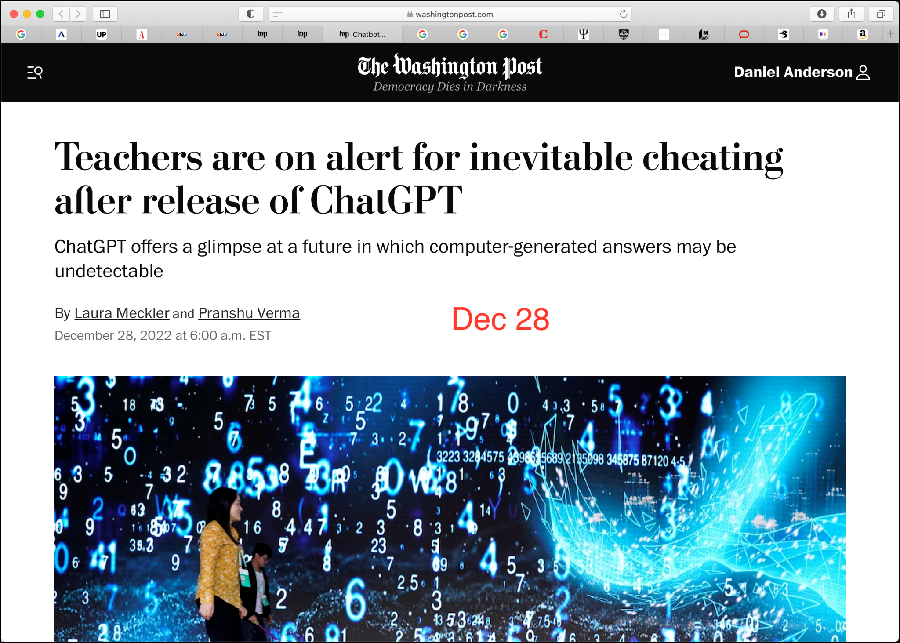
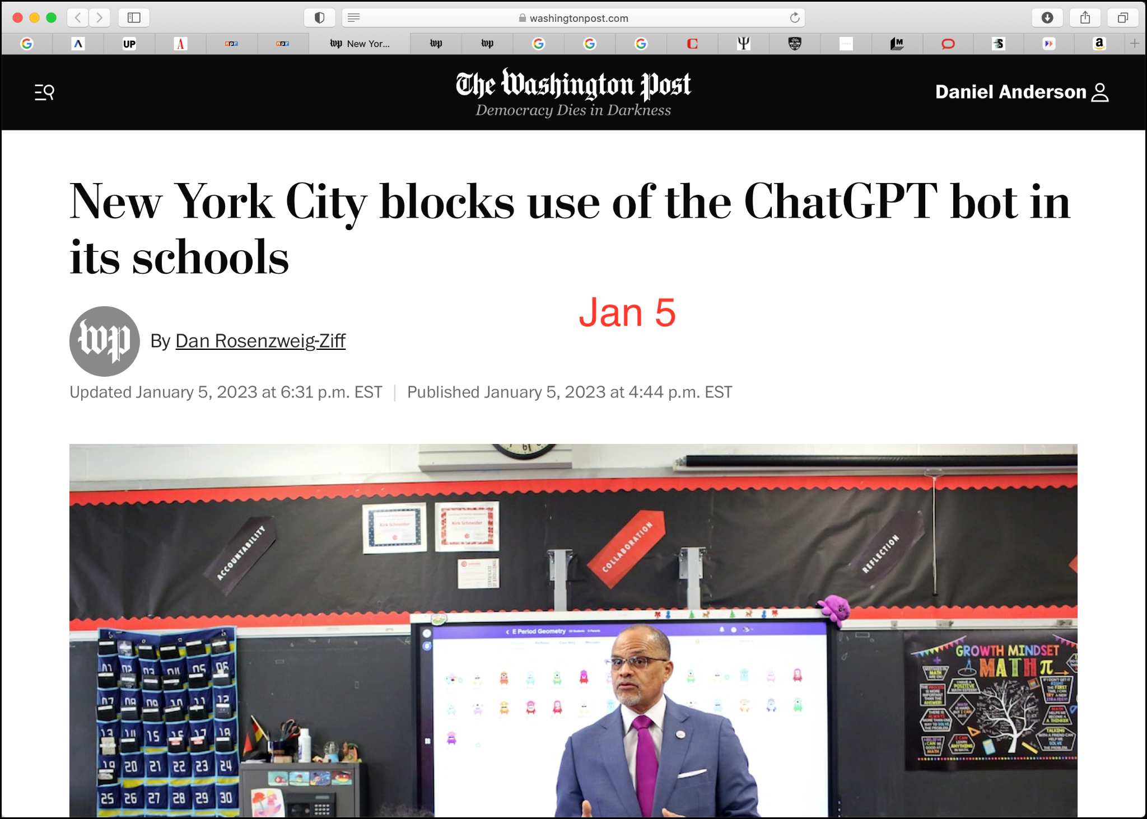
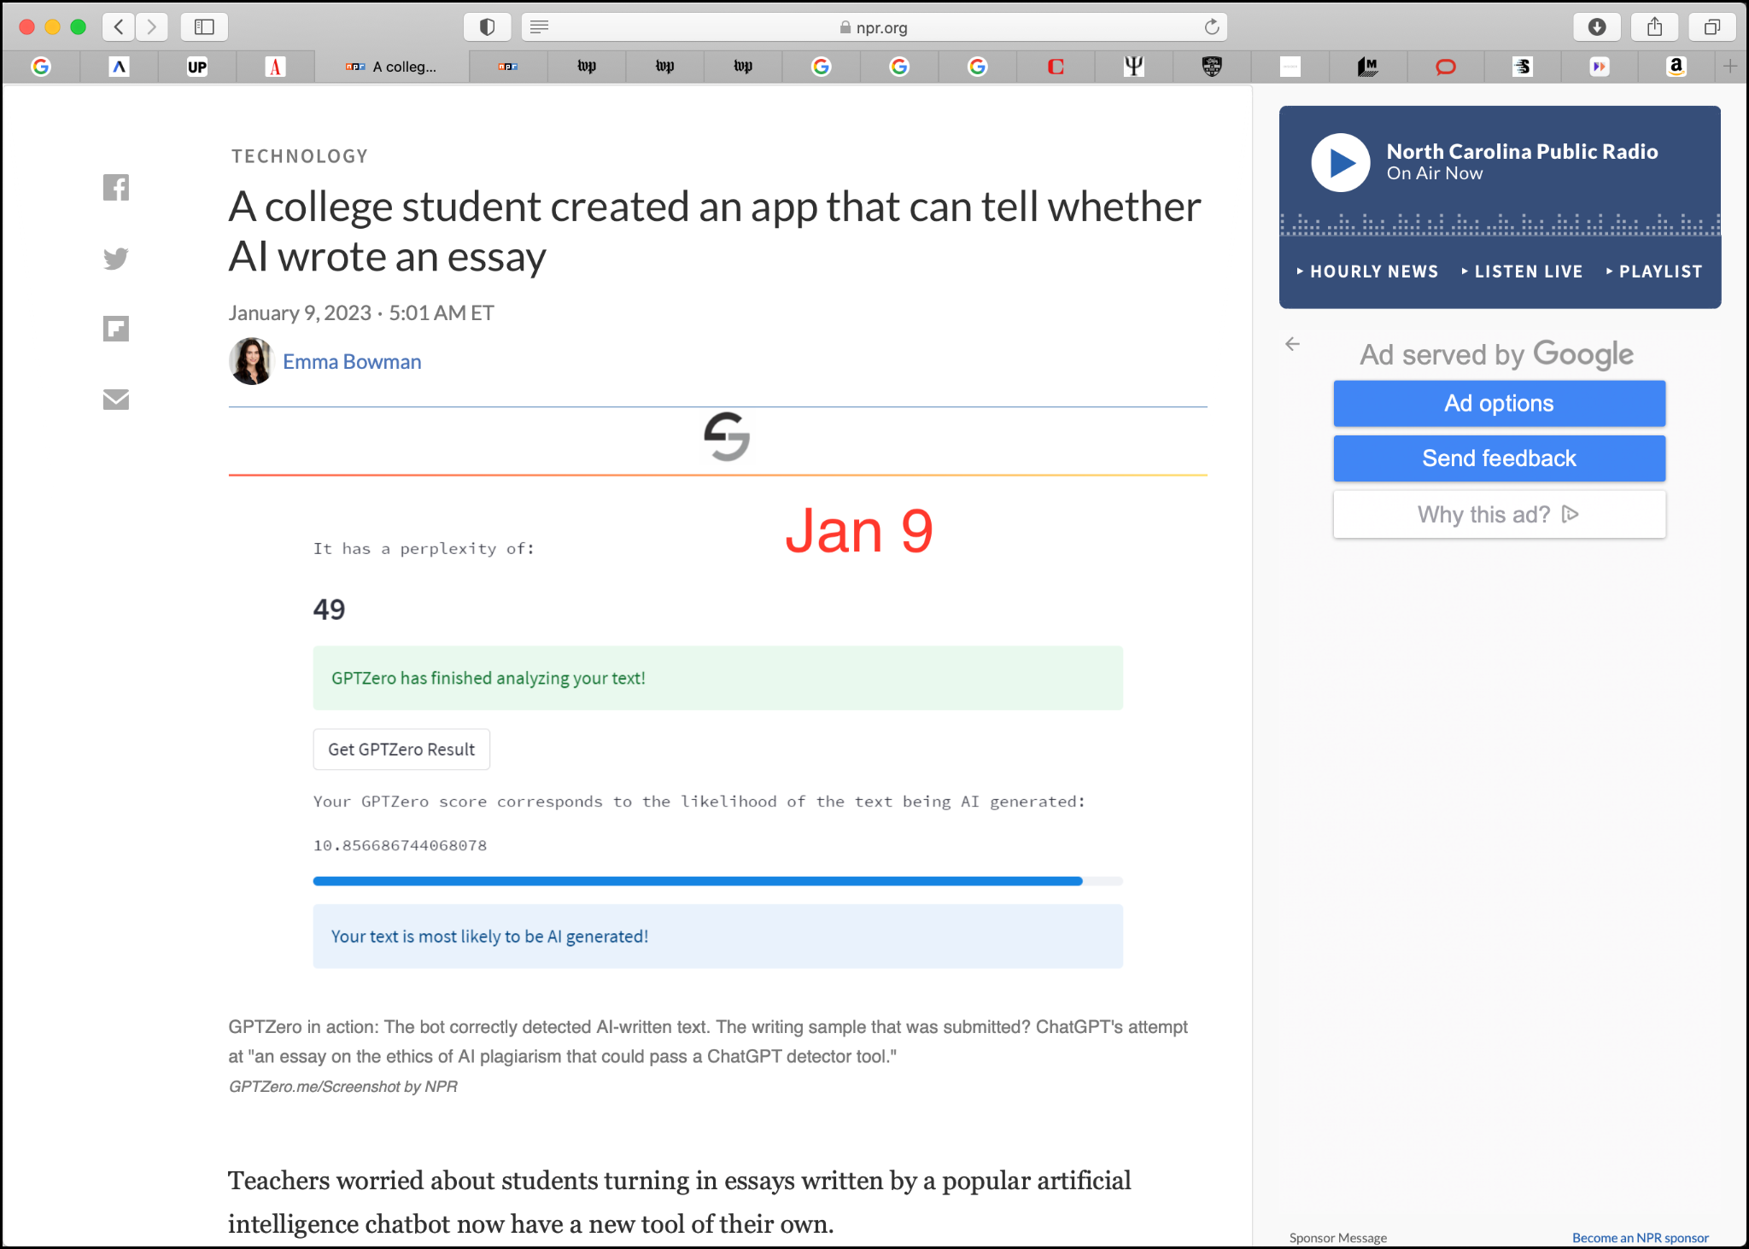
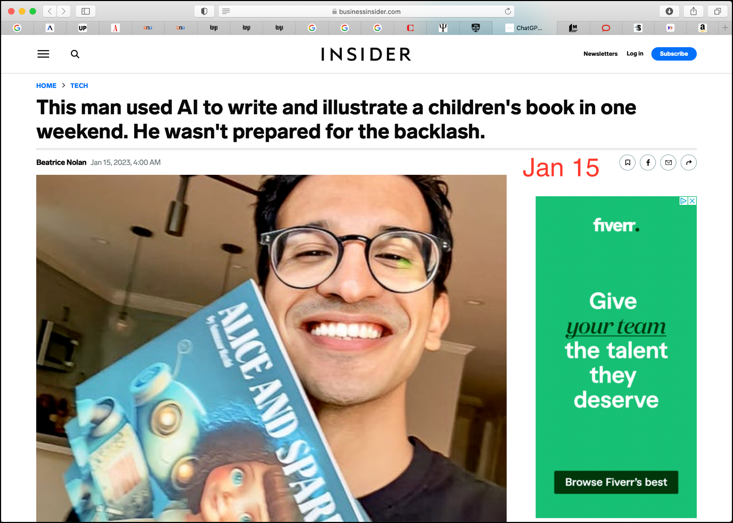
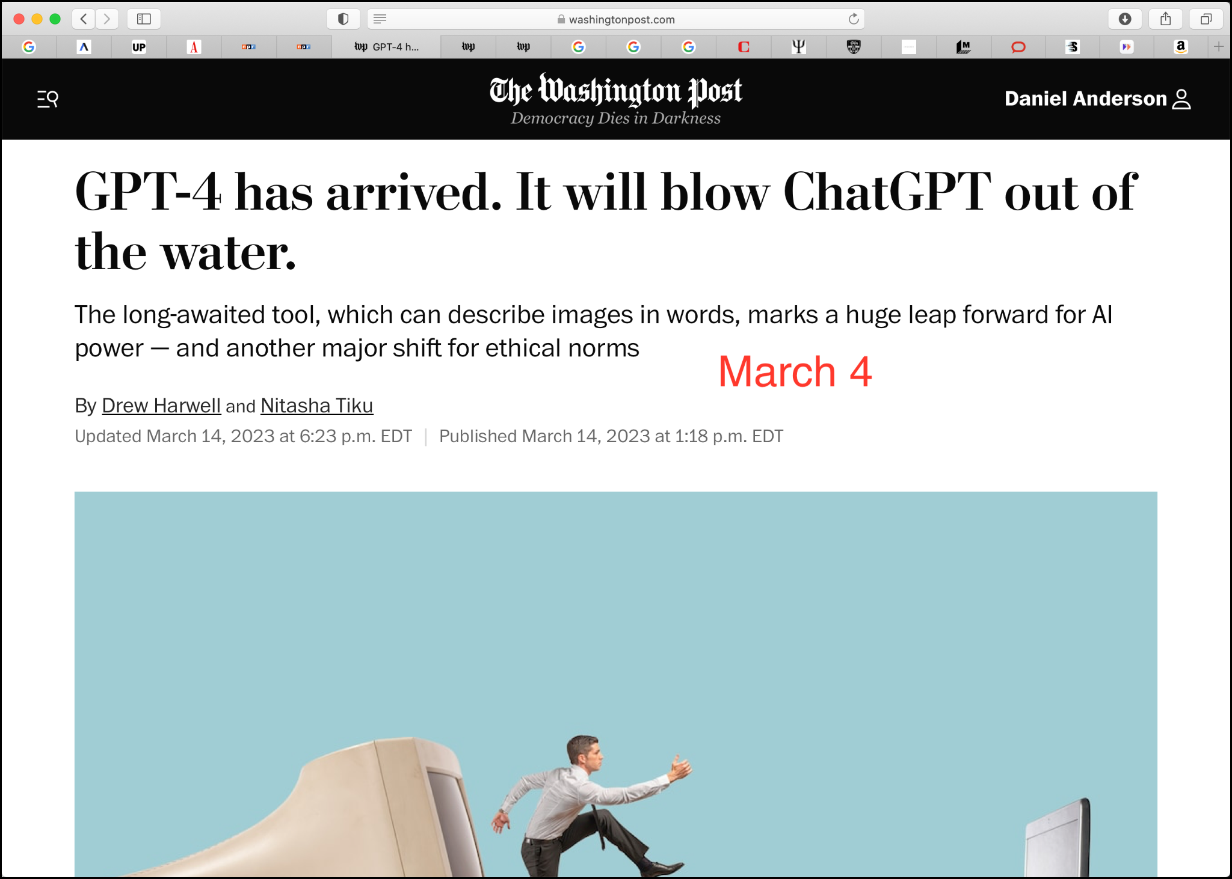
Big Picture Responses

Slide 3
Historical Tracings
Well, they’ve finally demonstrated something that I’ve known all along: that computers and word processors are instruments of the devil and should be exorcised at the first opportunity--along with TV game shows, Rambo movies and the Costa Mesa City Council--if our society is to survive. Now if Lou Sheldon and Rep. Dana Rohrabacher would get behind this one, I’d be out doing fund-raisers for them.
What happened was that a University of Delaware English professor ran a test. She had her writing students compose on both computers and typewriters, then she compared the results. The typewritten essays averaged six words longer per sentence (22 to 16) than those written on computers, and only one-third of the computer writers used complex sentences as contrasted with half of those using typewriters.
Soc. I cannot help feeling, Phaedrus, that writing is unfortunately like painting; for the creations of the painter have the attitude of life, and yet if you ask them a question they preserve a solemn silence. And the same may be said of speeches. You would imagine that they had intelligence, but if you want to know anything and put a question to one of them, the speaker always gives one unvarying answer. And when they have been once written down they are tumbled about anywhere among those who may or may not understand them, and know not to whom they should reply, to whom not: and, if they are maltreated or abused, they have no parent to protect them; and they cannot protect or defend themselves.

Slide 4
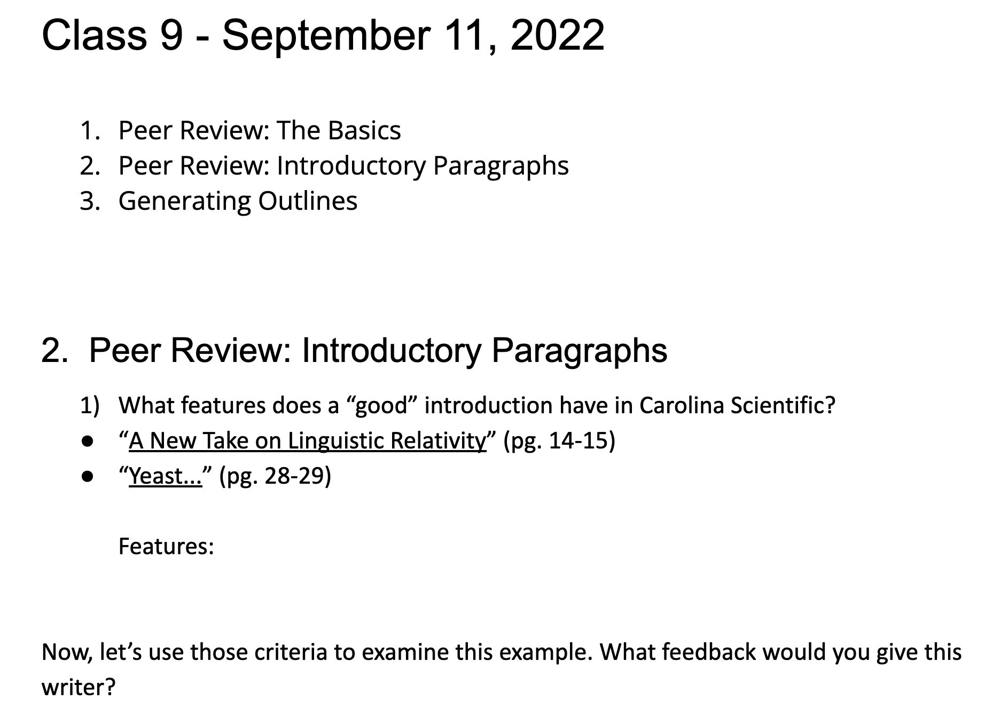
Writing Program Responses
Postplagiarism Mindset
Primary Research
Emergent Content
Performance-Focused
Machine-Assisted
Adjust Assignments
Foreground Process
Foreground Peer Work

Slide 5
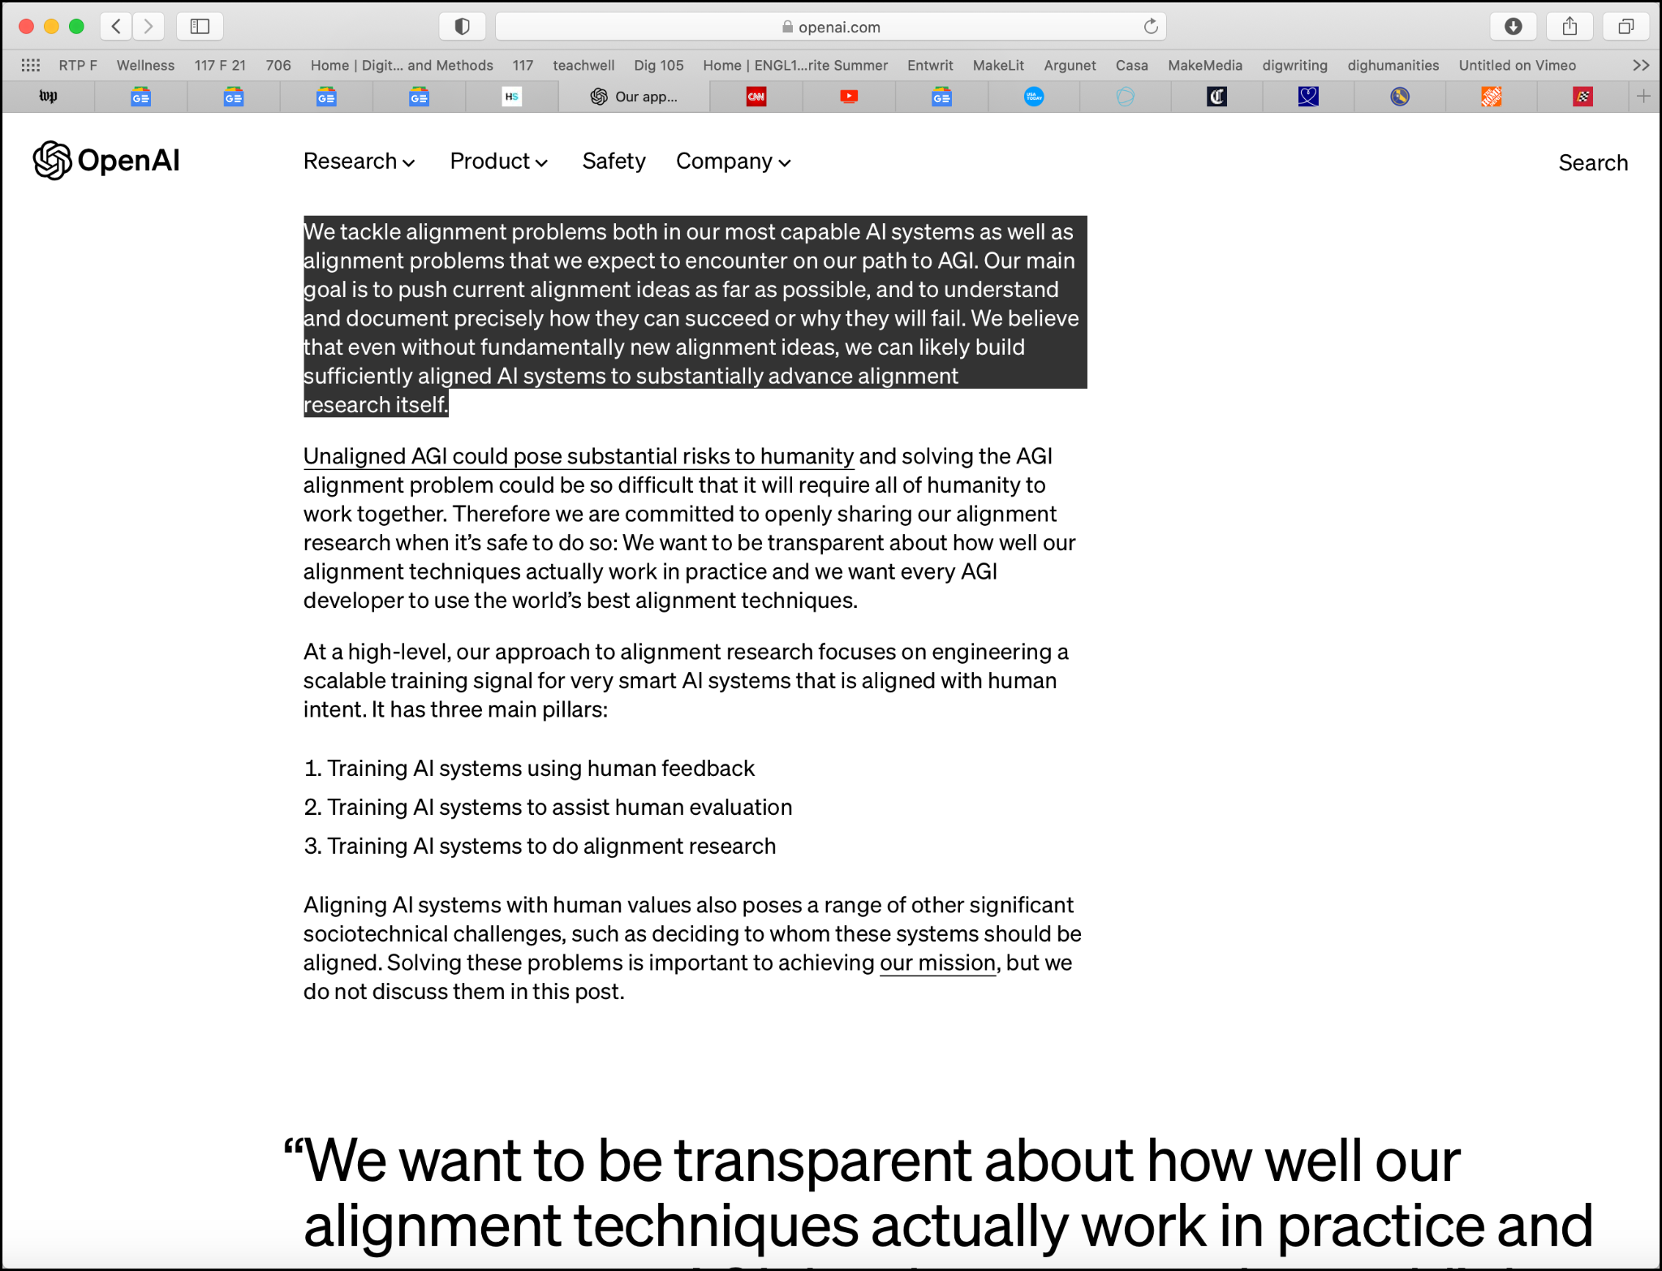
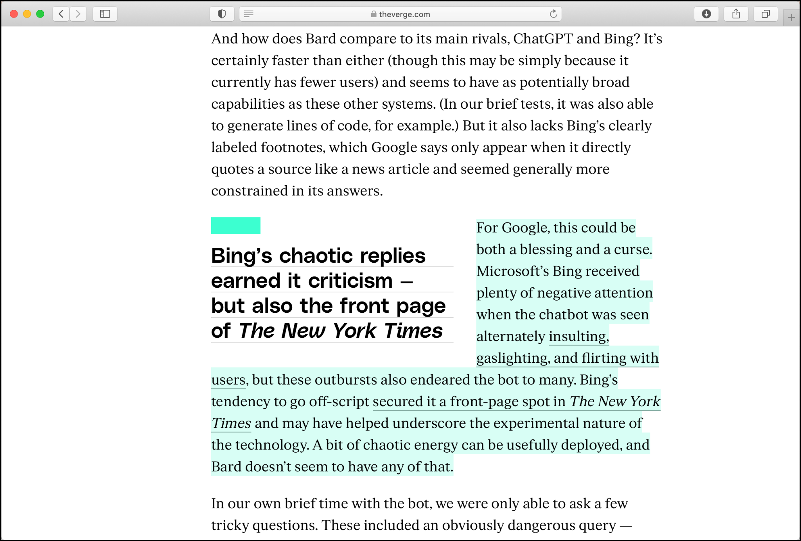
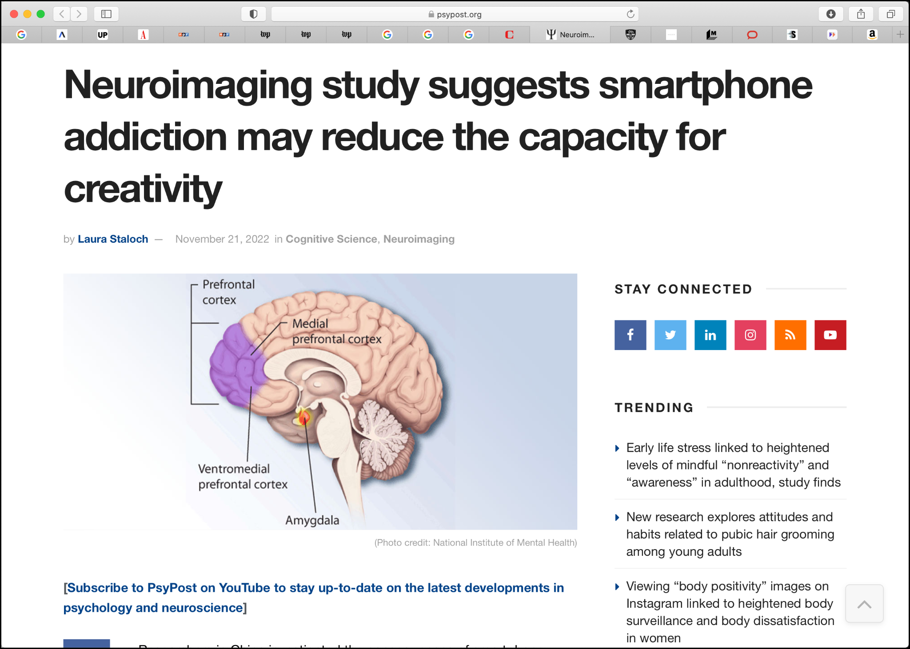
Critical Digital Literacy

Slide 6
Thank You
Daniel Anderson
iamdan@unc.edu
iamdan.org

