Slide 1
Peer to Peer: Supporting Student Learning with Undergraduate Learning Assistants (ULAs)
Carribeth Bliem, Chemistry
Center for Faculty Excellence Faculty Showcase
March 2023

Slide 2
Utilizing ULAs in a Chemistry Large-Enrollment Course
Surveyed students in two sections of Organic Chemistry I, CHEM 261
Fall 2022
Both sections taught by same instructor in different rooms:
Carroll 111, an active-learning space (n=205)
Murray G202, a traditional lecture hall (n=227)
Nine ULAs in each section
Response rate >80%

Slide 3
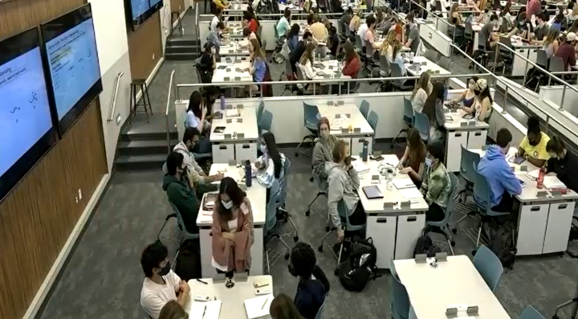
Students report that classroom design makes a difference
Carroll 111 (n=160) 4.37 | Based on where I usually sit during class, it is easy for ULAs to access my area and work with me. (5 = very easy) *Statistically significant difference based on independent t-test, p < 0.05 | Murray G202 (n=186) 3.82

Slide 4
Student experiences in Carroll 111 vs Murray G202
Thinking about your experience during this course, how much do you agree or disagree with the following statements: (5 = strongly agree) | Carroll 111 | Murray G202
The ULAs were available to answer questions during group activities. | 4.56 | 4.38
After talking with a ULA, I sometimes explain what I learned to the rest of my group. | 3.98 | 3.75

Slide 5
Student quotes about Carroll 111
I am so much more engaged in Carroll. I normally get distracted in class and lose focus but in [Carroll 111] the students at my table help keep me present and the ULAs walking around keep me engaged with the problems too.
I love this classroom so much. I am more likely to talk to ULAs and feel more comfortable being academically vulnerable with the people at my table.
The lecture-hall style classroom [Chapman with stadium seating] just was not practical for learning the material. […] it is near-impossible to get help from a ULA unless you sit on the end.

Slide 6
ULAs: More students get more assistance in active learning space
Carroll 111 (n=9) 100% | Percentage of ULAs who indicated that they could easily access all of the students in their section | Murray G202 (n=8) 0%

Slide 7
ULAs: Classroom design impacts their efforts
Percentage of ULAs who found it easy or very easy during class to: | Carroll 111 (n=9) | Murray G202 (n=8)
… see students’ work | 100% | 37%
… explain concepts to groups of students | 100 | 62
… hear student conversations | 90 | 37
… engage with students without getting in the way of others’ ability to see the screen or instructor | 100 | 0

Slide 8
ULAs: Initiating conversations is easier in a classroom designed for discussion
Percentage of ULAs who reported that they often initiated interactions by: | Carroll 111 (n=9) | Murray G202 (n=8)
… listening to student conversations | 78% | 25%
… looking at students’ written answers | 66 | 25
… verbally asking students if they need help. | 88 | 62

Slide 9
ULA comments about Carroll 111

Slide 10
Ready to create a ULA program to support your students’ learning?

Slide 11
Starting a ULA Program: Questions to consider
What course(s) would benefit from ULA participation?
How to solicit students?
How to train ULAs?
How to reduce administrative workload: Is there a program in another department with which to partner?
How to award course credit to ULAs?

Slide 12
Chemistry & Biology Programs: EDUC 150
Replaced Departmental Training courses for ULAs in Biology and Chemistry
Taught by Graduate TA in School of Education
One credit hour
Required for all Chemistry ULAs in their first semester

Slide 13
EDUC 150 Course Format
Meets once per week for 50 minutes
10 – 15 minute small group and whole class reflection on in-class ULA experience
35 – 40 minute discussion of readings and topics for the week
Weekly Assignments
1 hour of reading
250 – 350 word written reflection
Larger Assignments
ULA Goals for mentoring experience (first few weeks)
Study Guide & Plan for threshold concept (mid-late semester)
Final Essay (in place of final exam)

Slide 14
EDUC 150 Course Topics
Roles & Impact of ULAs in the classroom
Self-Efficacy & Growth Mindset
Class Climate & Inclusive Teaching
Note-Taking
Memory & Information Processing
Learning Strategies
Metacognition
Time Management
Goal Setting
Learning Myths & Positive Psychology
Assessment

Slide 15
Building community among ULAs
Faculty action
Create slack channel or other group text
Host informal meet-ups
Course/Department action
Host end-of-semester gathering

Slide 16
Acknowledgements
Anna Curtis and Danielle Zurcher, Chemistry
Viji Sathy, Director, Townsend Program for Education Research.
Bob Henshaw, UNC Center for Faculty Excellence

Slide 17
Questions for Michelle, Christine or Carribeth?

