Slide 1
Engaging Undergraduates in Disciplinary-Based Education Research to Build Scientific Competencies Laura E. Ott, Ph.D. Department of Biology

Slide 2
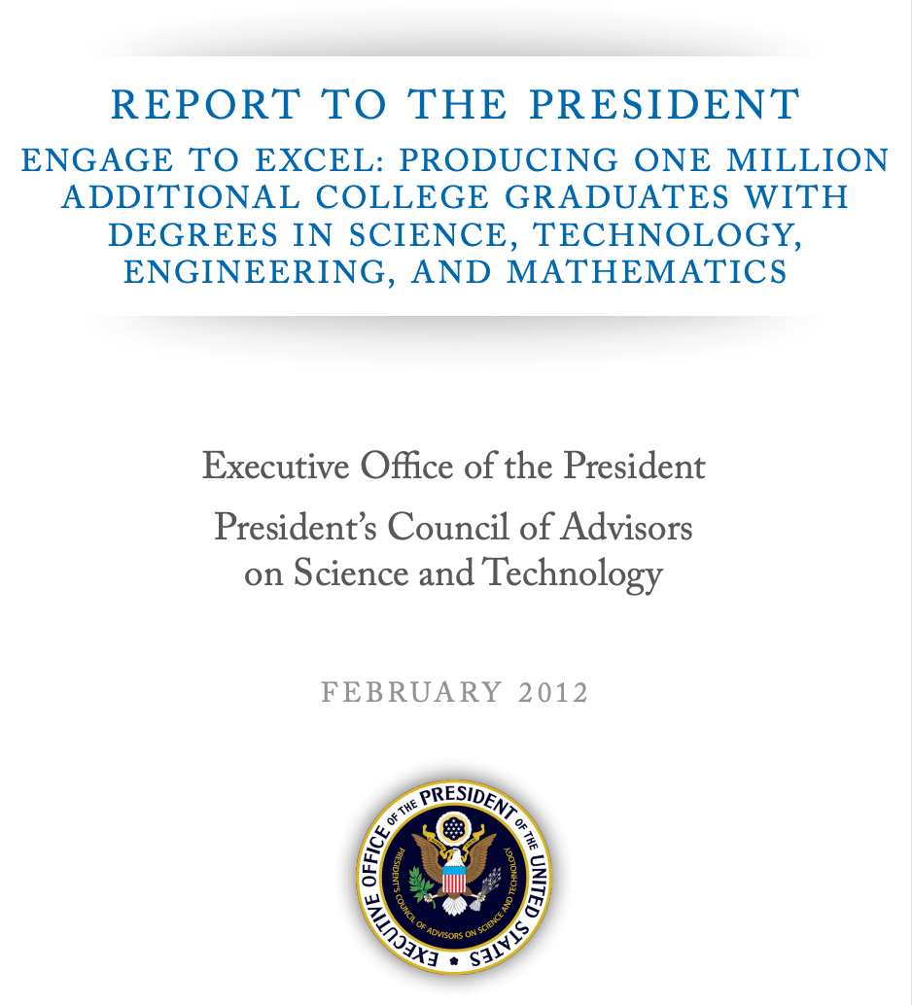
One of the five major recommendations that came out of the PCAST report as ways to improve STEM education is to engage students in authentic inquiry experiences
Notes:
The President’s Council of Advisors on Science and Technology has called for a 33% increase in the number of science, technology, engineering, and mathematics (STEM) bachelor’s degrees completed per year and recommended adoption of empirically validated teaching practices as critical to achieving that goal

Slide 3
In the field of biology, there is an assumption that to build students’ research competencies, we must engage them in wet lab, bioinformatics, or field research.
The challenge, however, is that we don’t have enough labs or opportunities for our growing student populations.

Slide 4
Could students develop the same research competencies through biology education research (BER)?

Slide 5
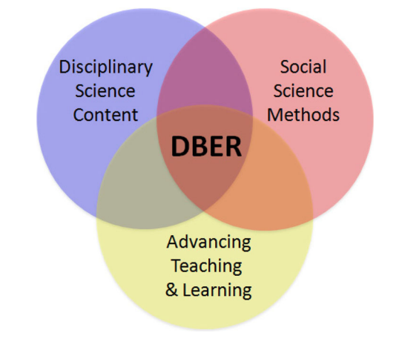
Disciplinary-Based Education Research (DBER)
Notes:
DBER is an interdisciplinary field situated at the nexus of science, social science, and education

Slide 6
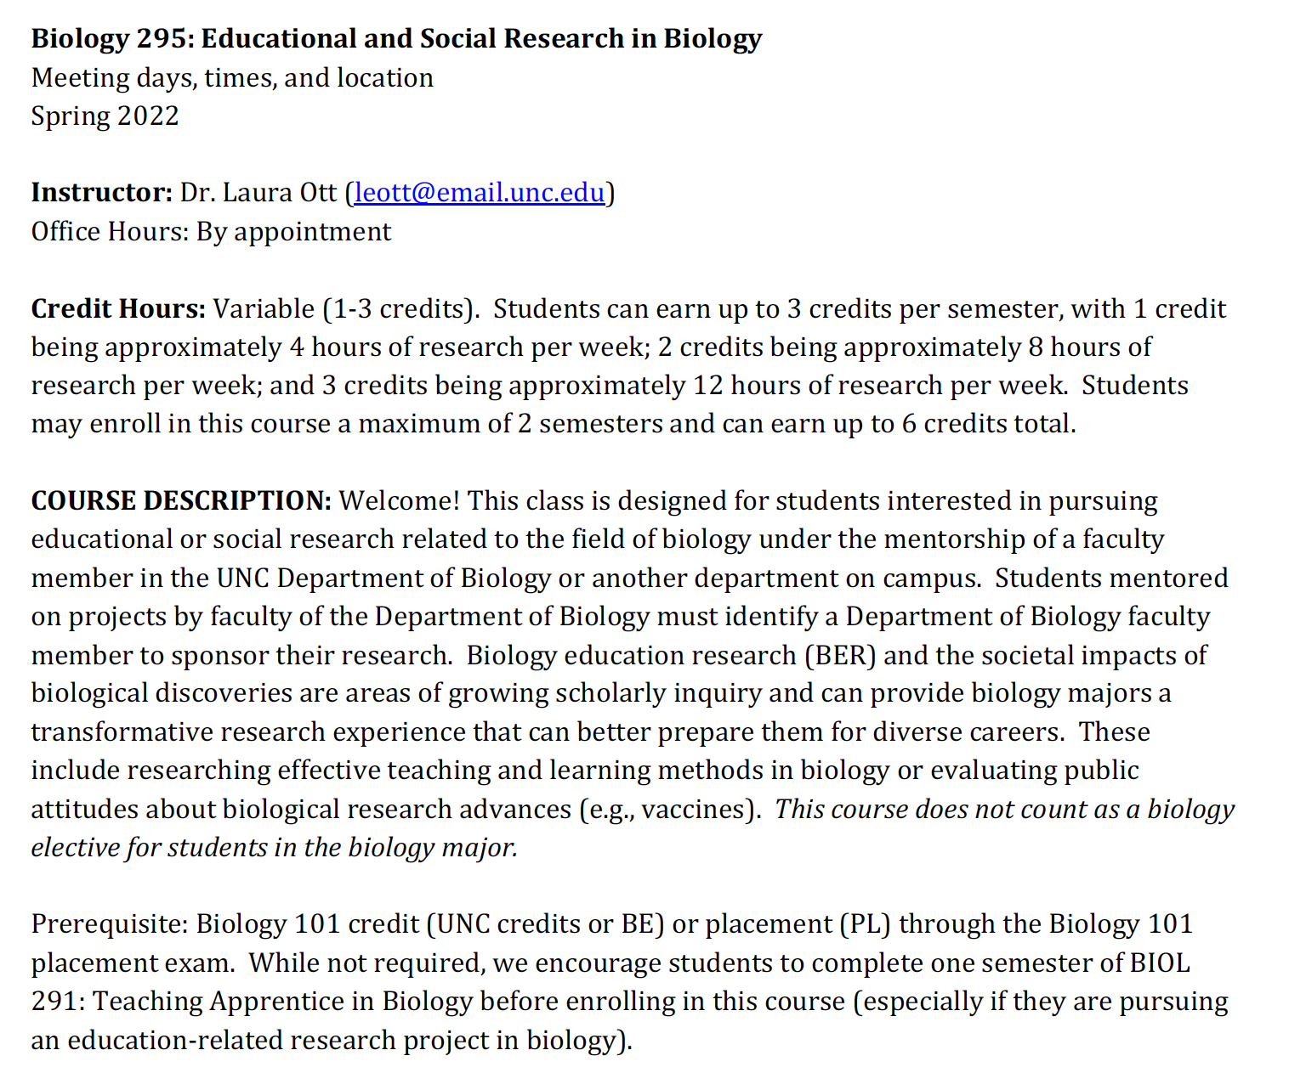

Slide 7
Example projects
Design, implementation and assessment of active learning case studies
Design, implementation, and assessment of tactile teaching tool activities with guided-inquiry
Evaluating how students prepare exam cheat sheets and if certain approaches correlate to student exam outcomes

Slide 8
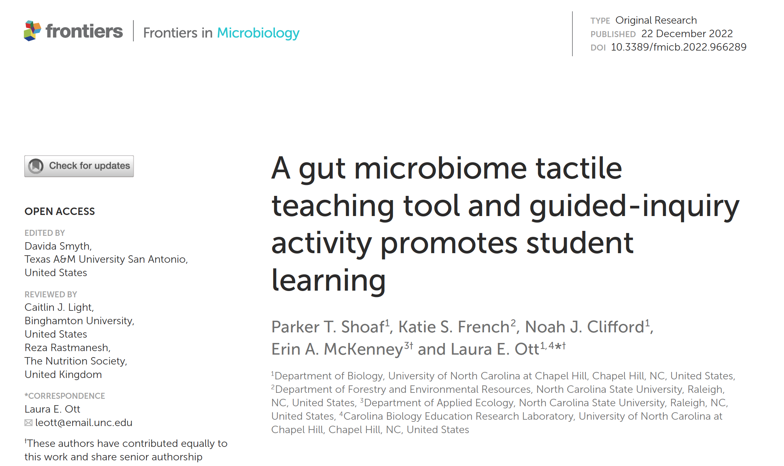

Slide 9
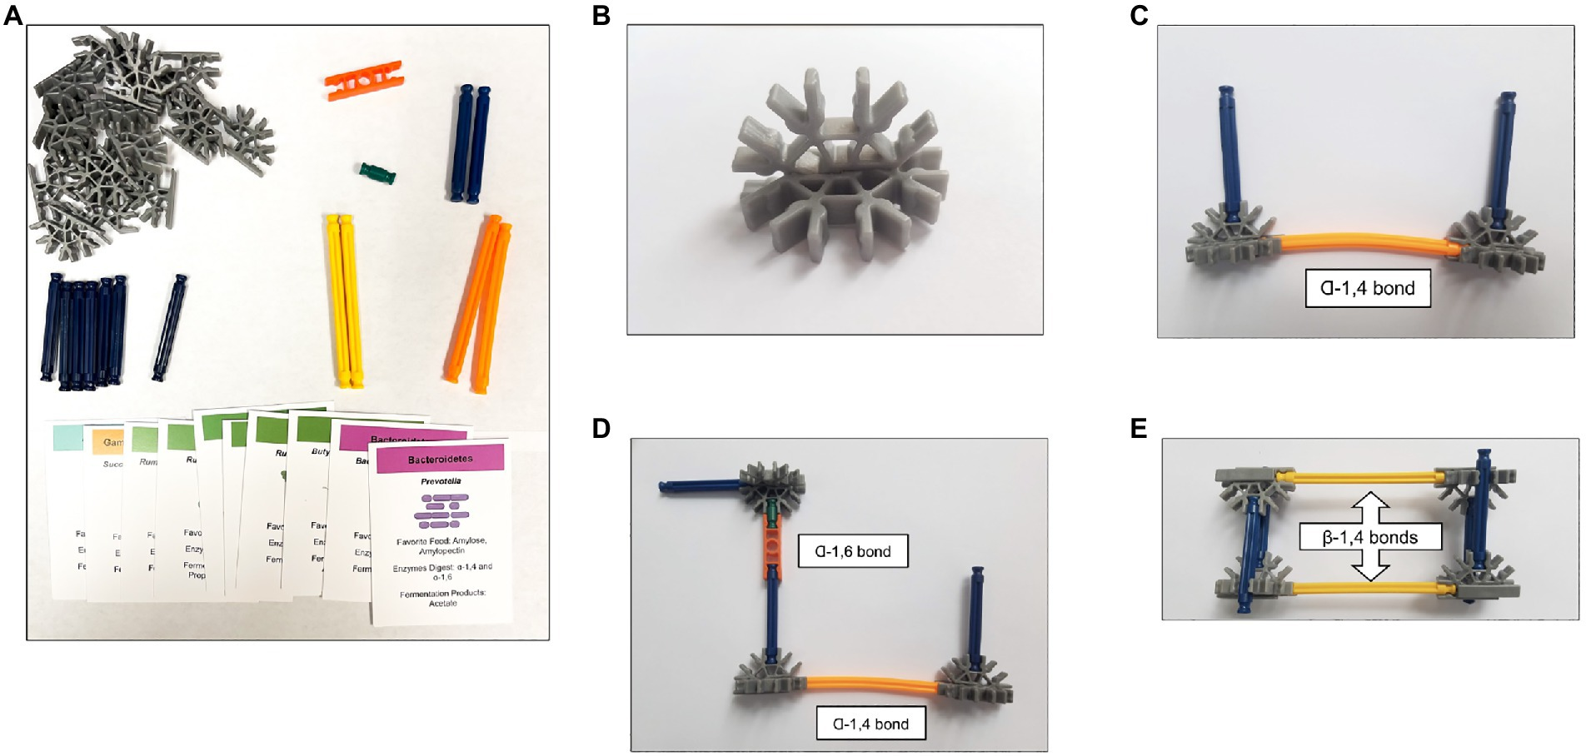
Shoaf, et al., 2023

Slide 10
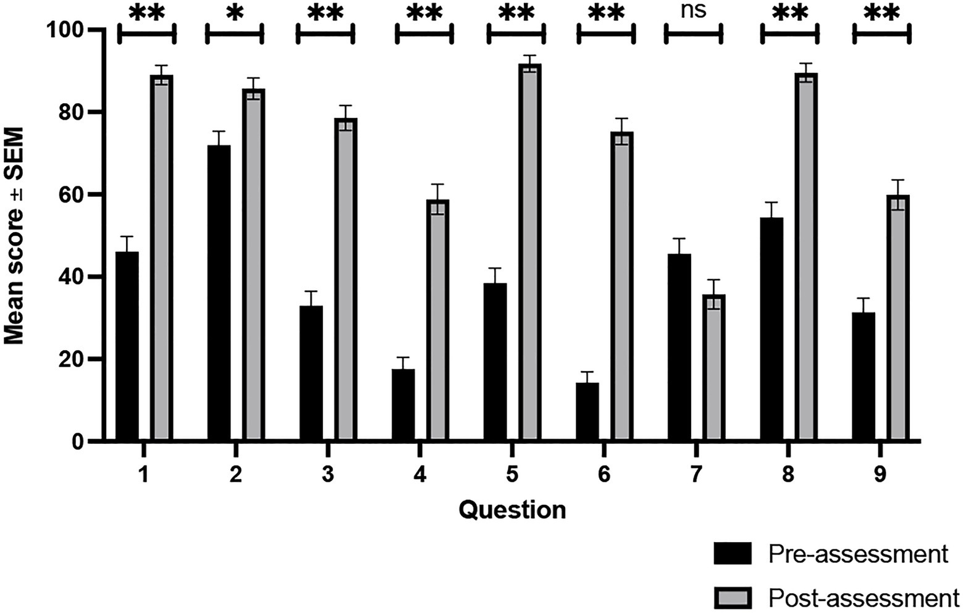
Shoaf, et al., 2023

Slide 11
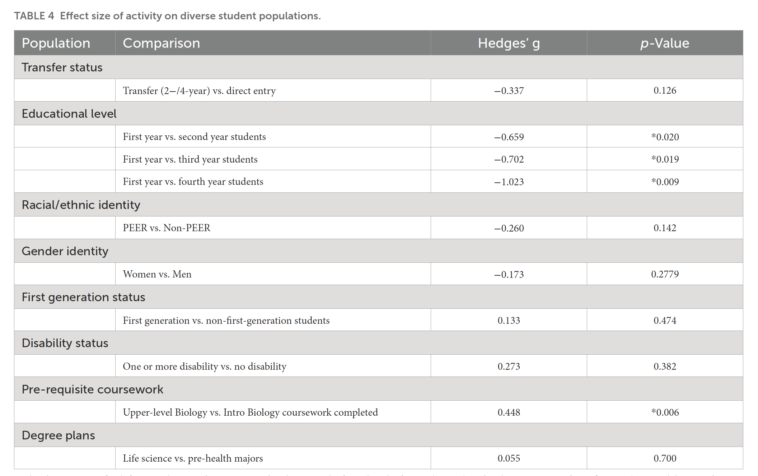
Shoaf, et al., 2023

Slide 12
“[BIOL] 295 has taught me how to not only work independently through the research process but has also given me the tools necessary to feel comfortable working as part of a larger research group.”
“I really appreciate having the opportunity to work with and analyze large datasets, the quantitative skills I am learning in [BIOL 295] feel very translatable to the wet lab.”

Slide 13
Current BIOL 295 Assessment
Do students engaged in BER develop psycho-social indicators of science identity and research self-efficacy?
Do we observe gains in these psycho-social measures similar to ”traditional” research experiences in biology?
Science Identity – 4-item measure adapted from Chemers, et al. (2011).
Research Self-Efficacy – 13-item measure adapted from Chemers, et al. (2011); Estrada, et al. (2011); Syed, et al. (2019).

Slide 14
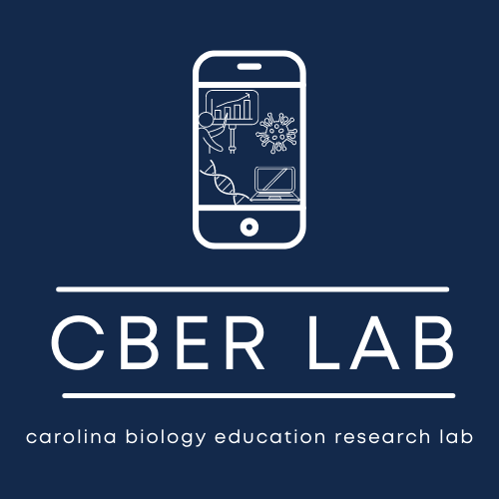
https://bio.unc.edu/cber-lab/

Slide 15
Acknowledgements
UNC Department of Biology
Dr. Eric Hastie
Dr. Mara Evans
Dr. Kelly Hogan
Dr. Jason Reed
Summer Montgomery
Noah Clifford
Lettie Hughes
Parker Shoaf
BIOL 295 students
BIOL 448 students
NC State University
Dr. Claire Gordy
Dr. Melissa Ramirez
Dr. Erin McKenney
Dr. Marta Klesath
Katie French
This work was supported by grants from the UNC Center of Faculty Excellence Lenovo Award Program and the UNC System Undergraduate Research Program awarded to the Carolina Biology Education Research Lab directed by Dr. Eric Hastie and Dr. Laura Ott.
The NCSU STEM BUILD project was supported by the National Science Foundation under RCN-UBE INCUBATOR #2018668 (Co-PIs: Gordy and Ramirez).

