Slide 1
Video-Based Teaching and Evaluation to Enhance Clinical Judgement
Maureen J. Baker, PhD, RN. Theresa Raphael-Grimm PhD, PMHCNS-BC

Slide 2
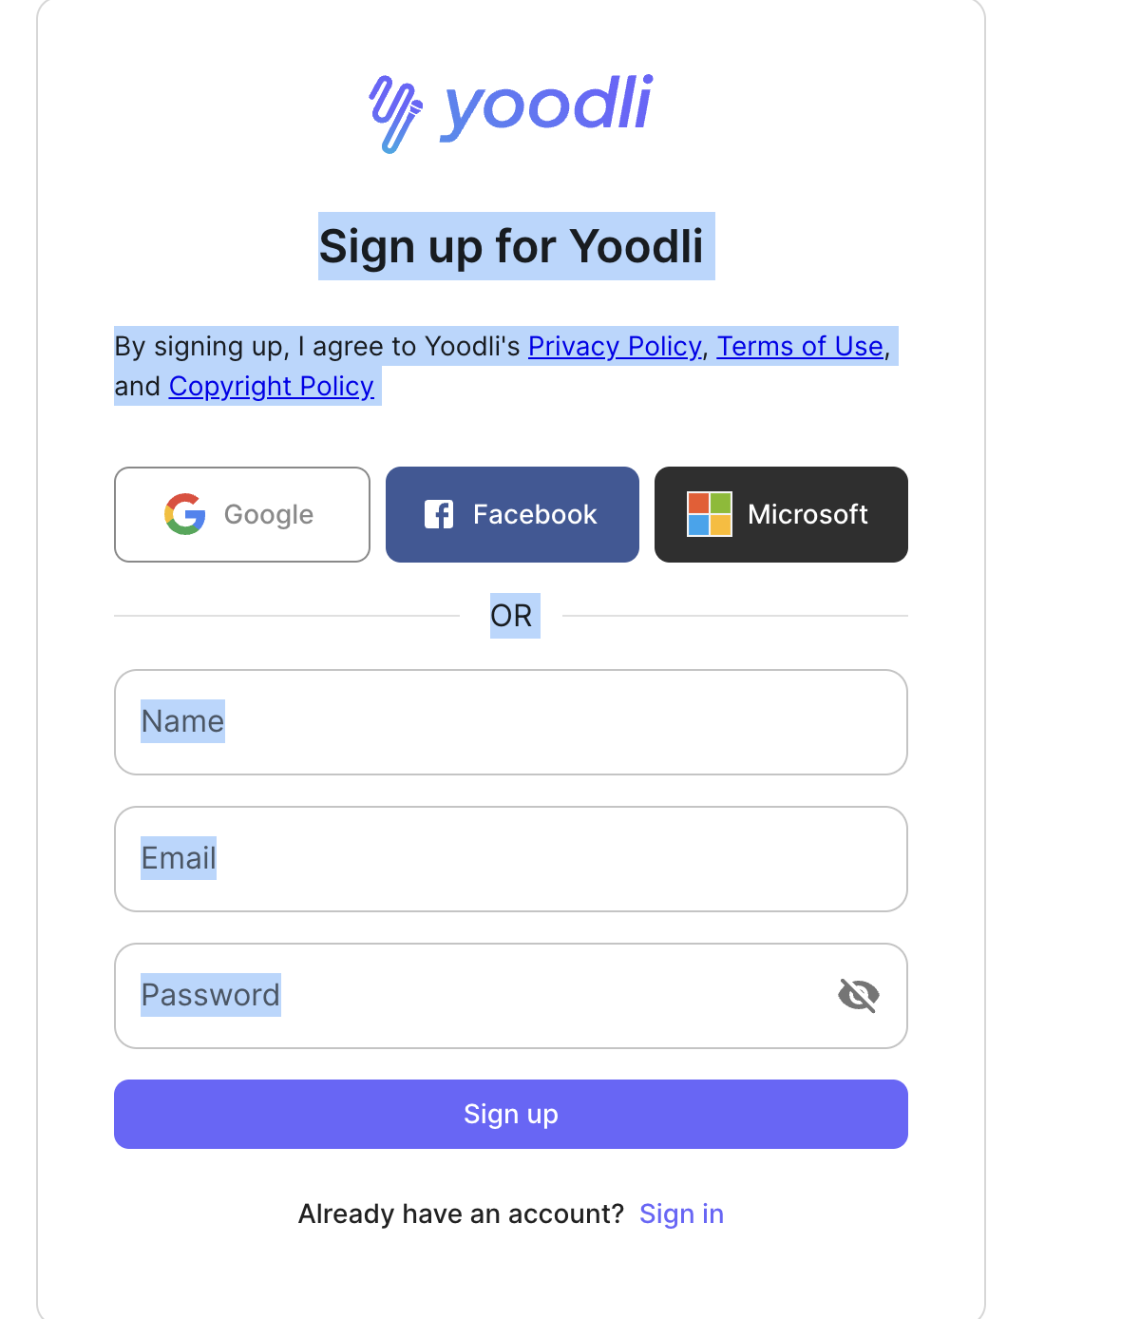
Register for FREE Yoodli account
Please register for free account at https://app.yoodli.ai

Slide 3
Course Focus:
N 301 NURS 301 Foundations of Relationship-Centered Care and Diversity and Inclusion: Carolina Core I (3 Credits)
Socialization into the profession of nursing
Tools to build interpersonally effective relationships but...
effective, supportive, interpersonal communication can be challenging for students to learn.

Slide 4
Professional shift in manner of communication: From social to professional
SOCIAL
PROFESSIONAL -

Slide 5
A formal (written) record that documents, in detail, the verbal and non-verbal interaction between student and patient.
Provides opportunity for students to perform an in-depth analysis of:
their own thoughts, behaviors, feelings and words, and
flow of communication between themselves and patients.
Interpersonal Process Recording
The IPR serves to help students identify places in the interaction where key patient cues were missed or misinterpreted, and where their own responses could be more effective (i.e.: empathic, therapeutic, etc. )

Slide 6
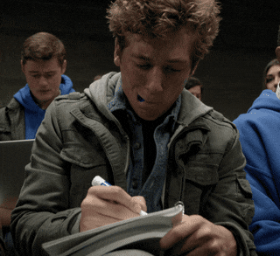
In the past

Slide 7
Written Format: Problematic
Tedious (notes)
Inaccurate (student shortcuts)
Students self-selected excerpt ("best" segment vs most important)
Students could not "see" themselves, they could only analyze their words
Audio recording fixes the accuracy but still doesn't address non-verbal aspects of interactions
Faculty feedback cumbersome and time consuming
Did not allow for peer feedback

Slide 8
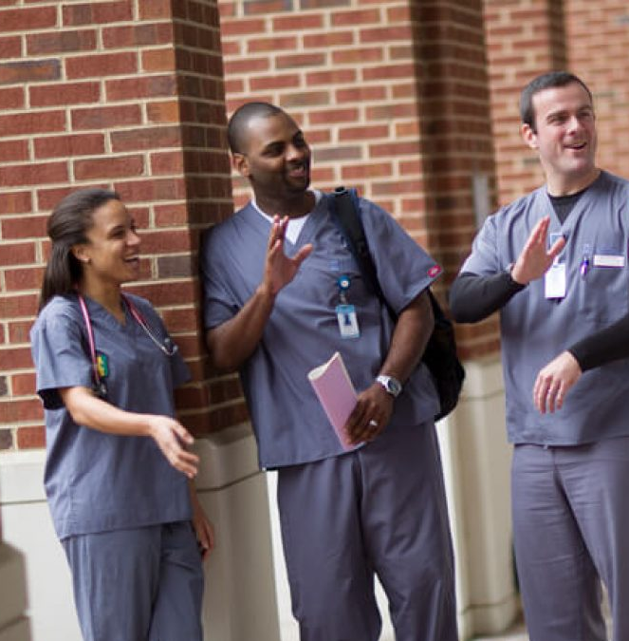
Early students needed practice before trying with patients
Peers rather than patients allowed us to
Control the nature, tone, feel of the interactions
Take HIPPA out of the equation (by not using patients)
Expand options for recording methods (videotape)
Provide a "low-stakes" learning environment
Engage students' peers in the feedback process

Slide 9
Enhancing Clinical Judgment
Nurses cannot access critical patient data if they cannot:
Create trust and rapport
Ask questions in a supportive, non-threatening manner
Express an attitude of caring and non-judgment
Use language in an effective, concise manner
Pick up on patient cues
Students need to have accurate reports of patients' subjective experiences (patient responses to questions, patient's demeanor, patient's candid accounts of symptoms) to better synthesize complete patient data while forming conclusions and planning actions

Slide 10
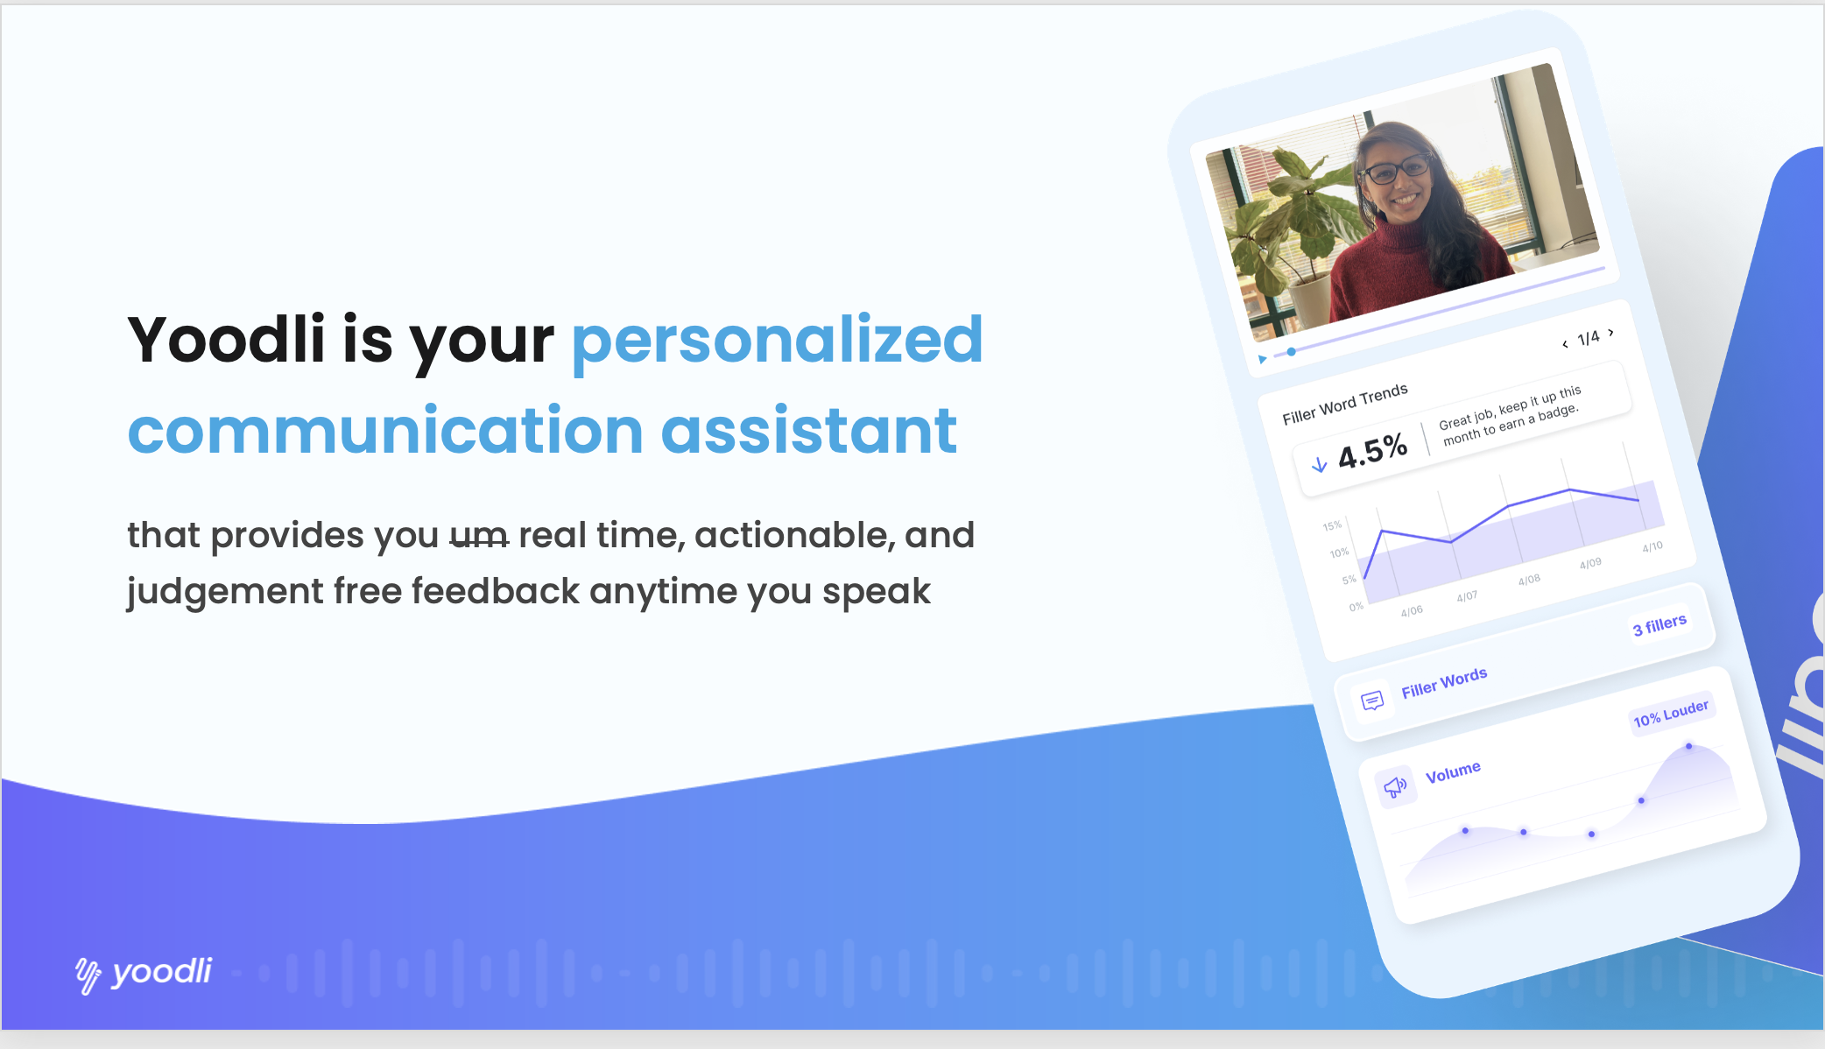
Yoodli is an artificial intelligence powered speech coaching platform.
Judgement free metrics on
filler words
pacing
eye contact
body language
N 934- 30 second speech demo
Artificial intelligence communication coach

Slide 11
What if?
Interpersonal Process Recoding
Yoodli Video capture communication skills and feedback feature
This Photo by Unknown Author is licensed under CC BY-NC-ND

Slide 12
The Demo
https://app.yoodli.ai/share/WQQqgBP3

Slide 13
Silence interest- Eye contact, leaning forward toward patient, facial expression reflect | False reassurance Don't worry, it will all work out. Everything will be alright. .
Listening Nod head "yes", say "uh huh" (Use mindfulness to redirect your attention back to the speaker) | Stereotypes I'm fine, how are you? It's all for the best. God doesn't give people more strife than they can handle
Recognition "Hello Mrs. R"; "I see that you are writing a letter". | Belittling It’s not that important. You shouldn’t feel that way.
Offering self "I would like to sit and talk with you for awhile". | Unrelated Topic Patient: I am feeling so frustrated today. Nurse: What did you learn about on the today’s TV news.
Broad Openings “Describe the events that happened that lead up to you coming into the hospital.” "What is on your mind?" "What has you so worried?" “How are you doing with coping with your illness?” | Approval I am glad you did that. That's great!
General Leads "Go on." "Then what happened?" "Describe that." | Advise You should avoid all contact with your sister. She just upsets you. You have to sign up for that pottery class.
Stating Observations "You seem worried." "I notice that you are wringing your hands."

Slide 14
Assumptions
Digital natives will love seeing themselves on video
Feedback from peer squad (4) will solidify communication strategies
Enhancement of student engagement and accountability

Slide 15
4 person “SQUAD”
Interview one another about what brought them to nursing school and how is it going thus far?
Hidden agenda- get to know one another !

Slide 16
Student Exemplar
https://app.yoodli.ai/share/Lhd8H19o
Video account of IPR
Student comments in real time/time stamps
Therapeutic communication
Non-therapeutic communication
Missed opportunities
Faculty watched videos and gave individual and squad feedback
Students had another chance to practice at end of semester with different prompts
Drew and Nichole

Slide 17
Common mistakes
“Oh, that’s Great!
“Awesome!”
“ME TOO!!”
“Yeah Definitely!”
”I am sure it will all work out”
Focusing on next question and not listening to response
Missing opportunities to explore
Talking about themselves

Slide 18
Student Reflections
"Harder than I thought it was going to be"
"Focus on the person … not the next question!"
"New experience+ being recorded= nervous"
"Engaging, fun"
"Helpful and amusing (e.g.hair, umms)"
"Connect and get to know peers better"
"Speech analytics make me more aware"
"Seeing my nonverbal communication was powerful!"

Slide 19
Student written reflection assignment
“After getting over the CRINGE factor of seeing myself on video, this activity solidified how important the simple task of being present and listening are in fostering an authentic therapeutic relationship”

Slide 20
Lessons Learned
Hidden curriculum of students getting to know one another
Students are quick studies at using new technology. Video added new level of accountability and reflection
Live text support was available
Students reported they will practice therapeutic with roommates and family
Diversity- military, rural, international students
Peer feedback with time stamps engages squad and solidified clinical judgement (what to say/what not to say)

Slide 21
Live Demo

Slide 22
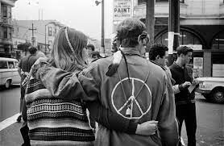
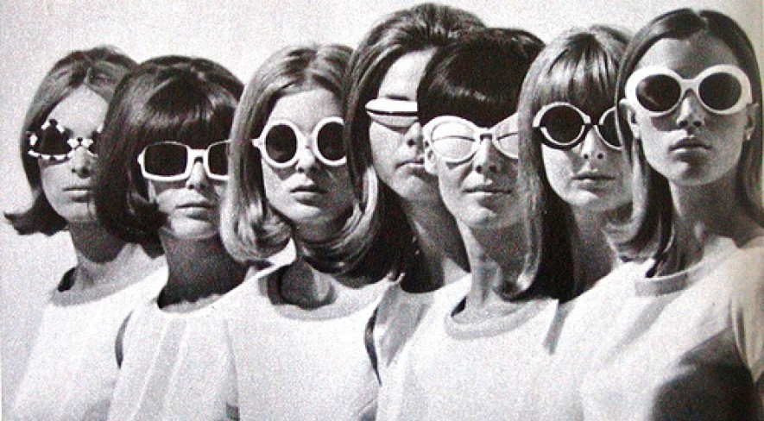
Live Demo Interview someone who came of age in the 60s and 70s

Slide 23
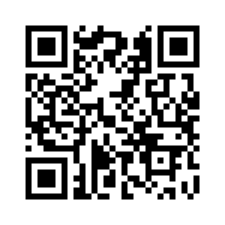
What is was like to be a kid in the 1960s
TRG AND MJB

Slide 24
How could you use this app to enhance student interviewing skills?

