Slide 1
Canvas Strategies for Large Courses
Dane Emmerling, Emily Forrest Hutchens, & Elizabeth Reeves Tomlinson
SPHG 352: Public Health Systems & Solutions

Slide 2
Strategies for Zoom Pro and Panopto in a Large Undergraduate Course
Alternative Hosts
Panopto Folders

Slide 3
Strategies for Zoom Pro & Panopto: Alternative Hosts
Notes:
Alternative hosts:
- Anyone can start the meeting
- Anyone can record, pause, or stop recording
- All recordings go to Panopto
- Anyone can create breakout rooms, move between rooms

Slide 4
Strategies for Zoom Pro & Panopto: Folders for Recordings
Notes:
Panopto recordings will automatically be available to everyone in the course
Main thing: Controlling who has access to which FOLDERS, not who has access to which VIDEOS
If you only want some recordings to be available to some students, you can utilize folders

Slide 5
Strategies for Zoom Pro & Panopto: Folders for Recordings
Notes:
First, remove full-class access to main folder (you can always change this later)

Slide 6
Strategies for Zoom Pro & Panopto: Folders for Recordings
Notes:
First, remove full-class access to main folder (you can always change this later)
Do not remove creator permission!

Slide 7
Strategies for Zoom Pro & Panopto: Folders for Recordings
Notes:
First, remove full-class access to main folder (you can always change this later)

Slide 8
Strategies for Zoom Pro & Panopto: Folders for Recordings

Slide 9
Strategies for Zoom Pro & Panopto: Folders for Recordings
Notes:
Don't be tempted to go over to the "Share" on the lefthand side – it won't work!
You have to change the folder that the video is housed in

Slide 10
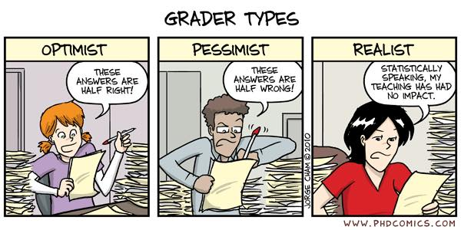
Grading Management Across Large TA Teams
Challenge: Consistency in grading for subjective assignments among a large TA team

Slide 11
Canvas New Analytics
Notes:
Can only see grades by Section (001, 002, etc) or individual student
Can only see grade comparisons after they're posted

Slide 12
Notes:
Basic template needs to attach student names to graders
Can download from Canvas if you already have TAs assigned
Then two pivot tables:
- Summary statistics for each grader
- Counts of letter grades for each grader

Slide 13
Summary Stats by Grader

Slide 14
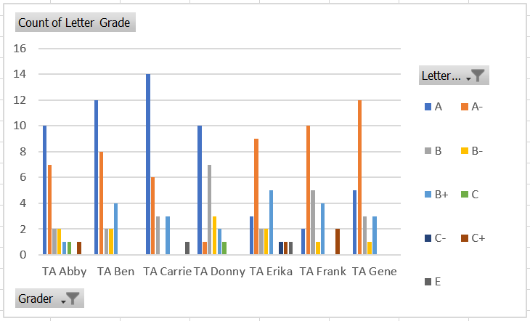
Letter Grade Counts by Grader

Slide 15
Using Quiz Question Banks
Becky Slifkin & Jake Stallard
Drawbacks
Adding & updating
Separate Canvas pages
Extra steps
Benefits:
Easier collaborative writing
Accessible for later iterations
Mixing up between sections
Notes:
Helps to avoid last-minute scramble to build a quiz, and to address quiz security between sections / cohorts

Slide 16
Question Banking & Quiz Building
Request "Sandbox" Site
Set Up Question Banks
Team Adds Questions
Collabora-tive Editing
Transfer to Quiz
Points & Last Edits
Admin-ister!
Refine Bank
Notes:
Having the teaching team add questions after each lecture also helps to ensure that questions are consistent with content delivery—writing while the information is fresh
Refining the bank based on quiz analytics and student feedback (more on that) gets it ready to go for next semester / year

Slide 17
Quiz Bank How-To: “Sandbox” Site

Slide 18
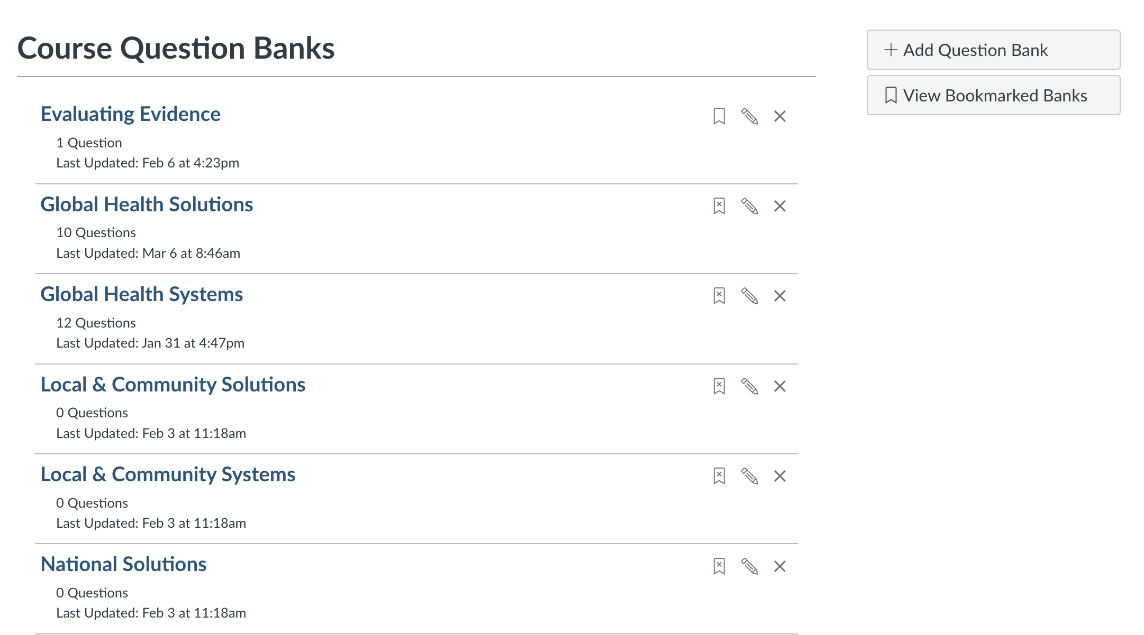
Quiz Bank How-To: “Sandbox” Site
GlobalSystemMC
Notes:
Star: Critical step—you must “bookmark” your question bank to have it be visible in other course sites. This enables you to find and add questions to the quiz you will build in your actual course site.
Also—the Global Health System question you see pictured is just titled “Question”. We suggest using a naming convention (overlayed) if you build quizzes from blueprint that distributes topic and question type across the quiz. Makes it easier to “pull” 3 multiple choice, 2 matching/multiple answer, and 2 short answer questions on the Global Health System, for example.

Slide 19
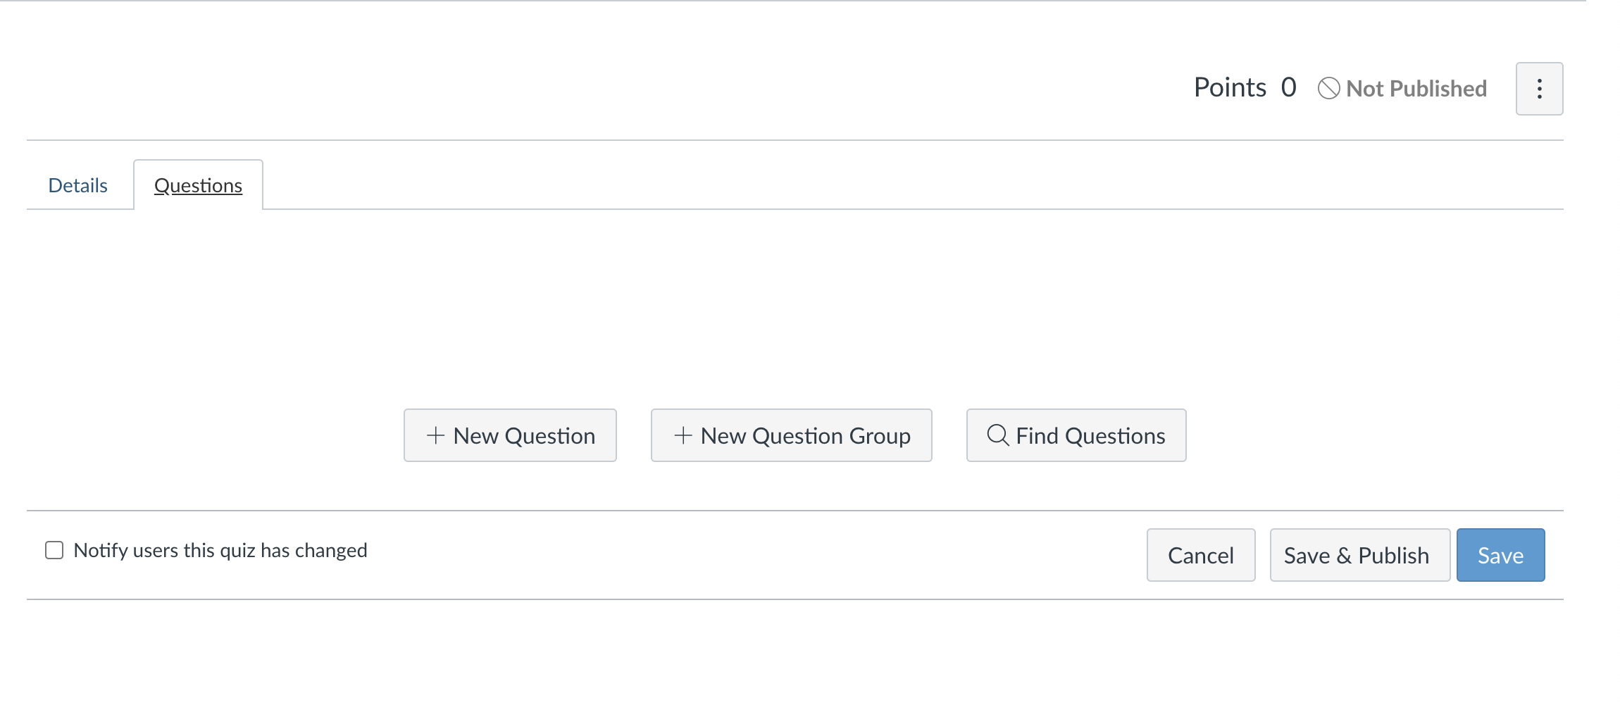
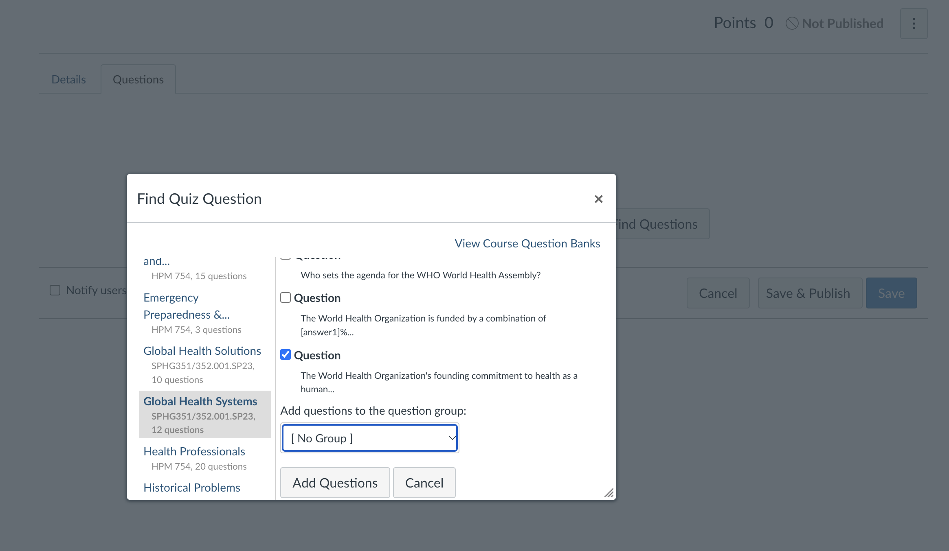
Quiz Bank How-To: Course Site

Slide 20
Weekly Announcements
Speakers – seeing content of the course as a part of the life of the university
Deadlines
Additional resources
What to expect for the week

Slide 21
Canvas Discussion Forum
TA specific forums & general forum for assignment and class questions
TA’s sign up for specific weeks to monitor closely
Previous class used Slack - pro’s and con’s
Anonymous or not?

Slide 22
Teams chat for TA’s
Keeps communication lines open
Cuts down on emails
Allows for “crowd sourcing” ideas for handling challenges

Slide 23
Questions?

