Slide 1
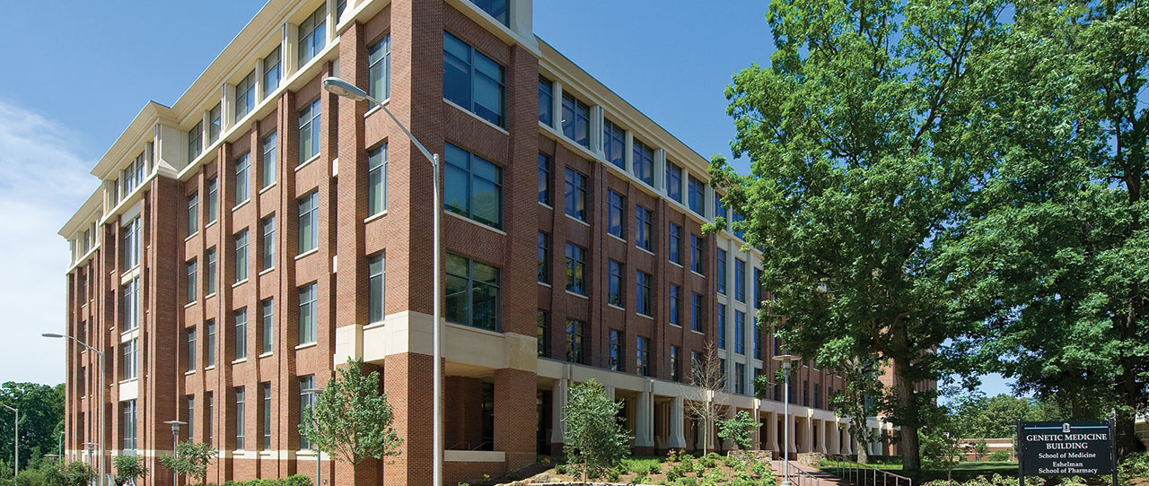
CFE Faculty Showcase on Teaching
March 23 – 24, 2023
Diverse Approaches to Teaching with Case Studies
Jim Fiordalisi, Ph.D.
Department of Pharmacology

Slide 2
Objectives of the Case Studies
Give students the opportunity to apply basic science knowledge to clinical scenarios in order to enhance retention/understanding
Basic Pharmacology I (PASC711)
Hematology
Cardiovascular
Pulmonary
Clinical Medicine I (PASC710)
Hematology
Cardiovascular
Pulmonary
Basic Pharmacology II (PASC721)
Clinical Medicine II (PASC720)
Basic Pharmacology III (PASC731)
Clinical Medicine III (PASC730)

Slide 3
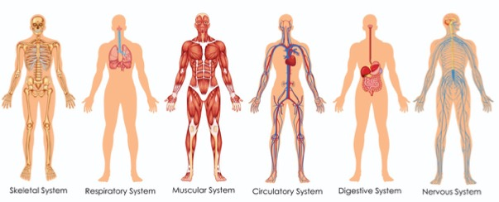
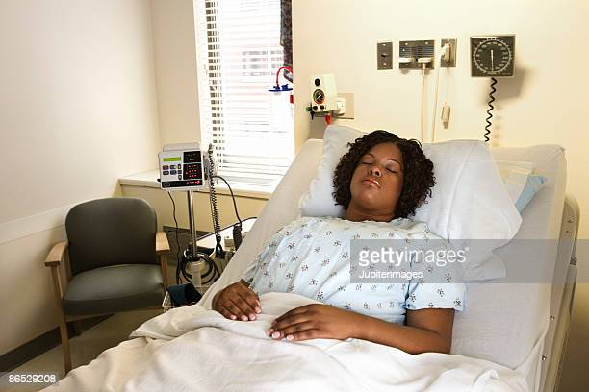
Objectives of the Case Studies
Encourage students to look at a patient as a whole person and not as a group of isolated symptoms

Slide 4

Objectives of the Case Studies
Have the students practice distinguishing between relevant and extraneous information (“Treasure hunt”)
BINGO!
Irrelevant
Red herring
Not important

Slide 5
Organization of the Case Studies

Slide 6
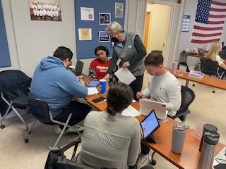
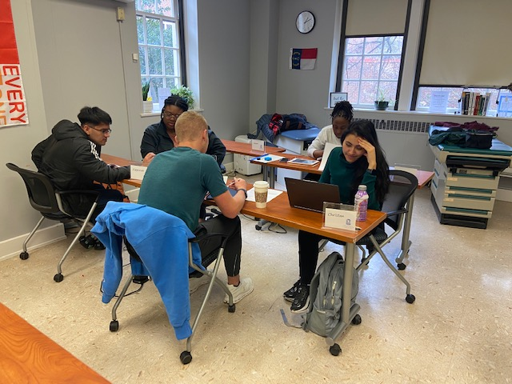
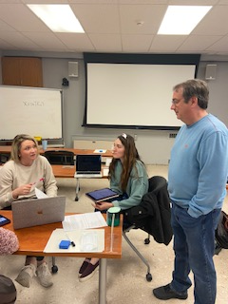
Organization of the Case Studies
Moderated by myself (basic science) and a PA faculty member (clinical science)
Students randomly assigned into groups of five
Student groups review the case and answer provided questions (45 minutes)
Whole class reviews answers through student-led discussion (45 minutes)

Slide 7
Example Case Study (Atrial fibrillation – A-fib)

Slide 8
Example Case Study (Atrial fibrillation – A-fib)

Slide 9
Example Case Study (Atrial fibrillation – A-fib)

Slide 10


What do these cases achieve?
Integration of basic science knowledge with clinical applications
and improved understanding of both
Integration of basic science knowledge across different topics often requiring on-the-fly research by the students
Improve the ability of students to distinguish relevant from non-relevant information (as they will need to do every day during their careers)

Slide 11
Still a work in progress…
Cases are still very informal (nothing turned in, not graded, not assessed on their exams in either class)
Cases are not yet fully integrated into Clinical Medicine courses. No reciprocal emphasis on basic science content
Basic Pharmacology I (PASC711)
Hematology
Cardiovascular
Pulmonary
Clinical Medicine I (PASC710)
Hematology
Cardiovascular
Pulmonary
???

Slide 12



Comments, questions, advice?
Thanks for your attention!

