Slide 1
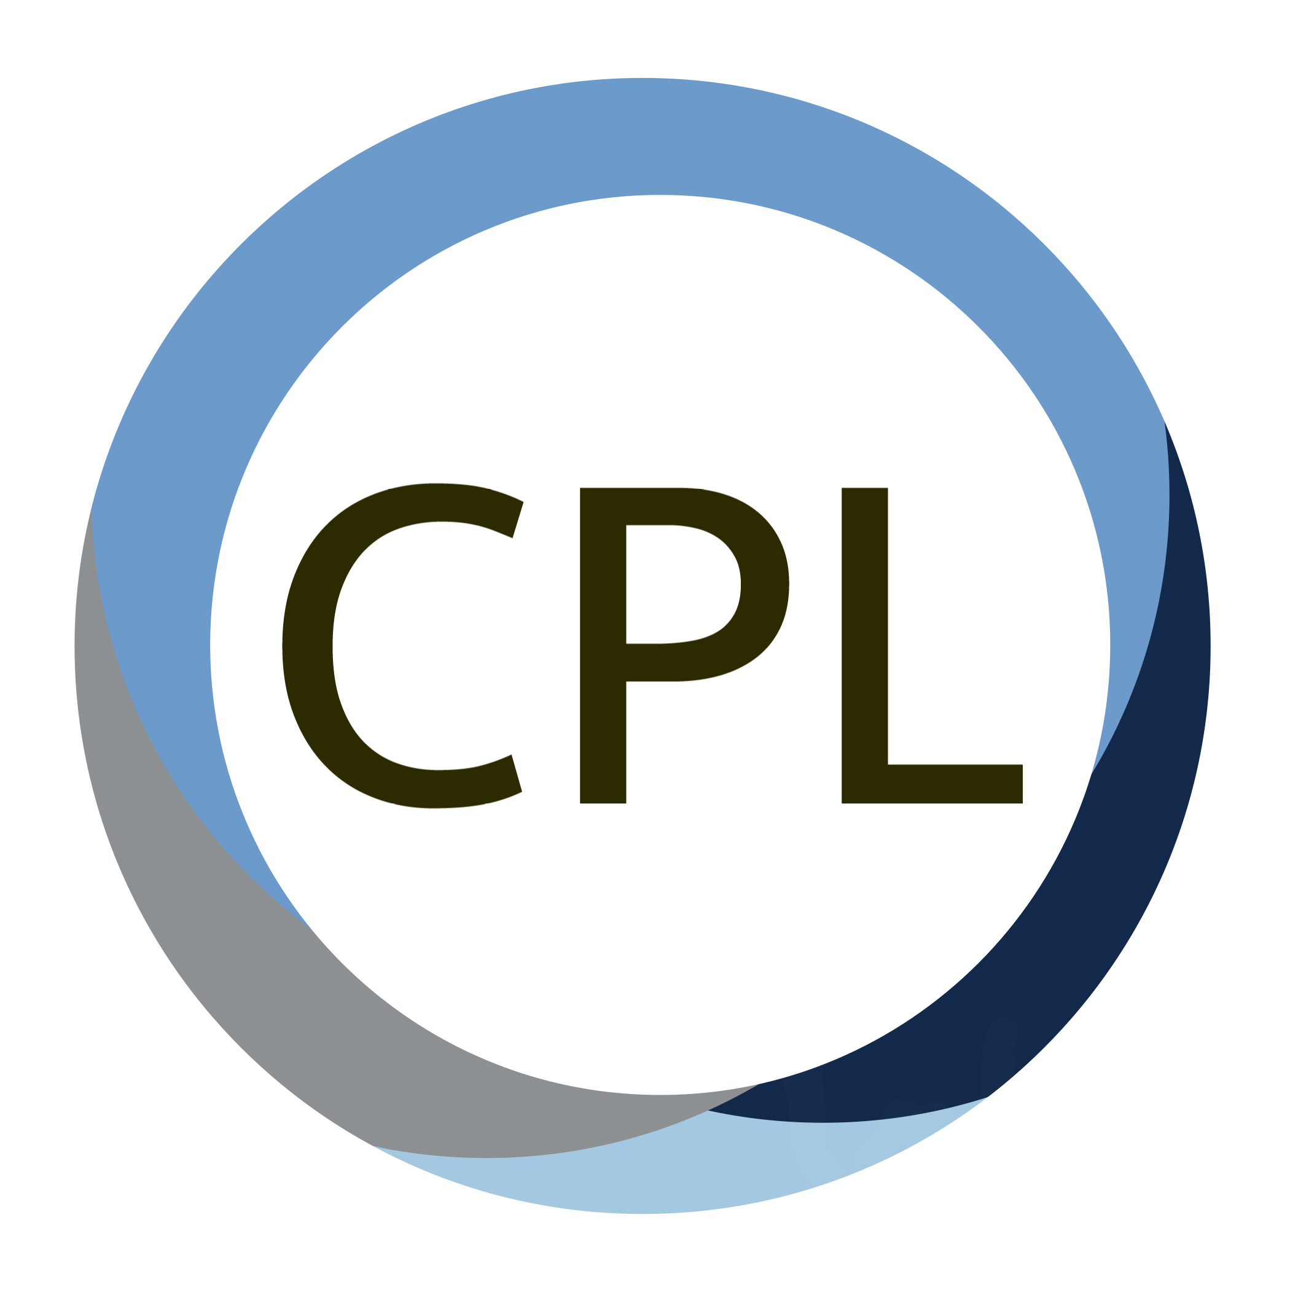
Prioritizing Partnerships & Modeling Commitment
The Pulls and Pushes of Community Engaged Teaching
The Community
Practice Lab
Ryan Lavalley PhD, OTR/L
Assistant Professor
Division of Occupational Science & Occupational Therapy
Department of Health Sciences

Slide 2
My History
Came to UNC in 2014 as a PhD Student
Began working as a Community OT
Developed partnerships across sectors:
  Aging Advocacy
  Home Repair Coalition
  Affordable Housing Advocacy
Expanded partnerships as Post-Doc 2019-2021, began teaching MSOT Community Practice Course
Hired as faculty member and began CPL in 2021

Slide 3
My Context
60% of my time is in community work
40% is teaching and faculty related commitments
The MSOT Community Practice Course is one semester for objectives.
Historical OT Context

Slide 4


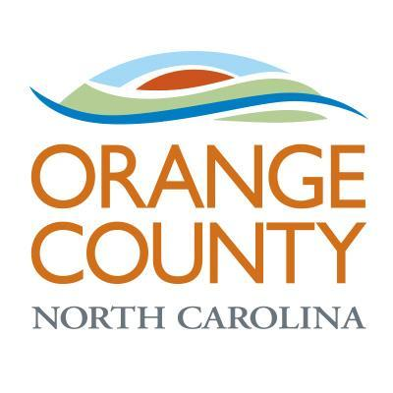
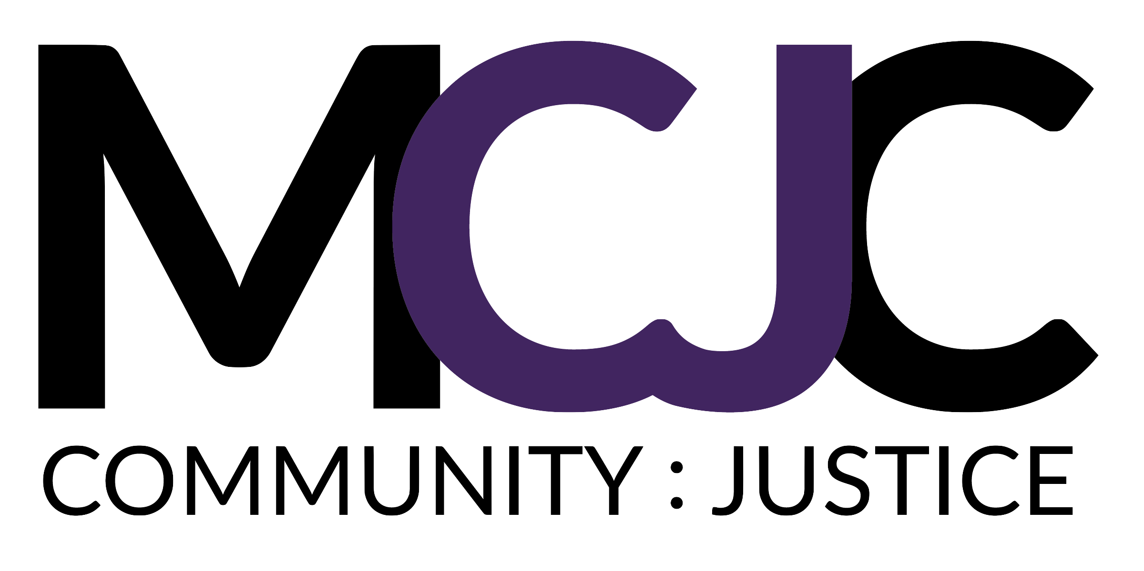
Our Sustained
Partners

Slide 5
Sustained Partnerships
Benefits
Faculty member is intimately aware of the context
Projects can be developed prior to student involvement
Groundwork can be set for students to have more impact
Projects can build on each other through faculty carrythrough
Challenges
Students must jump into the current
Faculty time is required
Students don’t get as much control or independence
Partners may not accommodate student timeline

Slide 6
Other Less Sustained Partnerships
Unique settings and organizations
Practitioners in orgs were greatly helpful
Often contributed to specific issues
Organizational follow through was unclear
Students weren’t sure how impactful they were
Org energy was a lot for student experience

Slide 7
Lessons
Prioritizing partner impact contributes to student experience
Centering partner needs in a sustained way, builds momentum that excites students
Students feel like the work is “real” and see a realistic process
Partners see more long-term benefits that outweigh student management burden
Partners don’t feel like a “lab” for students to practice in

Slide 8
Thank you!
Discussion?
ryan_lavalley@med.unc.edu
https://go.unc.edu/cpl

