Slide 1
Peer To Peer Learning: The ULA Perspective
Christine Mendoza
March 24, 2023

Slide 2
Data Sources
Department of Computer Science Returning ULA Applications
At the end of the semester, ULAs who plan to continue the following semester are asked “What have you gotten out of being an LA this semester, besides the stipend?”
Fall 2022 / Spring 2023 Application cycles: 216 responses, 151 ULAs
Informal Survey on Experiences of Undergraduate Learning Assistants
14 responses (as of 3/22/2023) on various aspects of the ULA experience
8 from stipend-based assistantship programs (7 COMP, 1 PHYS), 6 from course credit / volunteer assistantships (BIOL, ECON, MATH, POLI, PSYC)
Reddit Comments (source code / raw data)
84 comments (25 relevant) from the past few years with the keywords “ULA,” “UTA,” “peer mentor,” and variants
UNC 2022-23 Catalog (source code / raw data)
< 10 departments mention some form of ULAing in Program Opportunities

Slide 3
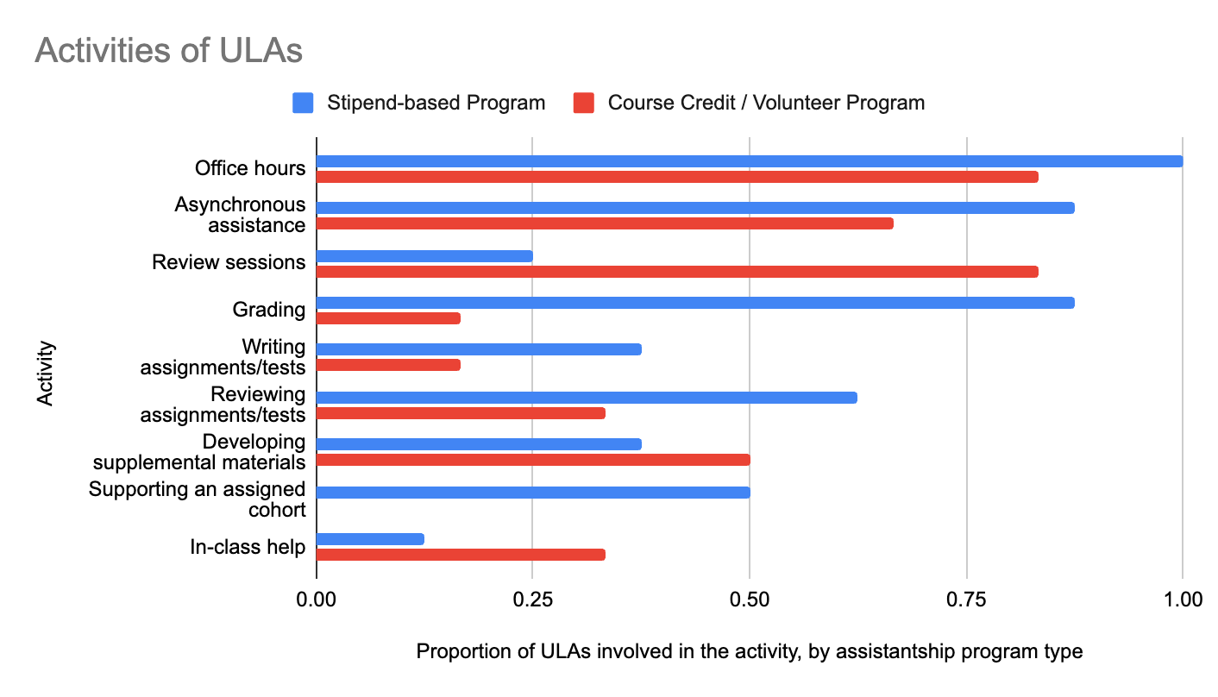
WHAT DO ULAs Do?
Dependent on department (different models exist)
The Department of Computer Science follows a model based on Brown University
Data source: Survey on Experiences of Undergraduate Learning Assistants
Notes:
https://cfe.unc.edu/wp-content/uploads/sites/326/2017/06/CFE2017_Assistants_Jordan.pdf
Office hours
Head ULAs
Curriculum design
Grading
Proctoring
Other Initiatives

Slide 4
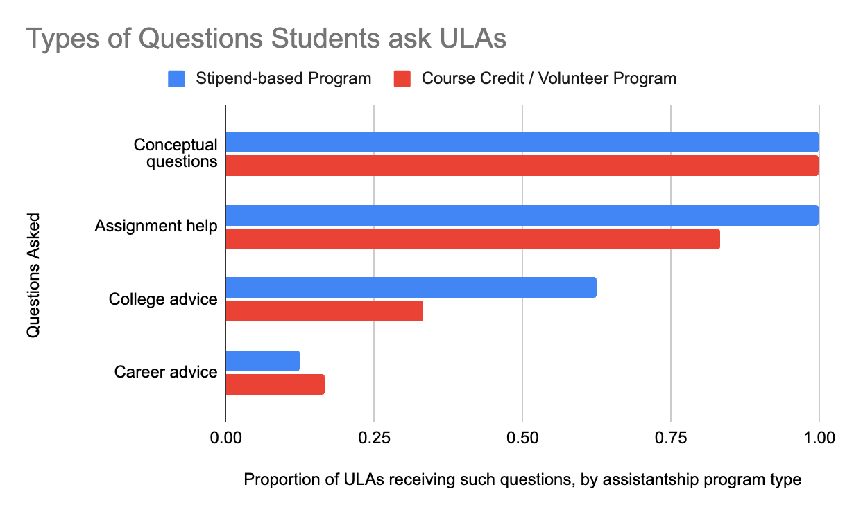
WHAT Kinds of Questions are ULAs Asked?
Data source: Survey on Experiences of Undergraduate Learning Assistants
Notes:
Empathy as peers

Slide 5
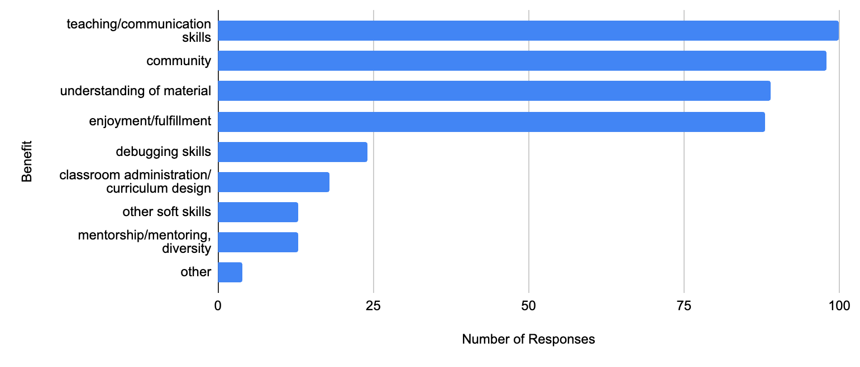
How DO ULAs benefit from Peer-to-Peer Teaching?
Data source: Department of Computer Science Returning ULA Applications
Notes:
other soft skills: problem-solving, conflict-resolution, time-management, leadership, teamwork
other: professor recommendations, test-taking, test-case writing, LA award
Most application responses mention office hours.

Slide 6
Teaching / Communication Skills
“I have … learned a lot about how people think about the same concept in many different ways and how I can best adapt my explanations to fit with their ‘framework for understanding’ (i.e., if their existing knowledge/understanding is a certain puzzle piece, I have to be able to find the right matching puzzle piece to fit in with it so that they can more easily learn new things).”
Adapting to student needs
Each ULA has unique perspectives and experiences they can bring to students
ULAs learn how to reach students where they are

Slide 7
Teaching/ Communication Skills, continued
“Since this semester was my first time being a ULA, I experienced a lot of growth not just in my understanding of computer science concepts, but also in my ability to communicate, empathize, and understand my students and peers.. I started off excited about this role but nervous about my ability to answer all of the student’s questions, but quickly realized my capabilities and role in helping students. ”
Confidence
Patience, understanding, empathy
Interest in pursuing education as a career
Experience in classroom administration and curriculum development
Notes:
One person spoke of knowledge as a puzzle piece…

Slide 8
Understanding of Material
“ I had the opportunity to relearn the class from a whole new perspective. This time, not only did I need to understand all the contents, but I also needed to tell my students in a way that all of them could understand.
… I have learned to summarize the problems that other students may encounter while doing it. This way I can help them more effectively during my office hours.”
Explaining material in different ways
Going beyond material in discussions and office hours

Slide 9
Community
“When I took COMP 110 the fall of my freshmen year, the LAs – in addition to making course content approachable to beginners – talked extensively about clubs, hackathons, and other resources for how to get involved in computer science. It was this encouragement to get involved in CS that gave me the confidence to change my major to CS without any coding experience prior to college.
The best thing I’ve gotten out of being an LA this spring is being able to contribute to this community by making coding concepts more accessible, and showing other students that computer science at UNC isn’t as intimidating as it may appear on the surface.
For Hack110, I co-led a workshop on how to get involved in computer science at UNC. … After the workshop I was able to talk one-on-one with students about the major, the B.A. vs. B.S., hackathons, clubs – about anything related to CS at UNC. It seems like a lot of beginning students are interested in CS, but just need some encouragement and guidance (I know I did at least).”
Passing on a passion for the material
Mentoring students
Fostering diversity through inclusive environments
Notes:
6 responses talked about contributing to the supportive environment that helped them in the first place

Slide 10
Community, Continued
“Being an LA has allowed me to both be a mentor and receive mentorship, something that is incredibly important for all students within the CS department! As a mentor, I have been able to interact with and offer guidance to so many incoming or new major-students in terms of both course-related and non-course work. I love sharing a passion for CS and I try to offer as many tips, programs, and experiences as I can.
On the flip side, I myself have been able to meet older and seasoned major-students who have many helpful things to say. They have encouraged me as a TA and educator, told me about programs & conferences, and helped me choose electives and the topics I am interested in! Being a TA has allowed me to truly become immersed in the CS department and I love participating in this student support system that fosters learning and growth!”
Receiving mentorship
Camaraderie with others in the department
Close friendships with other ULAs
Support system
ULAs
Students
Professors

Slide 11
ENJOYMENT / Fulfillment
“I have found myself much more invested in the success of students in the class than I thought I would be, I am right there with them celebrating the victories of figuring out a hard problem or getting a good score on the midterm. I was initially unsure how much I would enjoy being an LA, but it has been a truly impactful experience that has helped me find a hidden joy for peer teaching/support. After this semester I want to incorporate it into all remaining semesters I have at UNC if possible.”
Making a meaningful impact on others’ lives
Sharing a passion for the course material and for learning/teaching with students and the instructional team
Building memories

Slide 12
Skills for Work and Life
“My experience as an LA got my foot in the door for a lot of places that valued strong communication and conflict-resolution skills, and ultimately it's a huge part of why I was able to land a job offer so early on in my senior year. ”
Problem Solving
Conflict Resolution
Time Management
Teamwork
Leadership

Slide 13
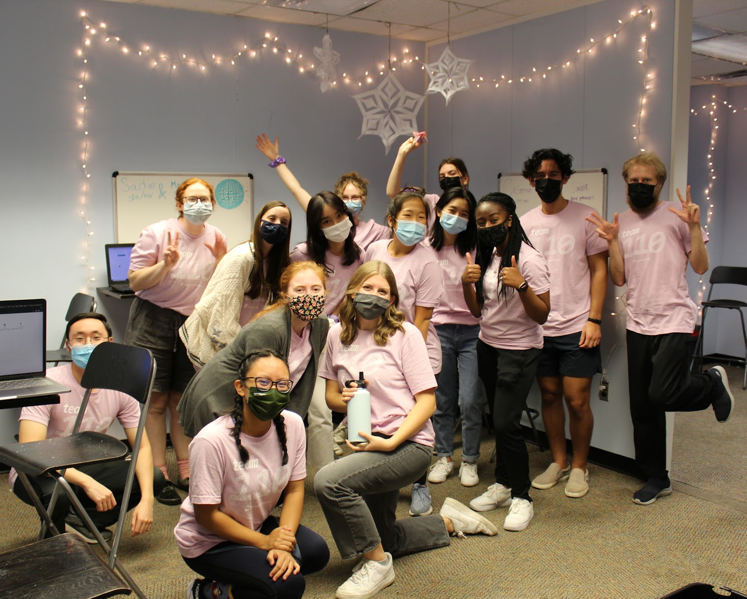
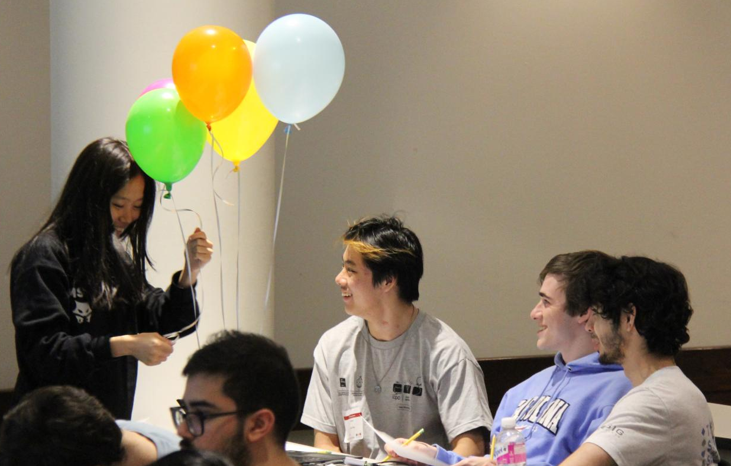
How do Programs Benefit?
Enhances the understanding of course material
Builds a pipeline of passionate students
Fosters community within departments
Creates opportunities for improved pedagogy
Photo credit: Rebekah Seawell
Photo credit: Anish Toomu

Slide 14
How CAN ULAs Be Supported?
Improved compensation (via increased stipend or graded credit)
“This was … my first paid job, I have had unpaid work before but the idea that my work was now worth something encouraged me to be independent and do my best.”
Disparity with private tutoring jobs, graduate teaching assistants
Support structure
Training
Weekly meetings, regular communication
Encourage mentorships between more experienced and less experienced ULAs
Build an alumni network

Slide 15
How CAN ULAs Be Supported? (Continued)
Provide spaces for community
Online (Slack, GroupMe, Discord)
In-person (informal gatherings)
Allow ULAs to take ownership of aspects of the learning experience
Trust your ULAs in the same way you would trust graduate TAs (see advice from Professor Kris Jordan’s 2017 CFE Presentation)
Solicit their input and involvement in pedagogy
Encourage them to organize events/initiatives for the instructional team and/or students
Community-building
Educational

Slide 16
Acknowledgements
Department of Computer Science
Professor Kris Jordan
Jesse Wei
Photo credits: Rebekah Seawell, Anish Toomu
Dr. Ketan Mayer-Patel
Survey respondents (ULAs from the Department of Computer Science and other departments)
Undergraduate Learning Assistants
Instructors of courses, especially those with ULAs

