Slide 1
A brief teambuilding activity to strengthen small group dynamics
Emily Moorefield, Ph.D.
Department of Cell Biology and Physiology
emily_moorefield@med.unc.edu

Slide 2
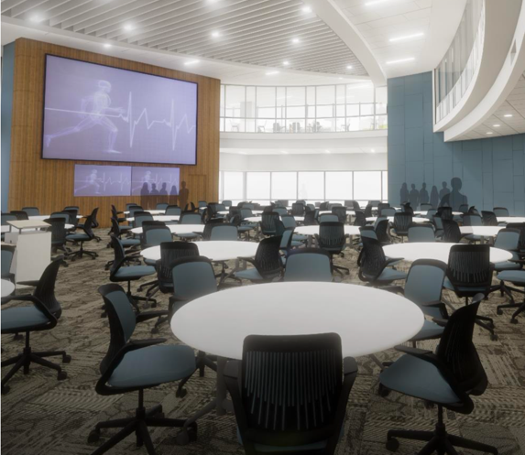
Small group instruction
Fall Semester, Medical Science
Principles of Medicine
Immunologic Block
Hematologic Block
Cardiovascular Block
~5 week organ-system blocks, 6-8 small group sessions per block
Purpose
Application of basic science concepts through clinical cases
Structure
Round tables of 6 students each
Groups remain together for one semester

Slide 3
Small group dynamics
Problem
Unengaged students
Small groups not cohesive
Negative impact on quality of learning
Goal
Develop and implement a short (< 1 hour) teambuilding activity to create positive group dynamics that provide a strong foundation for group development and collaborative learning.

Slide 4
Teambuilding activity
Conflict scenarios
Written by second year students
Based on previous experiences
Talking over a quieter group member.
Group member studies alone.
Hardship causes group member to check out.
Unprepared group members.
The group splits into two smaller groups.
Laughing at a group member for giving an incorrect answer.
Correcting a group member and coming across as dismissive or rude.
Introductions
Forming
Describe personal and team goals for small group experience.
Outline group rules and expectations.
Storming
Discuss a specific conflict scenario and identify possible solutions.

Slide 5
Impact of teambuilding activity
Principles of Medicine
Immunologic Block
Hematologic Block
Cardiovascular Block
Teambuilding
activity
Self and peer
evaluation
Positive student feedback immediately following activity.
The session was a valuable use of time.
I plan to adhere to the rules and expectations agreed upon in my group.
My group can communicate effectively and work collaboratively.
My group can overcome conflict together.
Students who participate in a teambuilding activity can more effectively evaluate themselves and their peers.
More honest assessment of performance.
‘Dependable in punctuality and attendance’ prompt.
Many more references to being late in open ended comments.
“He really honors the discussion guidelines we had agreed upon back from our first day of small group which is impressive.”

