Slide 1



Gaining instructional insights through learning analytics
NSF DUE 1821594
NSF DUE 1821601
Notes:
Jeff

Slide 2



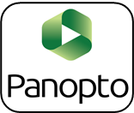








Using learning analytics to support students
Student engages in learning using course resources
Enact Intervention
Student continues to
learn & progress
Technologies log traces of engagement to
Learning
Analytics
Notes:
Jeff

Slide 3
Biology 101
Content: Introduction to Biology for both majors and non-majors
Format: High enrollment, blended class format
Pedagogy: Active learning, flipped classroom
Coursework: 2 topics weekly, guided reading questions, homework
Assessment: 7 online quizzes, 3 unit exams & a cumulative final
Students: 21 sections, 9 semesters (SP19 – SP23)
  3,440 Participants
  75% First-year students
  69% Female
  25% Under-represented in STEM
  24% First-generation college students
  23% Biology majors
Notes:
Jeff

Slide 4













Learning Cycle
Lessons
1
2
3
4
5
6
7
8
Exam 1
Before Class
During Class
After Class
Notes:
Jeff

Slide 5
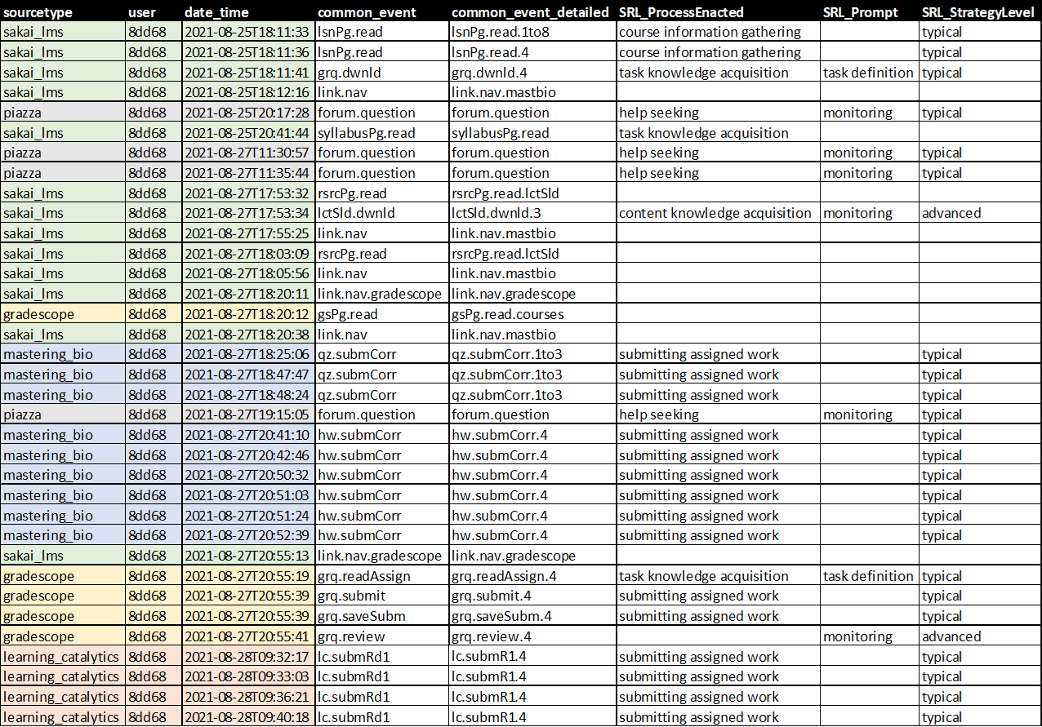
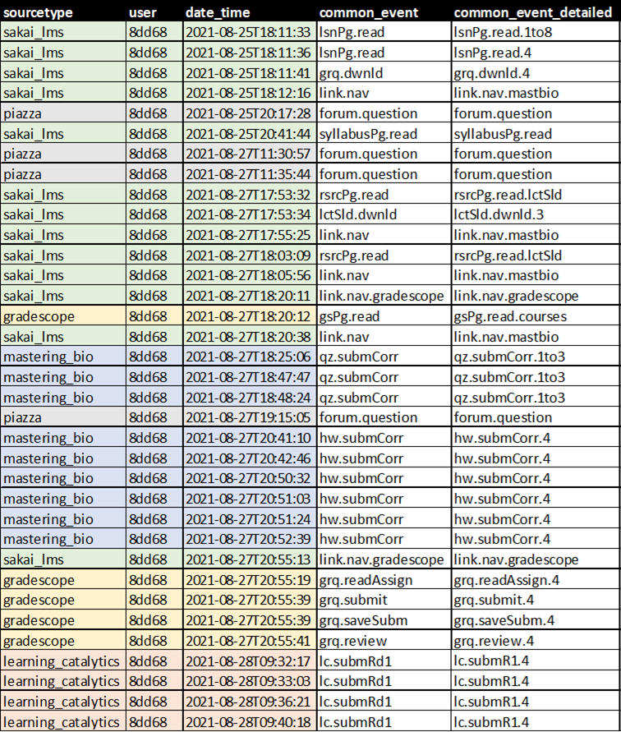
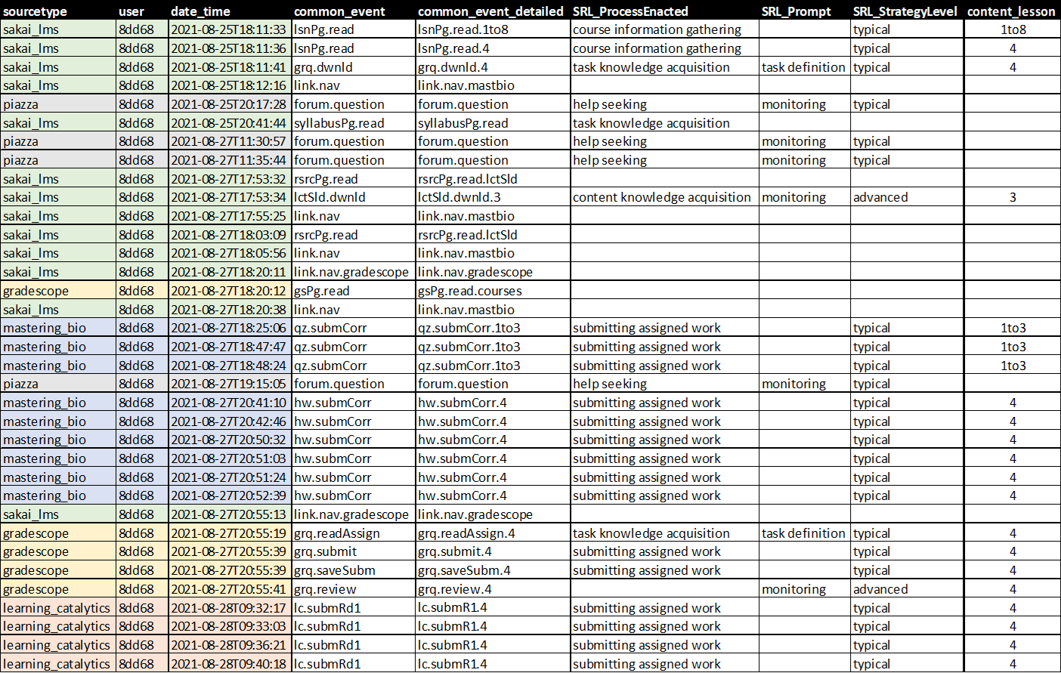
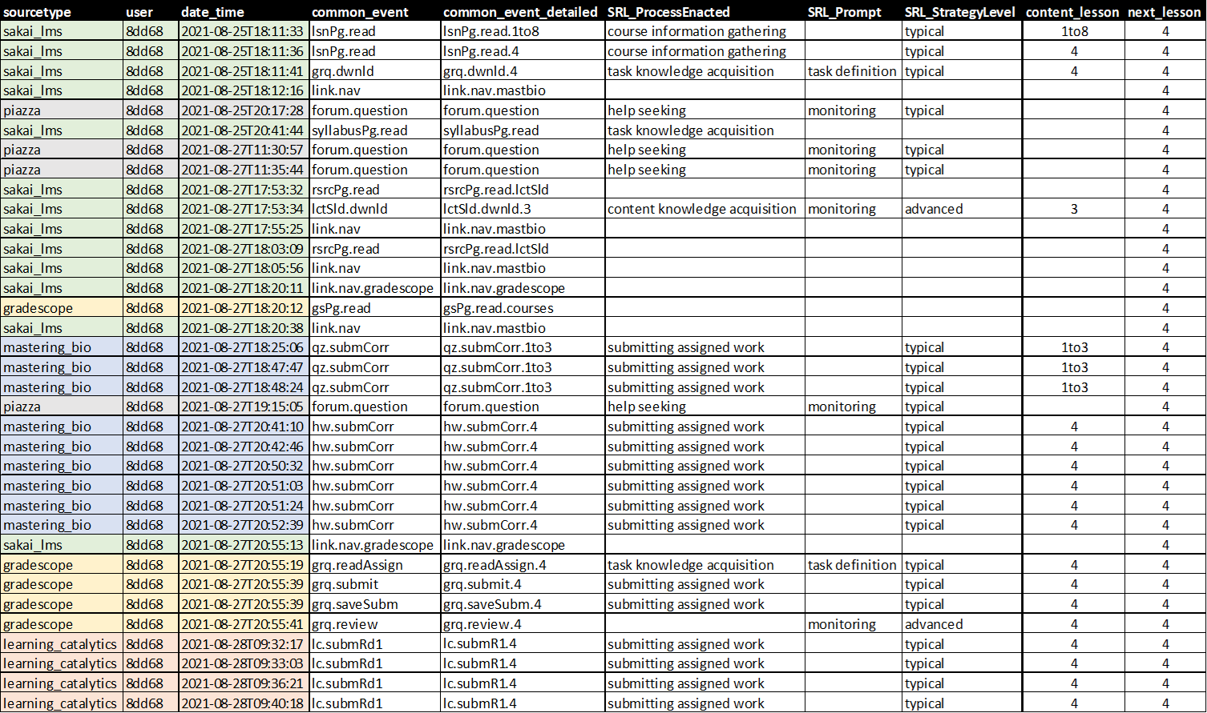
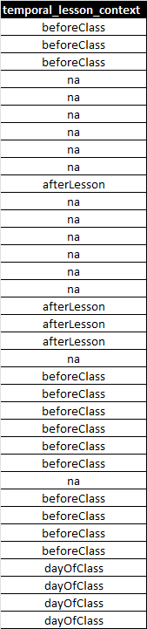
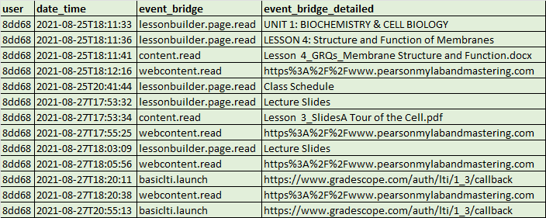
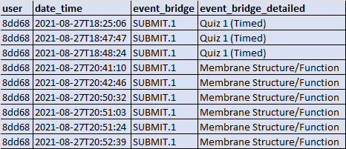
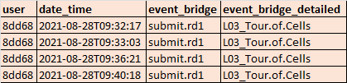
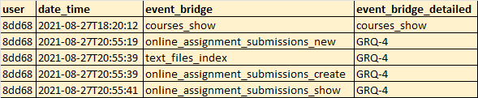
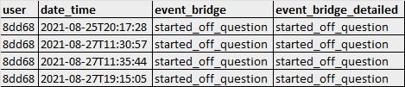
Event Log Data Preparation
Sakai LMS
Pearson Mastering Biology
Pearson Learning Catalytics
Gradescope
Piazza Forums
Notes:
In anticipation of creating the prediction model, we first needed to combine our multiple channels of log data in to a singular logfile.
We then replaced the native naming schema with one that was more consistent in granularity and nomenclature across sources.
From there we were able to apply our theory driven tags.
As well as tagging each asset with the content lesson it relates to.
These content lessons also align with meetings of class so we are able to label each date with the next lesson topic to be covered.

Slide 6
Predictive Model With Temporality
Criteria: Accuracy >=.7 , Sensitivity >= .7, Kappa >=.4
LASSO informed Logistic Regression Model
Temporally anchored counts of events thru 2 meetings of class
Pre-test
31 event related variables
Baseline 42.68%
Metric | k | Accuracy | n | Sensitivity | n
Overall | 0.54 | 76.83% | 63/82 | 88.57% | 31/35
Female | 0.49 | 74.07% | 40/54 | 85.71% | 18/21
Males | 0.64 | 82.14% | 23/28 | 92.86% | 13/14
Continuing Generation | 0.45 | 72.13% | 44/61 | 83.33% | 20/24
First Generation College Students | 0.81 | 90.47% | 19/21 | 100% | 11/11
Caucasian & Asian Students | 0.51 | 75.00% | 45/60 | 88.89% | 24/27
Underrepresented minority students | 0.52 | 76.47% | 13/17 | 83.33% | 5/6
Metric | k | Accuracy | n | Sensitivity | n
Overall | 0.54 | 76.83% | 63/82 | 88.57% | 31/35
Notes:
robert

Slide 7
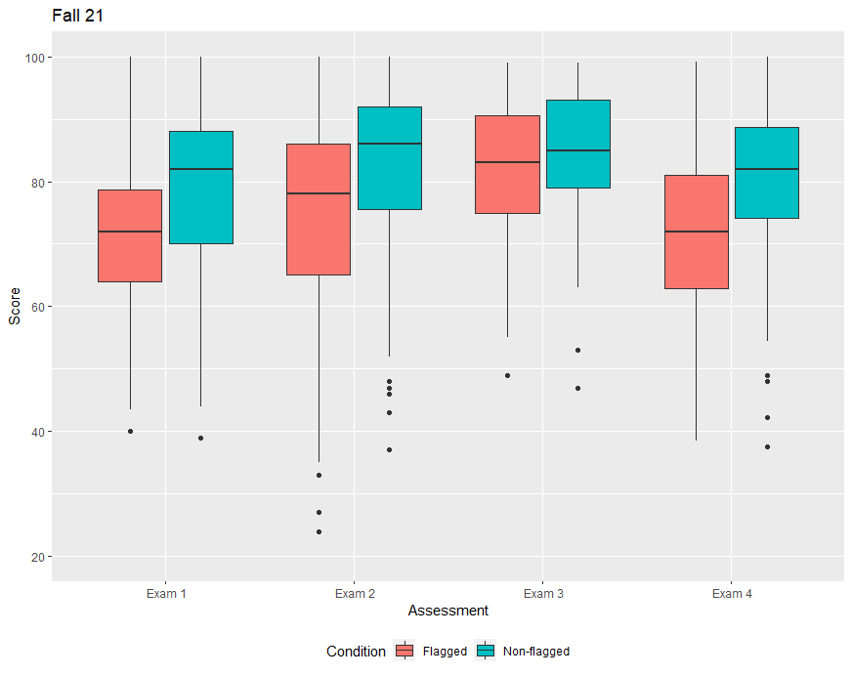
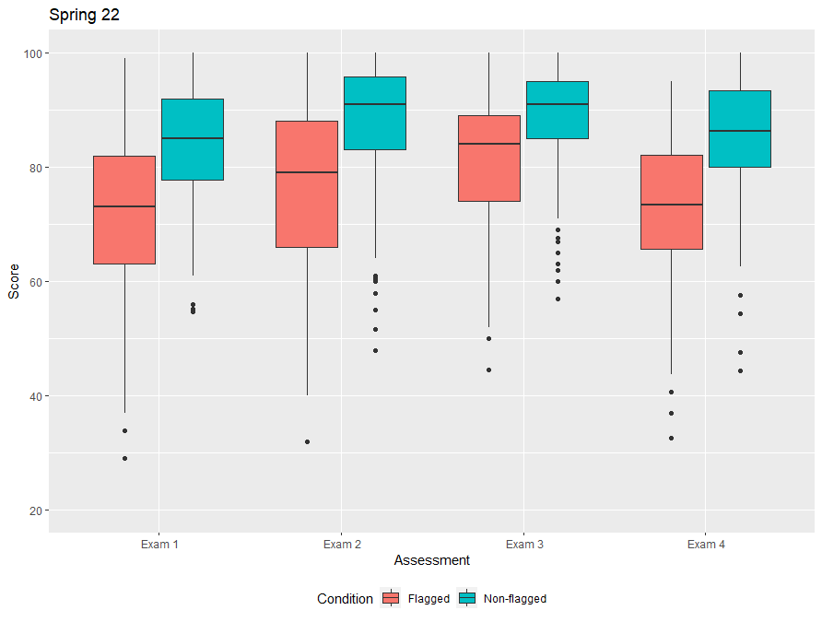
Temporal Model Performance
Notes:
Robert

Slide 8
Temporal Predictors
 | Non-Temporal | Multiple Lessons Ahead | 1 Lesson Ahead | During Lesson | Day of Lesson | After Lesson
Pretest | -.626
Syllabus View | .087
Gradebook View | -.152
Calendar View | -.287
Links to External Sites | .058
Links to Supplemental Instruction | -.120
Forum Questions | -.076
Reading Lesson Pages |  |  | .071 |  |  | -.261
Download Guided Reading Questions |  | -.064 | -.044 | -.013 | .013
Submit GRQ |  |  |  |  | .001
Revise GRQ Submission |  |  |  |  | .259
Review GRQ Submission |  |  |  | -.197
Homework Correct Submissions |  |  |  | -.264
Homework Incorrect Submissions |  |  | .056 | .564 |  | .198
Homework Hints |  |  |  | -.059 | -.071
Homework Solutions |  |  |  |  | -.029 | .006
Download Class Outline |  |  | -.073 | -.242 | .123
In-Class Response System |  |  |  |  | -.213
Download Lecture Slides |  |  |  |  |  | -.108
Taking Practice Exam |  | -1.018
Multiple Lessons Before
A Lesson Before
Before Class
Day of Class
Notes:
robert

Slide 9
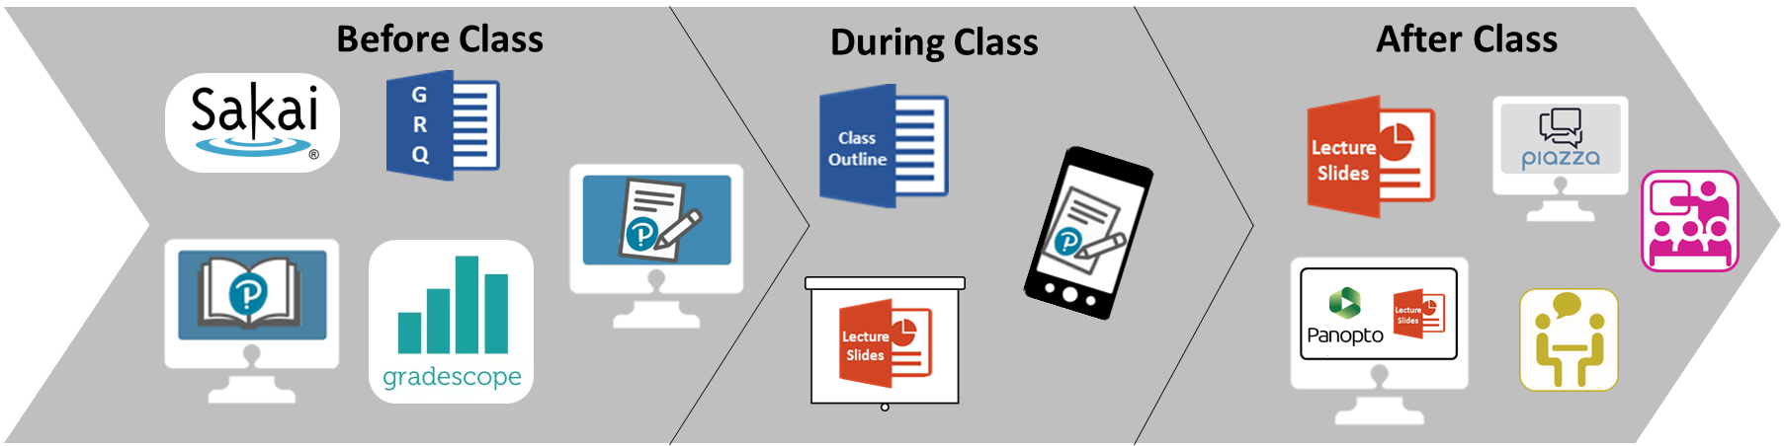
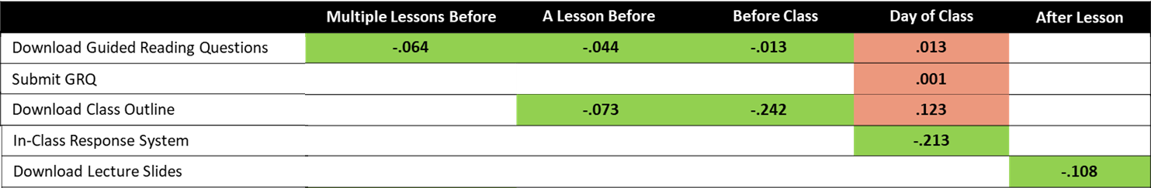
Explaining Variance with WHEN students engaged in action
Notes:
robert

Slide 10
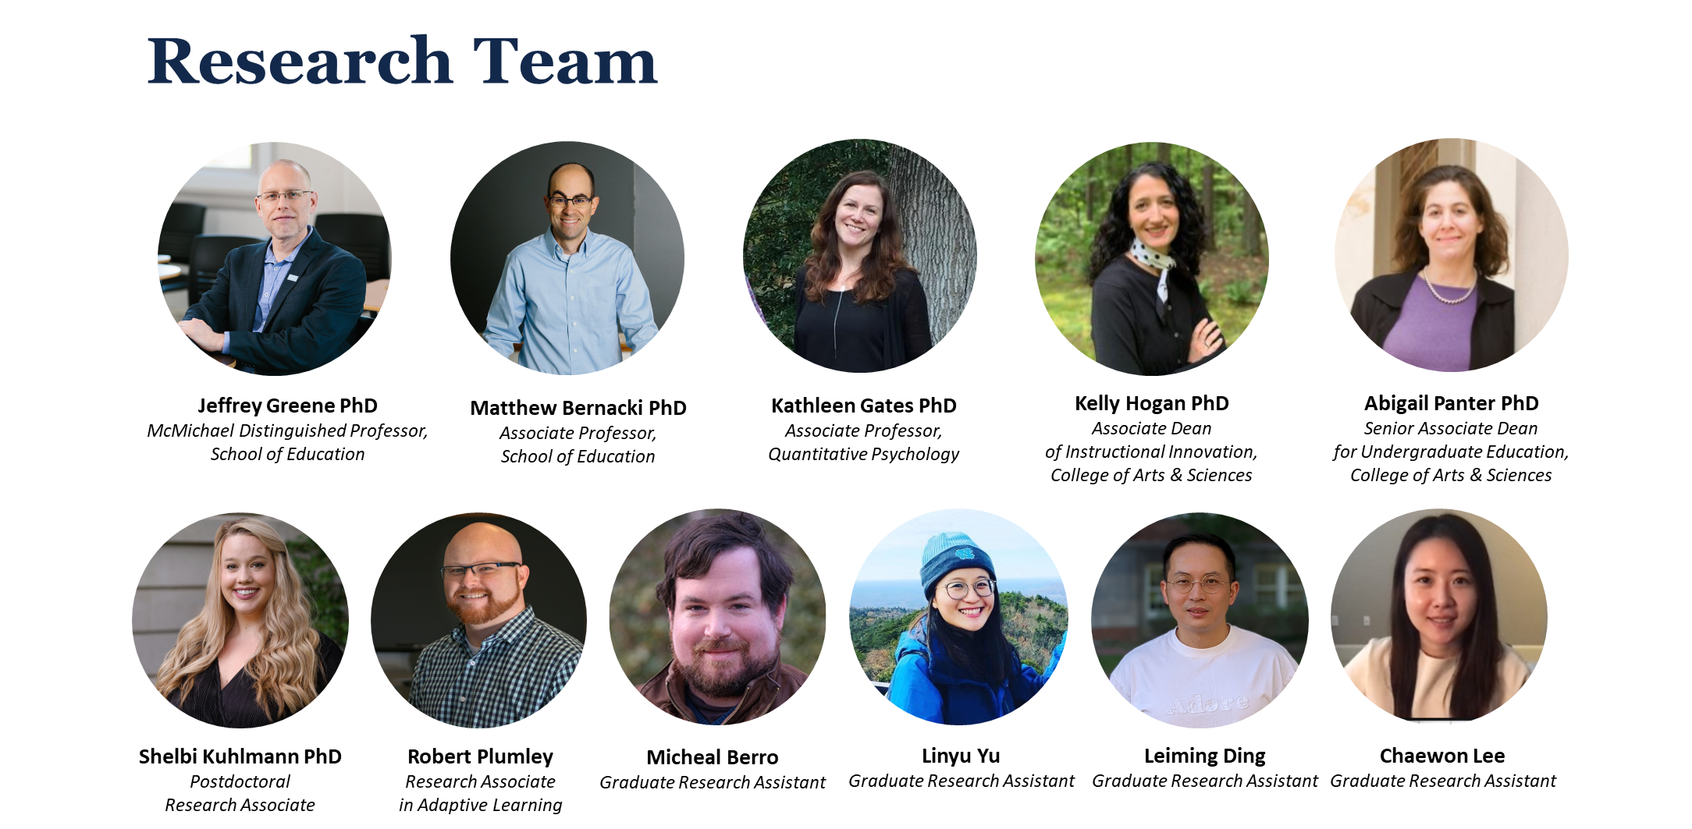




Notes:
Jeff

Slide 11

Thank you!
Robert Plumley rplumley@live.unc.edu
Notes:
Jeff

Slide 12
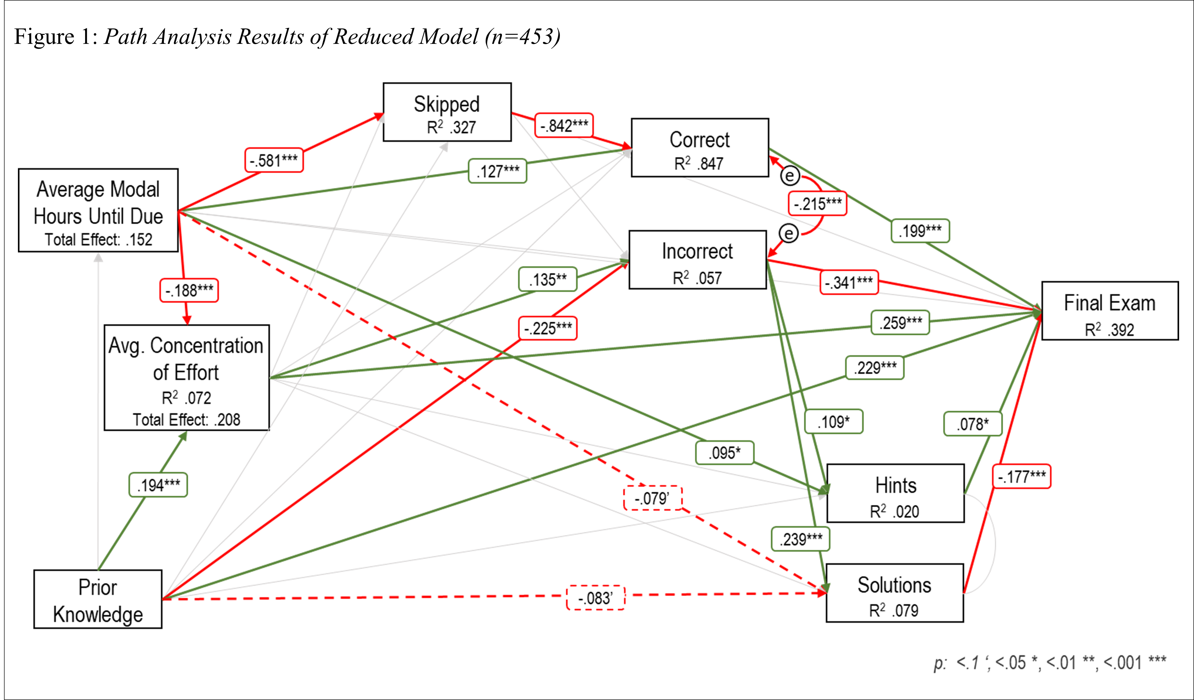
How Timeliness and Concentration of Effort Relates to Performance in Undergraduate Biology

Slide 13

Survey Data
Wk 1 | 2 | Week 3 | 4 | 5 | Week 6 | Week 7 | Week 8
Pre-test
Educational Psychology
Intervention Survey
Exam 1
Exam 1 Reflection
STEM Self-efficacy
Achievement Goals
    Mastery Approach
    Performance Approach
    Performance Avoidance
    Expectancy-Value
    Value -Attainment
    Value -Interest
    Value -Utility
    Cost -Effort
    Cost -Opportunity
    Cost –Psychological
    Metacognitive Self-regulation Scale
Which of the following best matches how you typically distribute your time studying for exams?
Rate these strategies by the amount of time you spend on them when preparing for an exam.
What grade do you expect to achieve on Exam 1?
How well have you prepared to achieve the grade you are aiming for on the exam?
Before Class | Reflect on how your efforts before class prepare you for engaging in class sessions. List the activities you consider most important in preparing for class. In a few sentences, justify the activities you selected.
During Class | Reflect on class time. What strategies are you using during class time that you consider to be most helpful? Why?
After Class | Reflect on your post-class reviewing. In a few sentences, describe how and when you review learning materials covered before and during class.
Exam Preparation | Reflect on your exam studying. In a few sentences, describe the best strategies you used to study for the exam.
Exam Preparation Changes | Describe how you intend to study for the next exam. What about your approach will stay the same and what will change?
Non-Academic Factors | In a few sentences, please elaborate on the non-academic issues you have dealt with during this class. How have they have affected your approach to the class and what strategies you have used to manage them?
Notes:
Robert

Slide 14
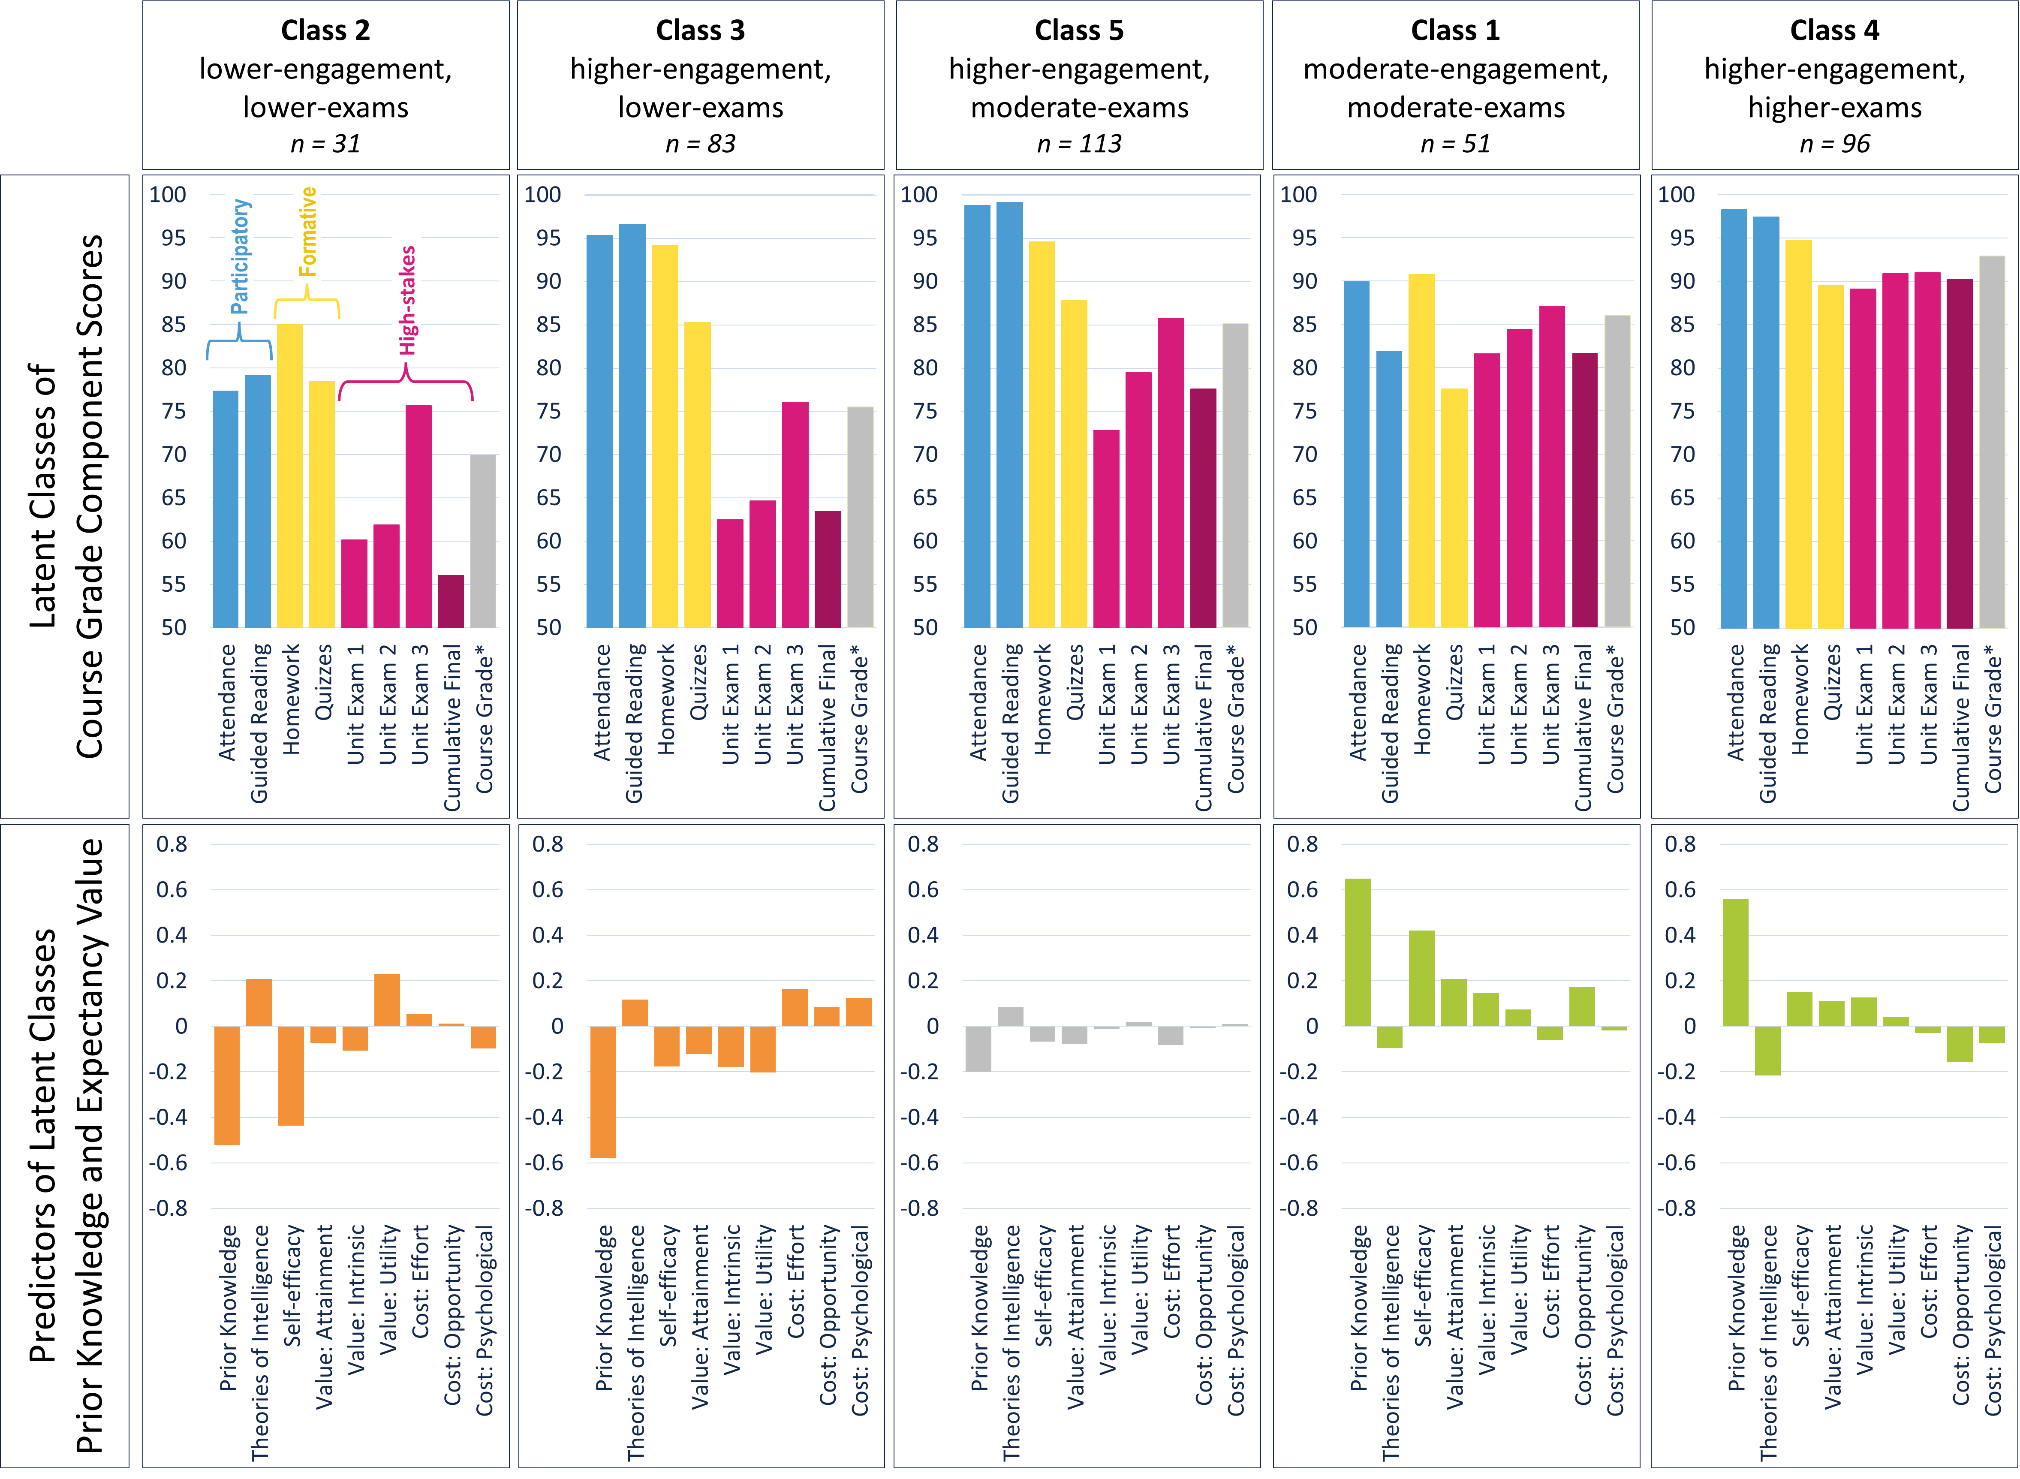
Influence of Prior Knowledge and Value on Biology Students' Course Grade Composition

