Slide 1
Reaching Students as Individuals: Empathy and Action
Patrick Harrison (he/him)
Department of Psychology & Neuroscience

Slide 2
“With the many responsibilities involved with teaching, reaching students as individuals can be a challenge.”

Slide 3
Notes:
Poll Title: Do not modify the notes in this section to avoid tampering with the Poll Everywhere activity. More info at polleverywhere.com/support What is your biggest barrier to reaching students as individuals? https://www.polleverywhere.com/discourses/6NdwpvVb394HnrMW2FSSc

Slide 4
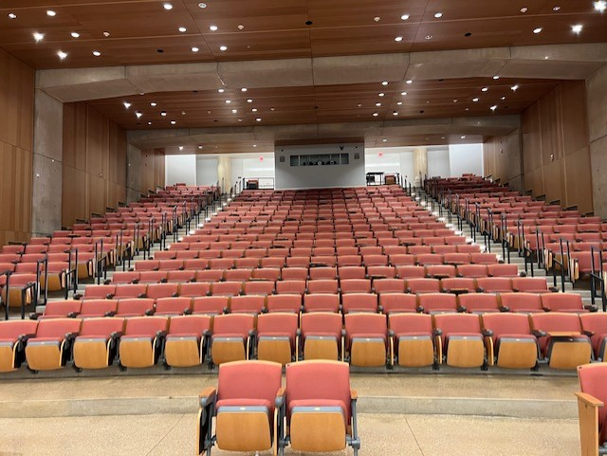
Barriers
Bridge between necessary efficiency of large class with individual needs
Multiple modes of engagement
Being a college student/professor isn’t easy!

Slide 5
Reaching Students with Compassion
How am I going to build a supportive and compassionate course culture?
Compassion = empathy + action (c.f. Sinclair et al., 2017)
1. Take students’ perspectives
2. Let perspective taking guide your interactions with students
3. Acknowledge student experiences are real (and important)
4. Model vulnerability/humility
5. Share victories

Slide 6
1. Taking Perspective
Do your homework ahead of time
Who is in your course? Why are they taking the course? What have you learned about your students in previous semesters?
Solicit feedback often
When you need to know, poll (PollEverywhere, online discussion community, etc.)
Utilize ULAs/IAs/TAs (if possible)
How can students have a voice in your course?
Listen!

Slide 7
2. Guiding Interactions
Set a positive tone
Provide structure for interactions/office hours (ambiguity can be stressful) (Hogan & Sathy, 2022)

Slide 8
3. Acknowledging Experiences
Build a strong course community
Structures in place to allow students to have leadership roles
Explicitly discuss things that are more important than your course
Identify deadlines that can be flexible and why
Acknowledge you have heard them and made a change (action)

Slide 9
4. Modeling Vulnerability
Don’t take yourself too seriously
Identify mistakes as soon as possible
Share personal anecdotes
Name common experiences
Humor*

Slide 10
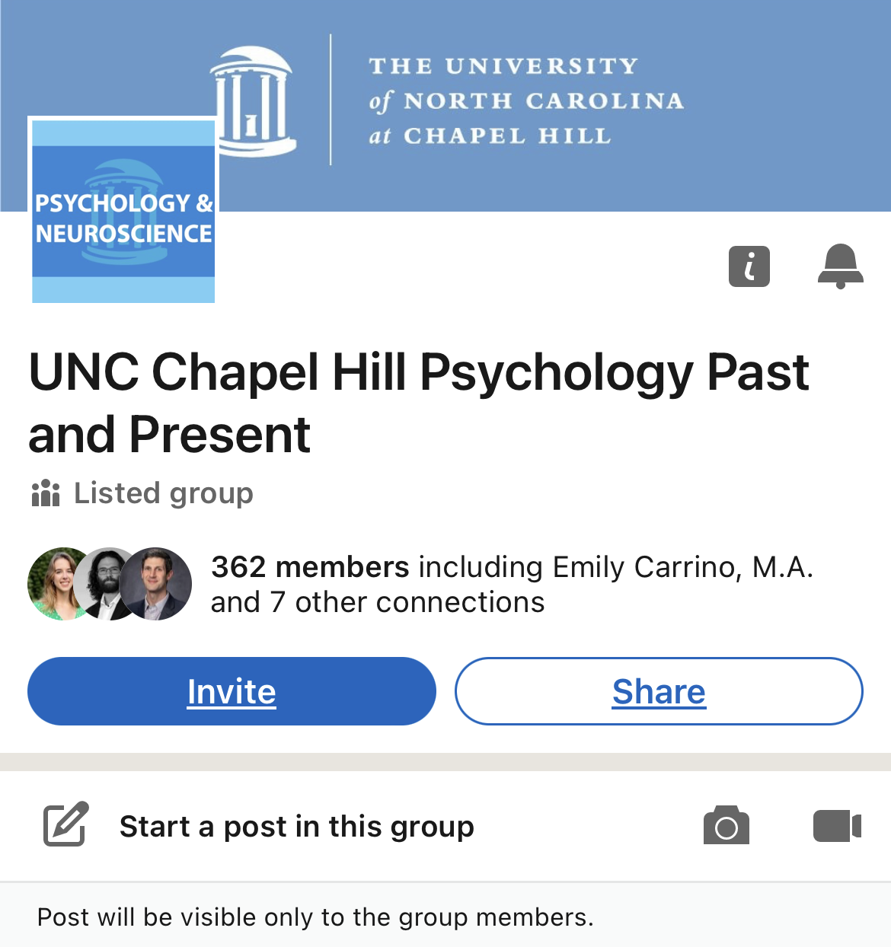
5. Celebrating Victories
Class data
Remind students they are amazing (!)
Work to change the “academic narrative”
Staying in contact with students

Slide 11
“With the many responsibilities involved with teaching, reaching students as individuals can be a challenge.”

