Slide 1
Structural Accessibility in Course Design
University of North Carolina at Chapel Hill
CFE Faculty Showcase on Teaching
Carly Schnitzler (she/her)
cschnitz@live.unc.edu
Department of English and Comparative Literature
Gillings School for Global Public Health

Slide 2
Overview
Welcome
My Background
Principles and Resources
Key Takeaway #1: Multiple Modalities
Key Takeaway #2: Choices + Clear Expectations
Key Takeaway #3: Accessible Content
Conclusion

Slide 3
bit.ly/cfe2023

Slide 4
My Background

Slide 5
Principles and Resources

Slide 6
What is Structural Accessibility?
Structural accessibility is clearly prioritizing accessibility when developing the format, content, and assessments of a course.

Slide 7
Notes:
Source: https://www.accessiblesyllabus.com/?cn-reloaded=1

Slide 8
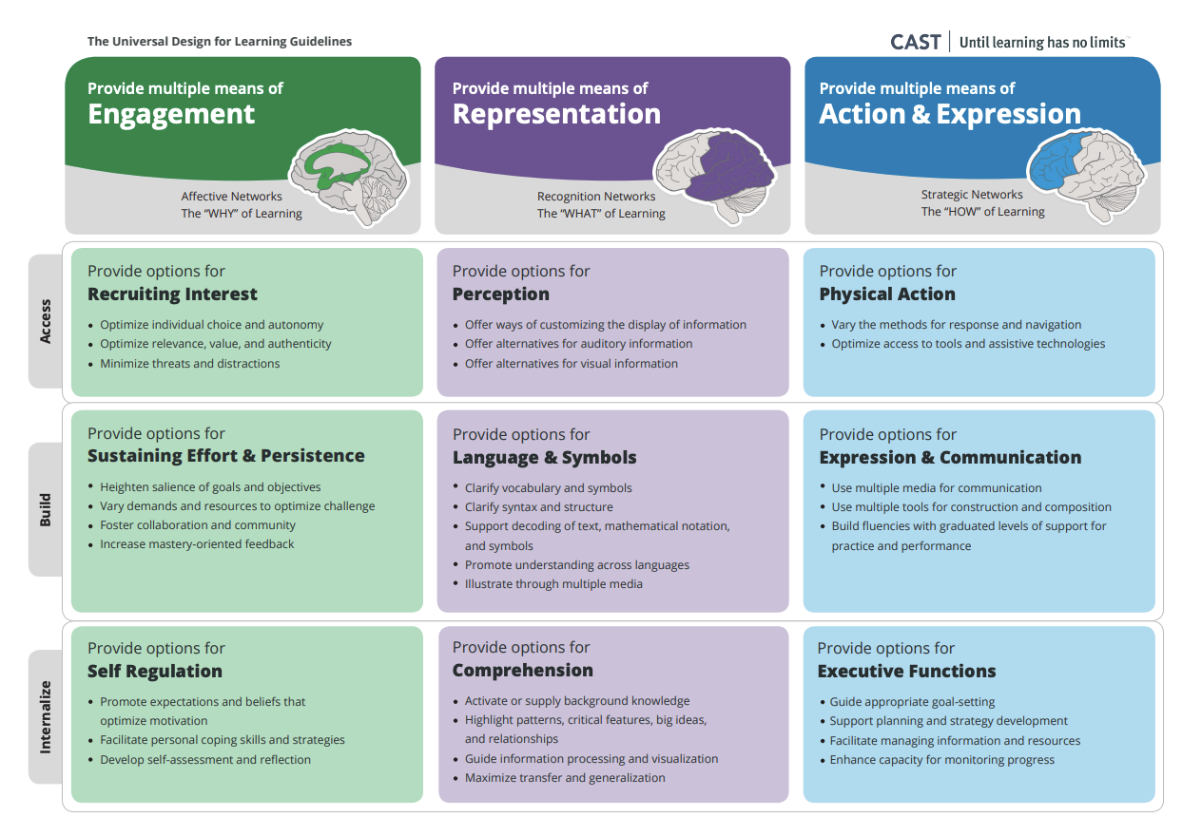
Notes:
Source: https://udlguidelines.cast.org/

Slide 9
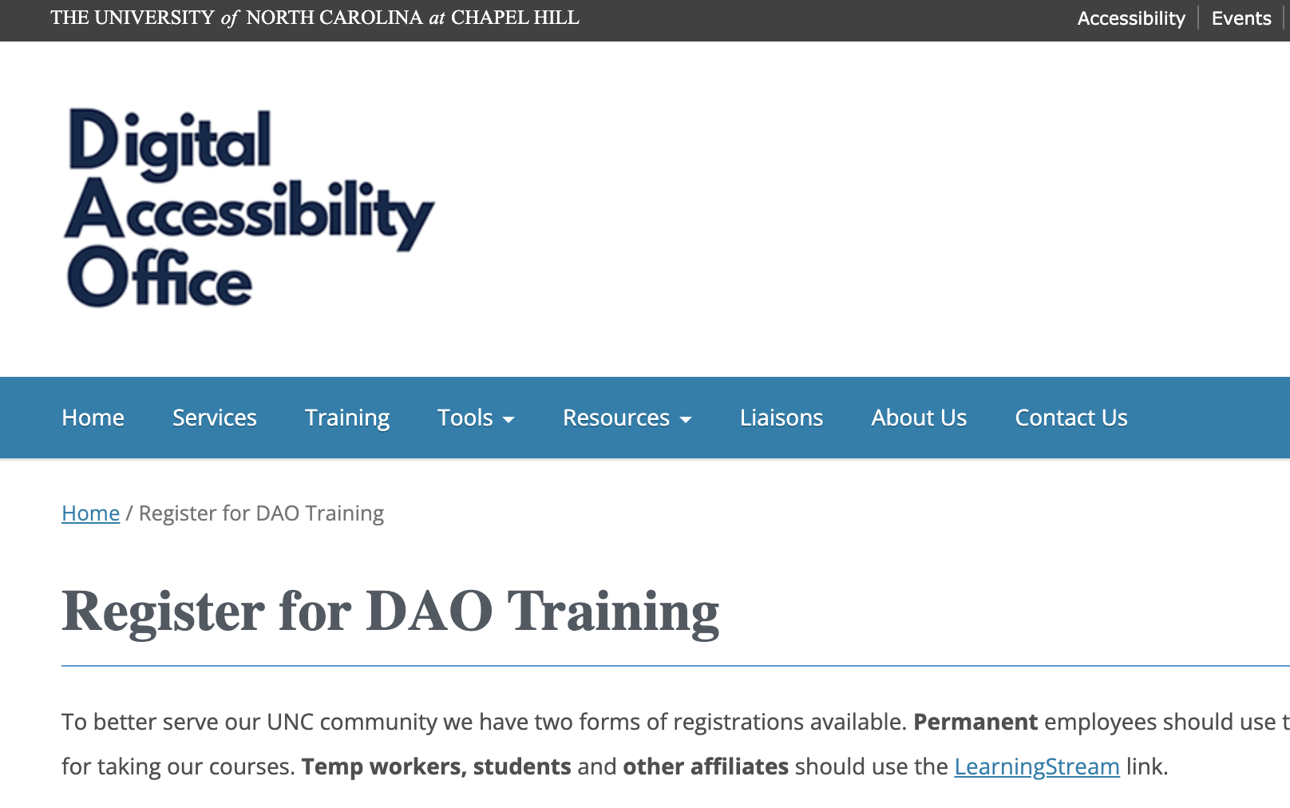
Notes:
Source: https://digitalaccessibility.unc.edu/training/

Slide 10
Key Takeaway #1:
Use Multiple Modalities

Slide 11
Multiple Modalities
Visual, auditory, textual, and kinesthetic
Provides diverse presentations and experience of content for diverse learners
Multiple modalities in a mini-lecture looks like:
Collaborative documents to follow along with and take notes on shared materials
Auditory/textual descriptions of visual content
Visual representations for auditory/textual content
Multiple modalities in a discussion activity looks like:
Assigning roles (recorder, reporter, etc.) within groups
Jigsaw and fishbowl style activities

Slide 12
Key Takeaway #2:
Combine Student Choices with Clear Expectations

Slide 13
Choices + Clear Expectations
Making accessibility structural in a course is about considering it within course policies
Offering students both choices for their learning alongside clear expectations for the course is key
In my classes:
Co-creation of course expectations
Choices for deadlines and assignment lengths
Zoom backup option for in-person classes
Clear policies on late work, attendance, and in-class engagement
Prioritization of communication between students/teacher

Slide 14
Key Takeaway #3:
Ensure Accessible Content

Slide 15
Accessible Content
Headings, consistent layout, default to text, plain language, descriptive link text, color contrast, alt text, captions/transcripts
Canvas
Microsoft Office
PDFs
Video/Audio
Links to readings whenever possible!
Notes:
Source: https://digitalaccessibility.unc.edu/resources/top-10-tips/

Slide 16
Q&A

Slide 17
CARLY SCHNITZLER
(she/her)
cschnitz@live.unc.edu

