Slide 1
Teaching Demonstrations
Faculty Showcase on Teaching | March 24, 2023
Design Sprint

Slide 2
Presenters
FACILITATOR: Doug James, CFE
Kyle McQuillan Innovate Carolina
Elizabeth Stone School of Nursing

Slide 3
Demonstration objectives Participants will be able to:
Describe the design thinking process
Apply the frame your design challenge method to one problem to engage students
Identify at least one design thinking method that they can incorporate into their teaching

Slide 4
Design thinking is…
INTRODUCTION TO design thinking
A human-centered approach
to problem solving and innovation.
IDEO.org, 2015

Slide 5
What does the process look like?
INTRODUCTION TO design thinking
IDEO.org, 2015

Slide 6
Why focus on building design thinking skills?
INTRODUCTION TO design thinking
We want students to:
Develop a deep understanding of the problem and focus on meeting genuine human needs
Create space and time to explore multiple options
Place small bets fast through experimentation using a “prototyping” approach
Emphasize collaboration and diversity

Slide 7
Frame your design challenge
Inspiration method
Think about the design challenge for your project.
What is the specific challenge?
How do you know this is a challenge?
Who else is trying to address this challenge already and how have they tried?

Slide 8
Tips for writing ambitious yet actionable questions
Inspiration method
Questions should be generative (open-ended).
Common question stems include “How might we…?”
Questions should not specify solutions.
Include who you are designing with.
Be specific about what you want to achieve.

Slide 9
Design sprint challenge
Inspiration example
Too broad: How might we better student well-being at UNC?
Too specific: How might we better fourth year nursing students’ well-being as they being searching for a job using existing career support services?
Better: How might we leverage existing and innovative support services to better UNC SON student well-being?
It’s open-ended
Doesn’t specify an exact solution
Includes who we’re designing with/for
Specifies what you want to achieve

Slide 10
Your turn!
Design sprint challenge
In groups of 2-3 try to identify a problem students in your classes may experience and frame it as a design challenge.
Problems should be related to topics students are able to speak about and understand the complexities of.
For example, research questions directly related to course content are likely too broad. Questions related to building study habits, completing course assignments, improving student experience are more accessible.

Slide 11
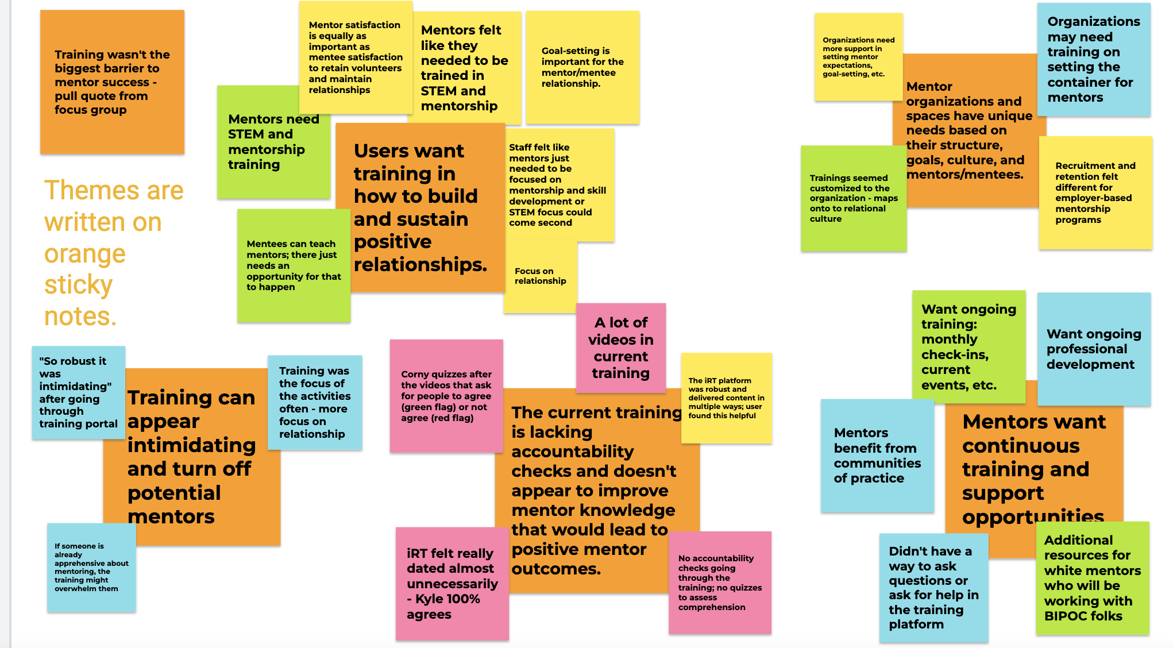
Ideation Method : Brainstorming
IDEATION method
Defer judgment
Encourage wild ideas
Build on the ideas of others
Stay focused on the topic at hand
One conversation at a time
Be visual
Go for quantity

Slide 12
Overall, how might we…
Meaningfully engage students in collaborative, experiential learning meant to strengthen critical thinking and analytical problem solving skills?
Position students as experts to solve problems in their communities?
Leverage empathy and compassion to build classroom community?

Slide 13
References
IDEO.org. (2015). The Field Guide to Human-Centered Design. Retrieved from http://www.designkit.org/resources/1

