Slide 1
Teaching as Performance
Connecting the tools of performance to the tools of effective teaching.
Notes:
My presentation is Teaching as Performance. The idea is that Theater is about communication and so is teaching. I will be focusing on how we communicate so much with our physical presence in the classroom and how tools and techniques in the theater help us engage more successfully with students.

Slide 2
The Stats
Seven Seconds to make an Impression
55 % of first impressions are made by what we see (visual).
38 % is the way we hear your first words (vocal).
7 % percent are the actual words you say (verbal).
--US Chamber of Commerce , Institute of Organization and Management
-Forbes Magazine
Notes:
https://www.forbes.com/sites/carolkinseygoman/2011/02/13/seven-seconds-to-make-a-first-impression/?sh=5cb904c02722
https://institute.uschamber.com/what-makes-a-good-first-impression/#:~:text=We%20have%20all%20heard%20the,words%20you%20say%20(verbal).

Slide 3
Notes:
Embracing the fact that performance is an aspect of teaching Looking at this through the particular lens of theater
Approaching this work through the lens of the theater is capitalizing on the humanity of this art form and aligning it with your humanity as an educator. Theater is about communication and so is teaching This is the tool I'm sharing

Slide 4
Theater is about communication and so is teaching
Notes:
Embracing the fact that performance is an aspect of teaching Looking at this through the particular lens of theater
Approaching this work through the lens of the theater is capitalizing on the humanity of this art form and aligning it with your humanity as an educator. Theater is about communication and so is teaching This is the tool I'm sharing

Slide 5
Theater is about communication and so is teaching
The body is an equal tool to the brain
Notes:
Embracing the fact that performance is an aspect of teaching Looking at this through the particular lens of theater
Approaching this work through the lens of the theater is capitalizing on the humanity of this art form and aligning it with your humanity as an educator. Theater is about communication and so is teaching This is the tool I'm sharing

Slide 6
Theater is about communication and so is teaching
The body is an equal tool to the brain
Yes, it is performance, but the purpose is education​
Notes:
Embracing the fact that performance is an aspect of teaching Looking at this through the particular lens of theater
Approaching this work through the lens of the theater is capitalizing on the humanity of this art form and aligning it with your humanity as an educator. Theater is about communication and so is teaching This is the tool I'm sharing

Slide 7
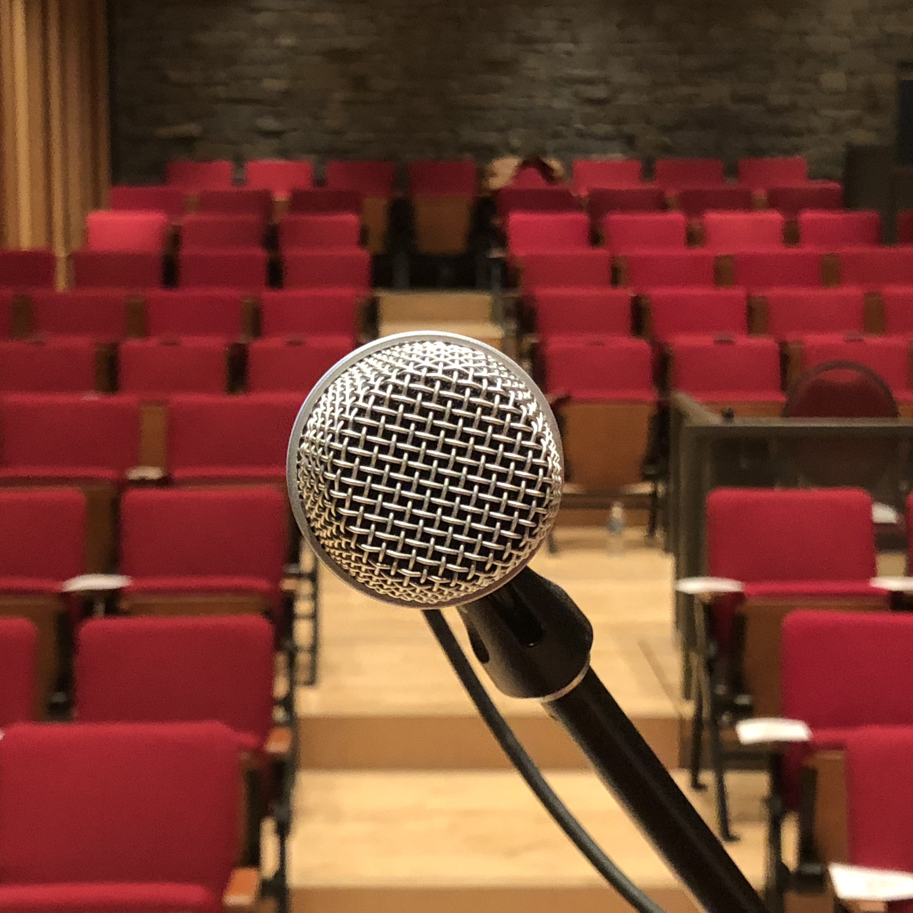
Why it's more than public speaking
Notes:
Approaching this work through the lens of the theater is capitalizing on the humanity of this art form and aligning it with your humanity as an educator.
the your body align with
We bring the human element
Beyond public speaking or
Feels sterile
A veneer

Slide 8
Not About Faking it
Not about fooling your class or playing a role or becoming a character
Acting is about striping away, not putting something on.
Notes:
The assumption is that acting and theater is about pretending to be something you are not. When in fact, Its about behaving truthfully under imaginary circumstances. We are just replacing the imaginary circumstance with the class room. It is still about behaving truthfully
Bringing out a different mode
Not about fooling your class or playing a role or becoming a character
INSTEAD It’s about becoming your most authentic self that is open and vulnerable so you are vibrantly alive in front of your students. Isnt that who you want to learn from?
INSTEAD its about discovering what your intentions (Objective) is and then aligning those intentions/objectives with your non verbal visual language.
Acting is about striping away, not putting somethng on.
An Actors tell

Slide 9
What makes a good Actor makes a good Teacher
Notes:
Example If they were moving from thie r own power and not putting on airs then we do buy them as a queen
Body + Voice + Breath = Delivery
ASK YOURSELF:
Am I clear?
Am I getting a response?
Am I speaking with aliveness

Slide 10
What makes a good Actor makes a good Teacher
Grounded in your body​
Notes:
Example If they were moving from thie r own power and not putting on airs then we do buy them as a queen
Body + Voice + Breath = Delivery
ASK YOURSELF:
Am I clear?
Am I getting a response?
Am I speaking with aliveness

Slide 11
What makes a good Actor makes a good Teacher
Grounded in your body​
Clarity of thought​
Notes:
Example If they were moving from thie r own power and not putting on airs then we do buy them as a queen
Body + Voice + Breath = Delivery
ASK YOURSELF:
Am I clear?
Am I getting a response?
Am I speaking with aliveness

Slide 12
What makes a good Actor makes a good Teacher
Grounded in your body​
Clarity of thought​
Variety of voice and gesture​
Notes:
Example If they were moving from thie r own power and not putting on airs then we do buy them as a queen
Body + Voice + Breath = Delivery
ASK YOURSELF:
Am I clear?
Am I getting a response?
Am I speaking with aliveness

Slide 13
What makes a good Actor makes a good Teacher
Grounded in your body​
Clarity of thought​
Variety of voice and gesture​
Connecting with your audience​
Notes:
Example If they were moving from thie r own power and not putting on airs then we do buy them as a queen
Body + Voice + Breath = Delivery
ASK YOURSELF:
Am I clear?
Am I getting a response?
Am I speaking with aliveness

Slide 14
What makes a good Actor makes a good Teacher
Grounded in your body​
Clarity of thought​
Variety of voice and gesture​
Connecting with your audience​
Landing information​
Notes:
Example If they were moving from thie r own power and not putting on airs then we do buy them as a queen
Body + Voice + Breath = Delivery
ASK YOURSELF:
Am I clear?
Am I getting a response?
Am I speaking with aliveness

Slide 15
Let's get up!
Notes:
Physical life congruent with your teaching objectives.
Knowing what you look like is half the battle

Slide 16
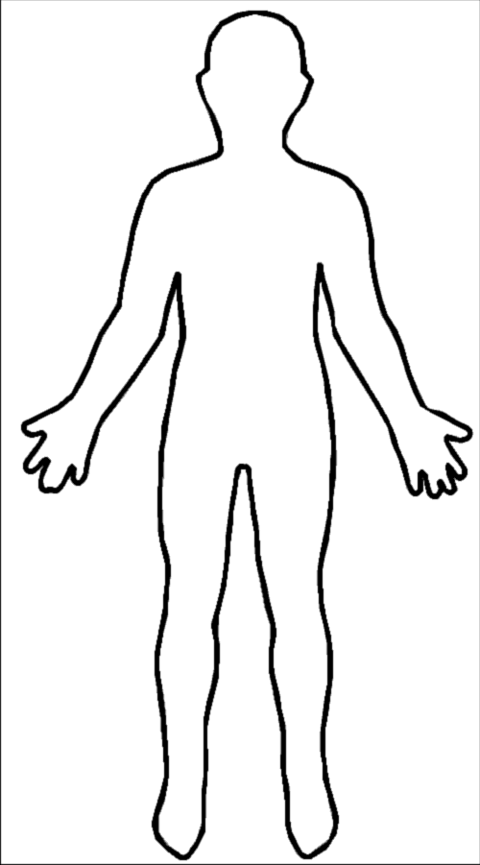
The Check in
Head on top of your shoulders
Root your feet
Hips tucked and under shoulders
Feet shoulder width apart
Move your weight slightly towards your toes
Hands loosely at your sides

Slide 17
The Check in
Open palm
No pointer finger
Take up the space if you have it
Arms extended
One arm gesture
No self touch
Variety in gesture

Slide 18
Ask yourself three questions

Slide 19
Ask yourself three questions
Am I clear ?

Slide 20
Ask yourself three questions
Am I clear ?
Am I getting a Response?

Slide 21
Ask yourself three questions
Am I clear ?
Am I getting a Response?
Am I speaking with aliveness?

Slide 22
Activity
Pair up with someone near you
While maintaining this level of rooted and aliveness in your body, tell your partner a few sentences about what you are teaching this semester.

Slide 23
How'd it go?

Slide 24
Questions?

Slide 25
Thank you!
Asnowden@email.unc.edu
Aubrey.snowden@gmail.com

