Slide 1
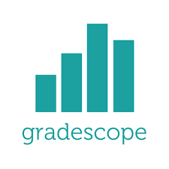
Using Gradescope in Canvas
UNC Faculty Showcase on Teaching 2023
Kalina Staub
Teaching Associate Professor in Economics

Slide 2
Show of Hands
Raise your hand if you have NOT used Gradescope before.

Slide 3
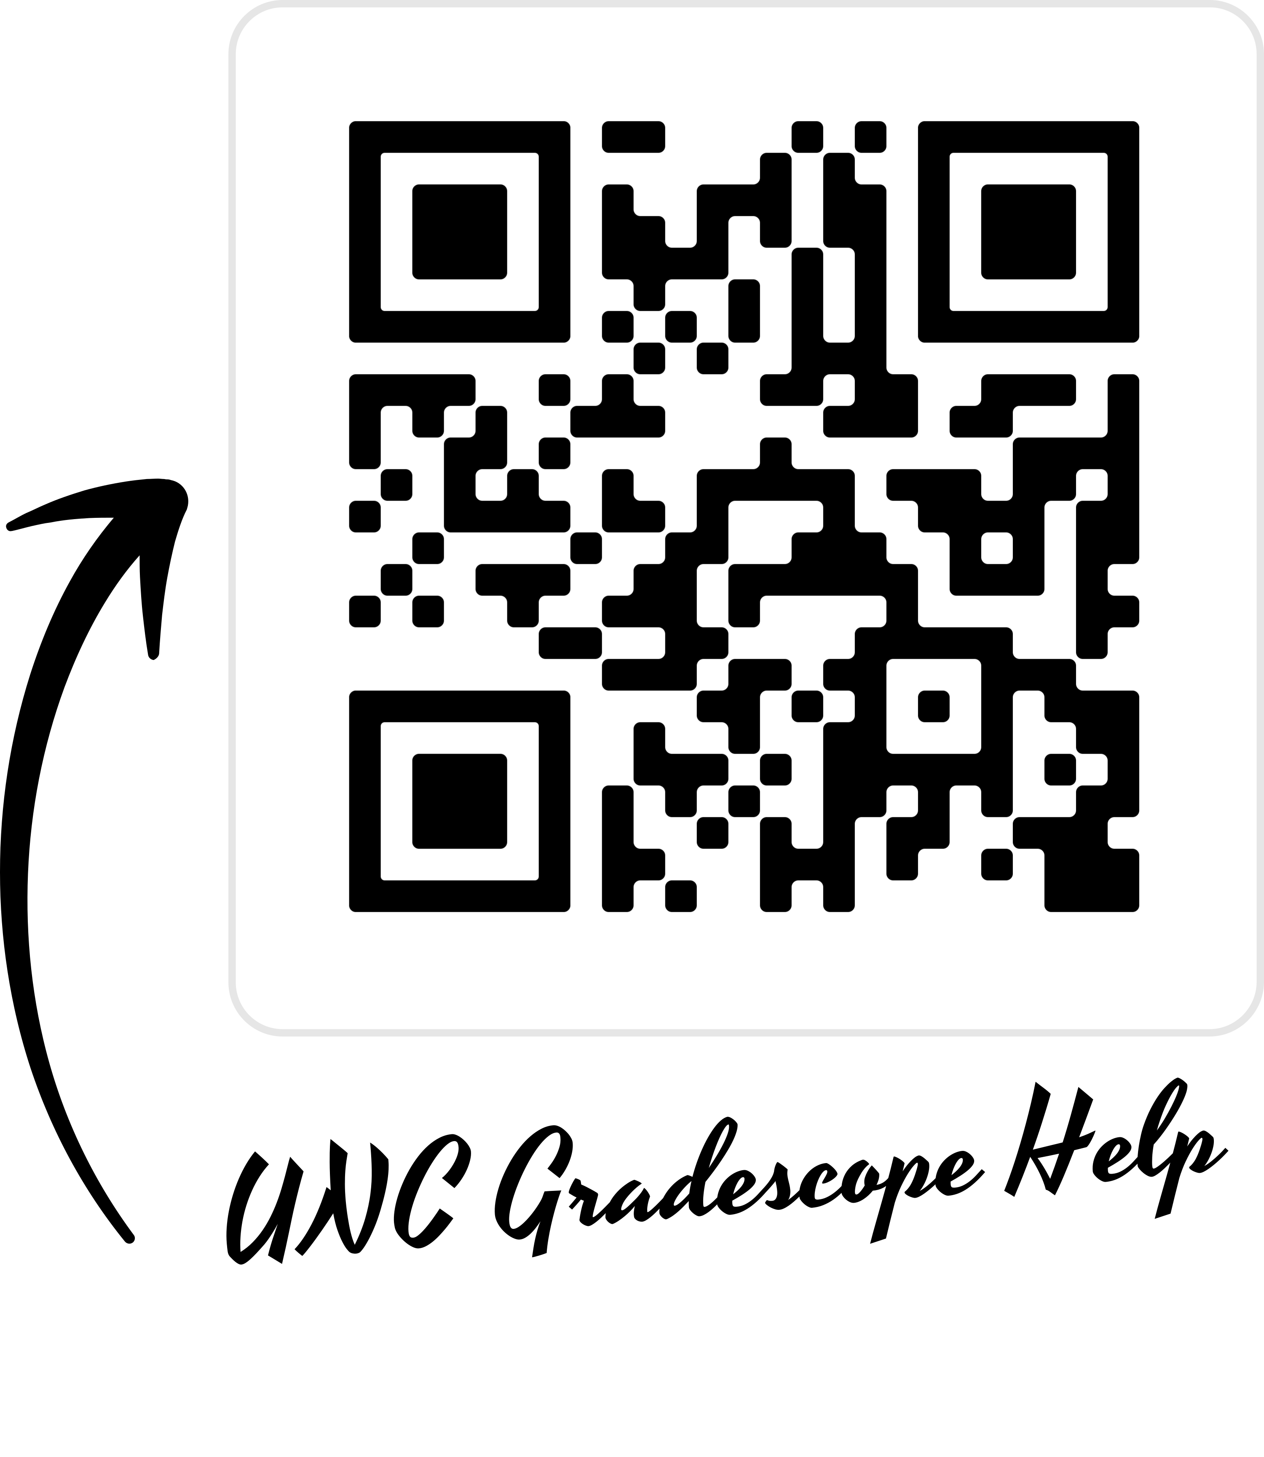
What is Gradescope?
Online grading tool that supports multiple choice bubble sheet assignments, online assignments with multiple question types, programming assignments, instructor-uploaded (exam) or student-uploaded (homework) written assignments.
Allows blind grading to reduce bias
Assignments can be graded question by question with a flexible rubric
Can comment and annotate assignments and re-apply the same comments to different submissions.
Many people (TAs or co-instructors) can grade at once

Slide 4
Show of Hands
Raise your hand if you have NOT used Gradescope in Canvas

Slide 5
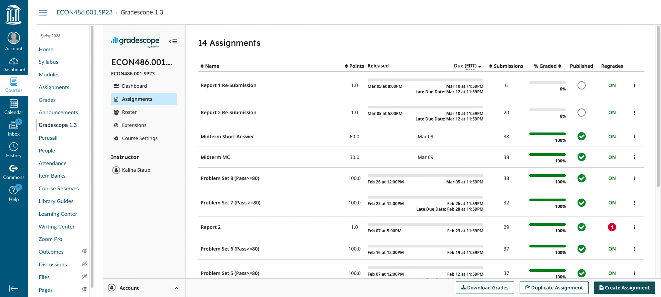
What are the benefits to using Gradescope in Canvas?
Gradescope automatically integrates with Canvas
Notes:
Easy to use for both Instructors and Students
Much more intuitive integration than the integration with Sakai

Slide 6
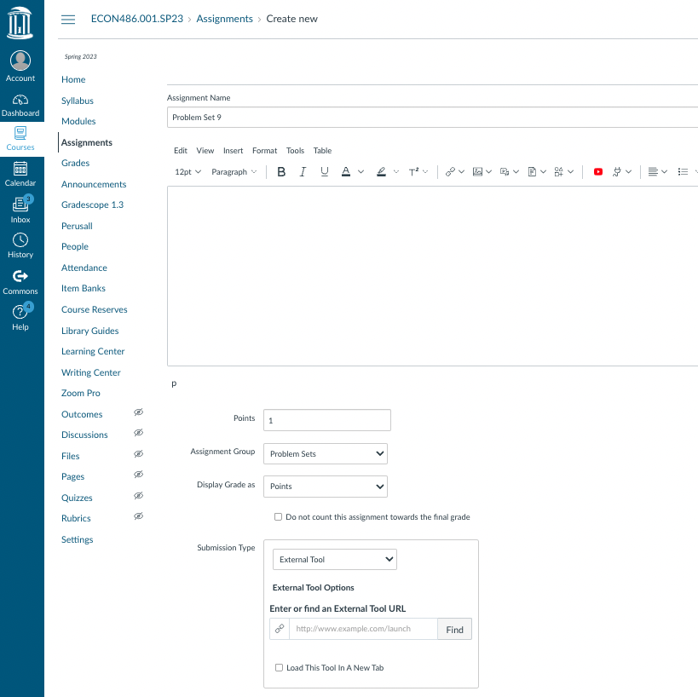
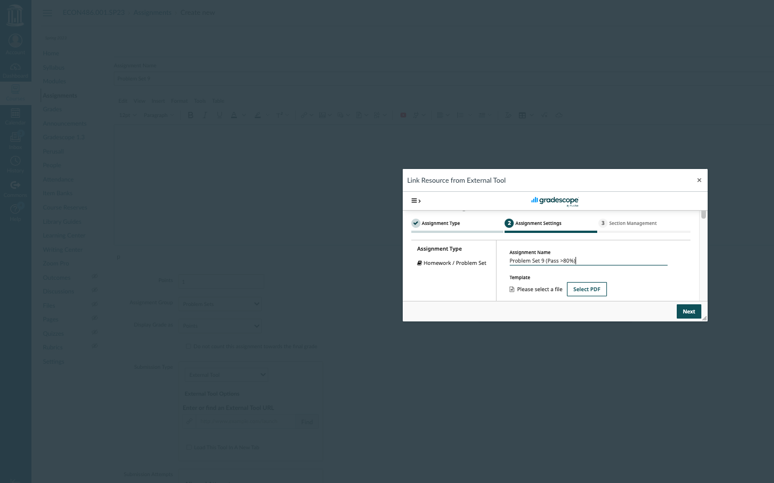
What are the benefits to using Gradescope in Canvas?
Create assignments in Canvas and link them with a new or existing Gradescope assignment
Notes:
When students click on the created assignment, they will be taken to Gradescope to submit.

Slide 7
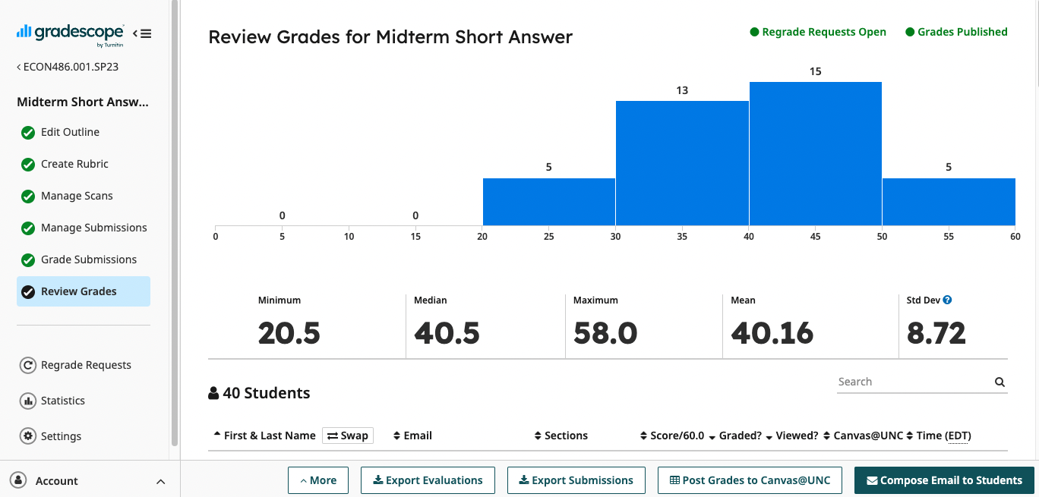
What are the benefits to using Gradescope in Canvas?
Gradescope grades sync seamlessly with Canvas Gradebook
Notes:
Once you have finished grading and published grades, you just click one button to post grades to Canvas.

