Slide 1
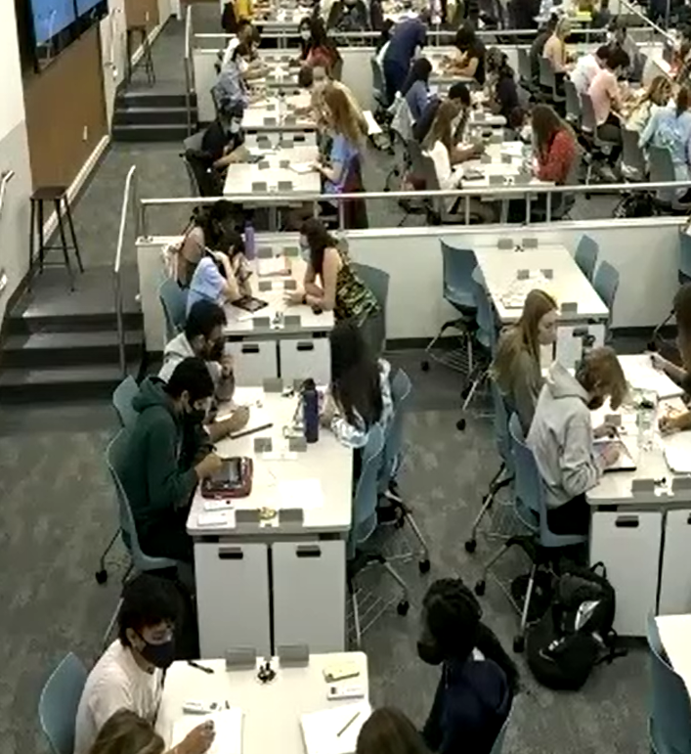
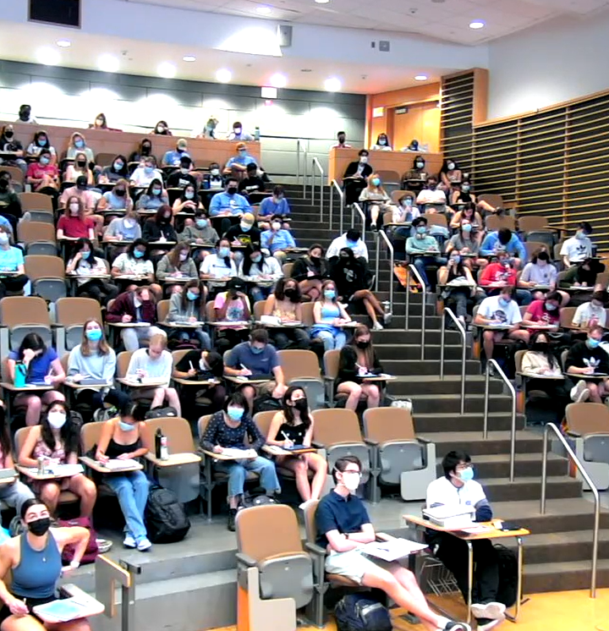
The Effectiveness of Undergraduate Learning Assistants in Large-Enrollment Courses Across Different Learning Spaces
Danielle Zurcher, Chemistry
Anna Curtis, Chemistry

Slide 2
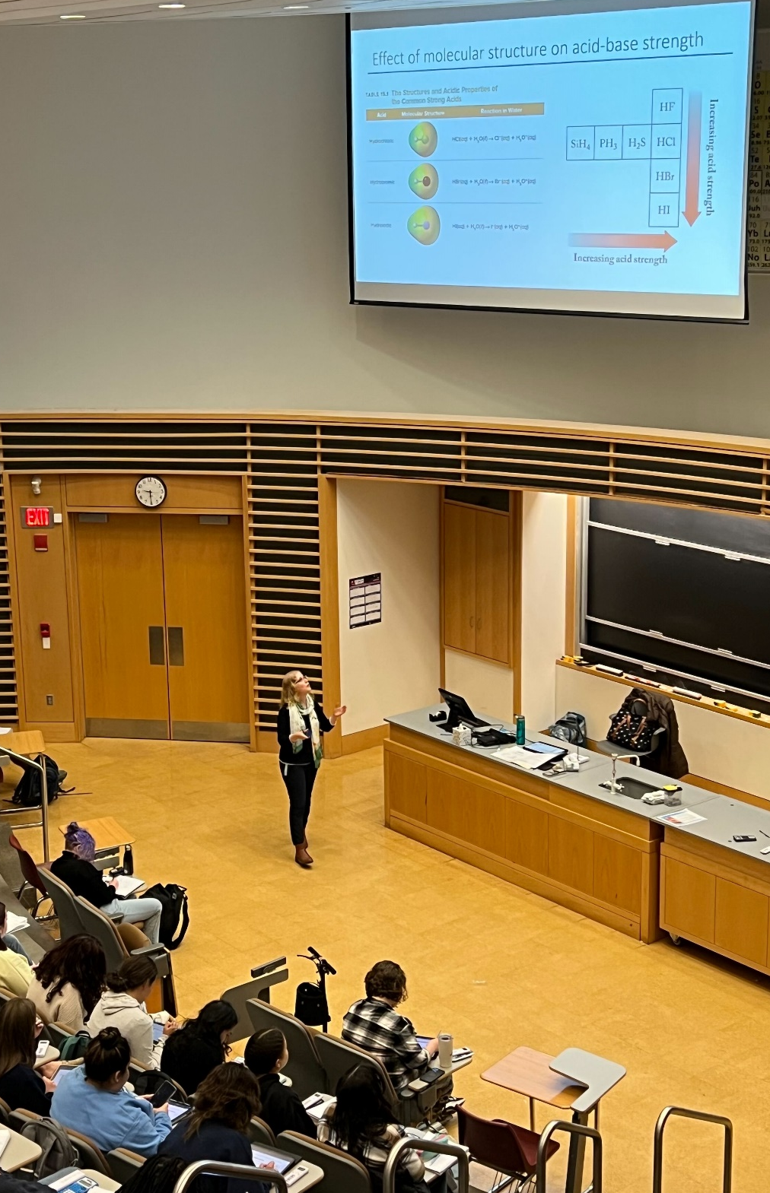
Background: Chemistry Course Structure
Class sizes 200-400 students per section
Introductory chemistry courses have a standardized curriculum
Introductory chemistry courses are taught using high structure active learning techniques
Undergraduate Learning Assistants (ULAs) have been utilized in introductory large chemistry courses since 2015
This Photo by Unknown Author is licensed under CC BY-SA-NC

Slide 3
Background: Chemistry Course Structure
Before Class
In Class
After Class
Assigned readings and assignment
Problem posed
Whole class debrief
Set up next problem (mini lecture if needed)
Time to solve individually
Group based discussion
assignment due weekly
ULAs most active here
This Photo by Unknown Author is licensed under CC BY-SA-NC

Slide 4
Study Goal: Assess how ULA-student interactions during class are influenced by classroom design
This Photo by Unknown Author is licensed under CC BY-SA-NC
Notes:
Can we make ULAs more effective by changing the classroom space

Slide 5
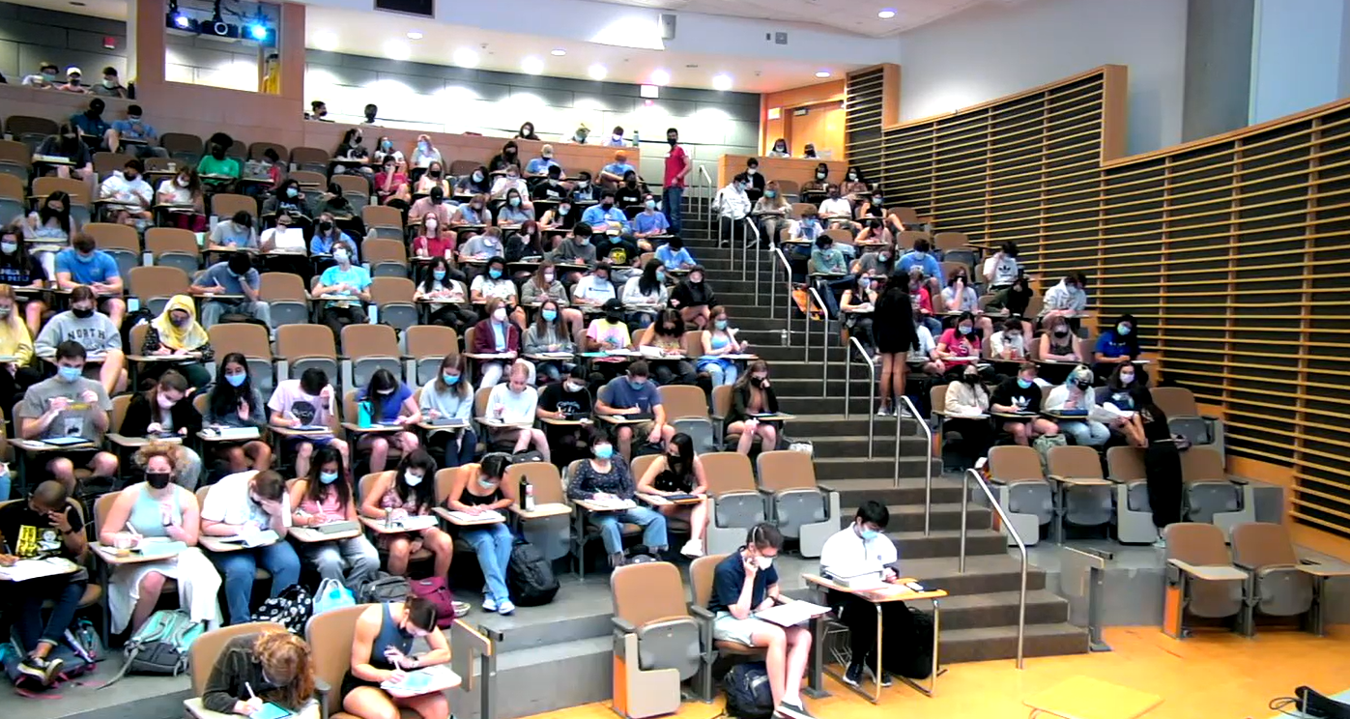
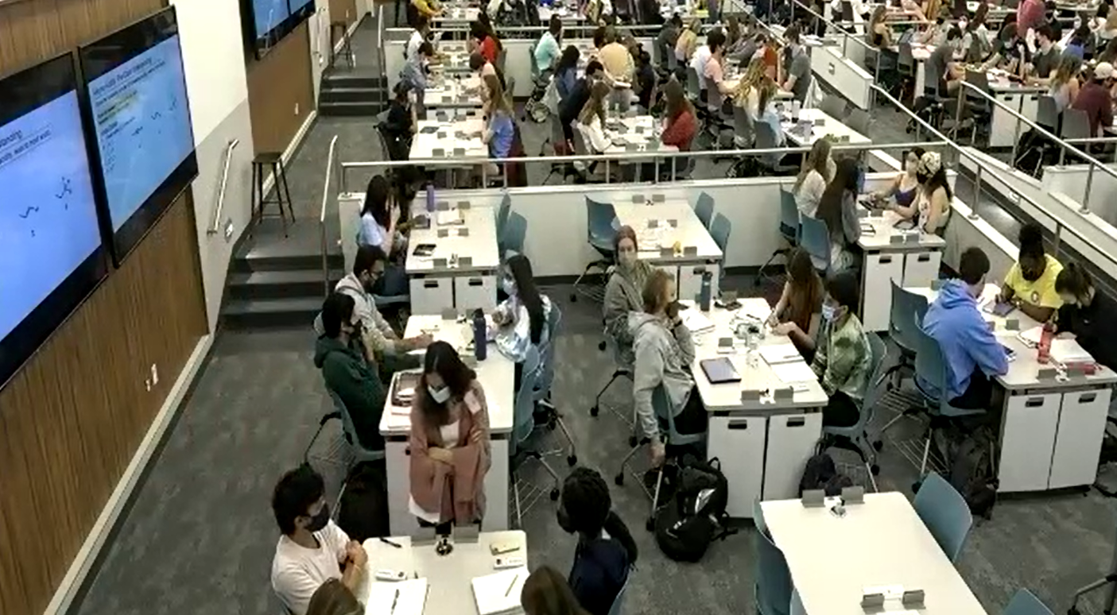
Different Learning Spaces for Large Lectures on Campus
Murray G202
Carroll 111
traditional stadium seating
tables of four
Photos from Spring 2022 CHEM 261 Courses
This Photo by Unknown Author is licensed under CC BY-SA-NC

Slide 6
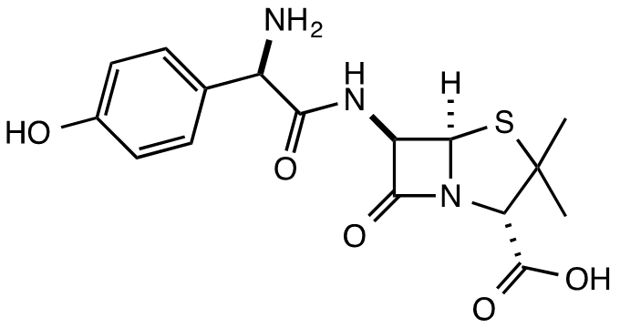
Full Study Carried out in Fall 2022
Pilot Study in Spring 2022 which we redesigned before implementing in Fall 2022
​Fall 2022​ Study
Two sections of CHEM 261: Organic Chemistry I ​
Instructor the same for both ​
One section taught in Carroll 111 (205 students)
One section taught in Murray G202 (227 students)
9 learning assistants in each classroom (18 total)
This Photo by Unknown Author is licensed under CC BY-SA-NC

Slide 7
Study Design: A Mixed Method Approach
Student Perception Survey
ULA Perception Survey
ULA focus group
Observe/Record ULA-student interactions
ULAs record interaction context
IRB: 21-3323
This Photo by Unknown Author is licensed under CC BY-SA-NC

Slide 8
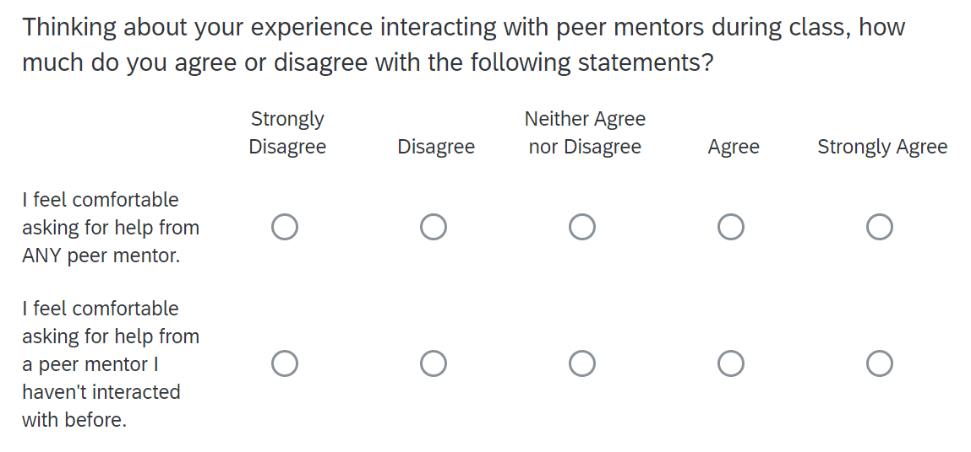
Student Perception Survey
Administered on the last day of the semester in class
Collected student responses to
Statements using a Likert scale
Open-ended questions
Demographic questions
*Note ULAs were referred to as peer mentors during Spring 2022
Notes:
Included questions about the classroom space not just about ULAs as part of a larger study on effectiveness of classroom design

Slide 9
Classroom design makes a difference!
 | CA 111 | MY G202
Based on where I usually sit during class, it is easy for ULAs to access my area and work with me. (5 = very easy) | 4.37 N = 160 | 3.82 N = 186
*Significant difference based on independent t-test (p < 0.001)
Notes:
Response rate > 80%
Significant difference based on independent t-test (p < 0.001)

Slide 10
Next Steps
Present at
Tomorrow’s Panel “Peer to Peer: Supporting Student Learning with Undergraduate Learning Assistants” (Presenter: Carribeth Bliem)
UNC System Learning and Technology Symposium (April 2023)
In-depth data analysis and discussion
(Townsend Fellowship, Summer 2023)
Future publication

Slide 11
Acknowledgements
Carribeth Bliem, Chemistry
Viji Sathy, Director, Townsend Program for Education Research.
Bob Henshaw, UNC Center for Faculty Excellence

