Slide 1
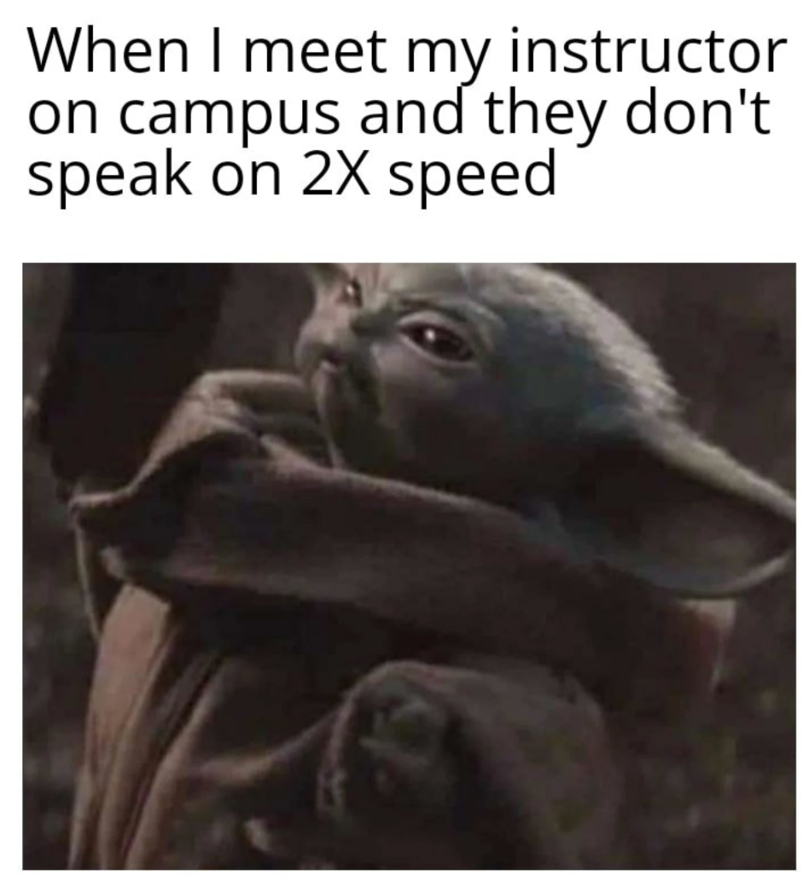
Using Panopto Quizzes as Real-Time “Accountability Buddies”
Lillian Zwemer, PhD (she/her) Teaching Assistant Professor
Biology Department at UNC Chapel Hill

Slide 2
Strategy 1: Using Quizzes to Give Students real-time feedback on their facility with content or skills

Slide 3
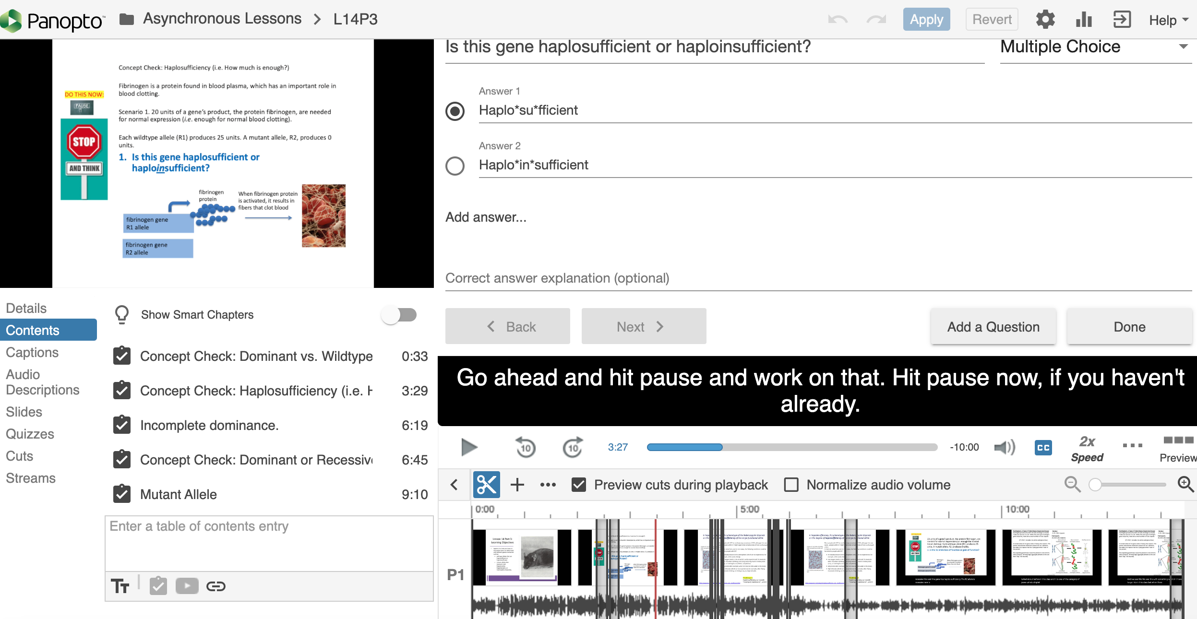
Strategy 1: Using Quizzes to Give Students real-time feedback on their facility with content or skills

Slide 4
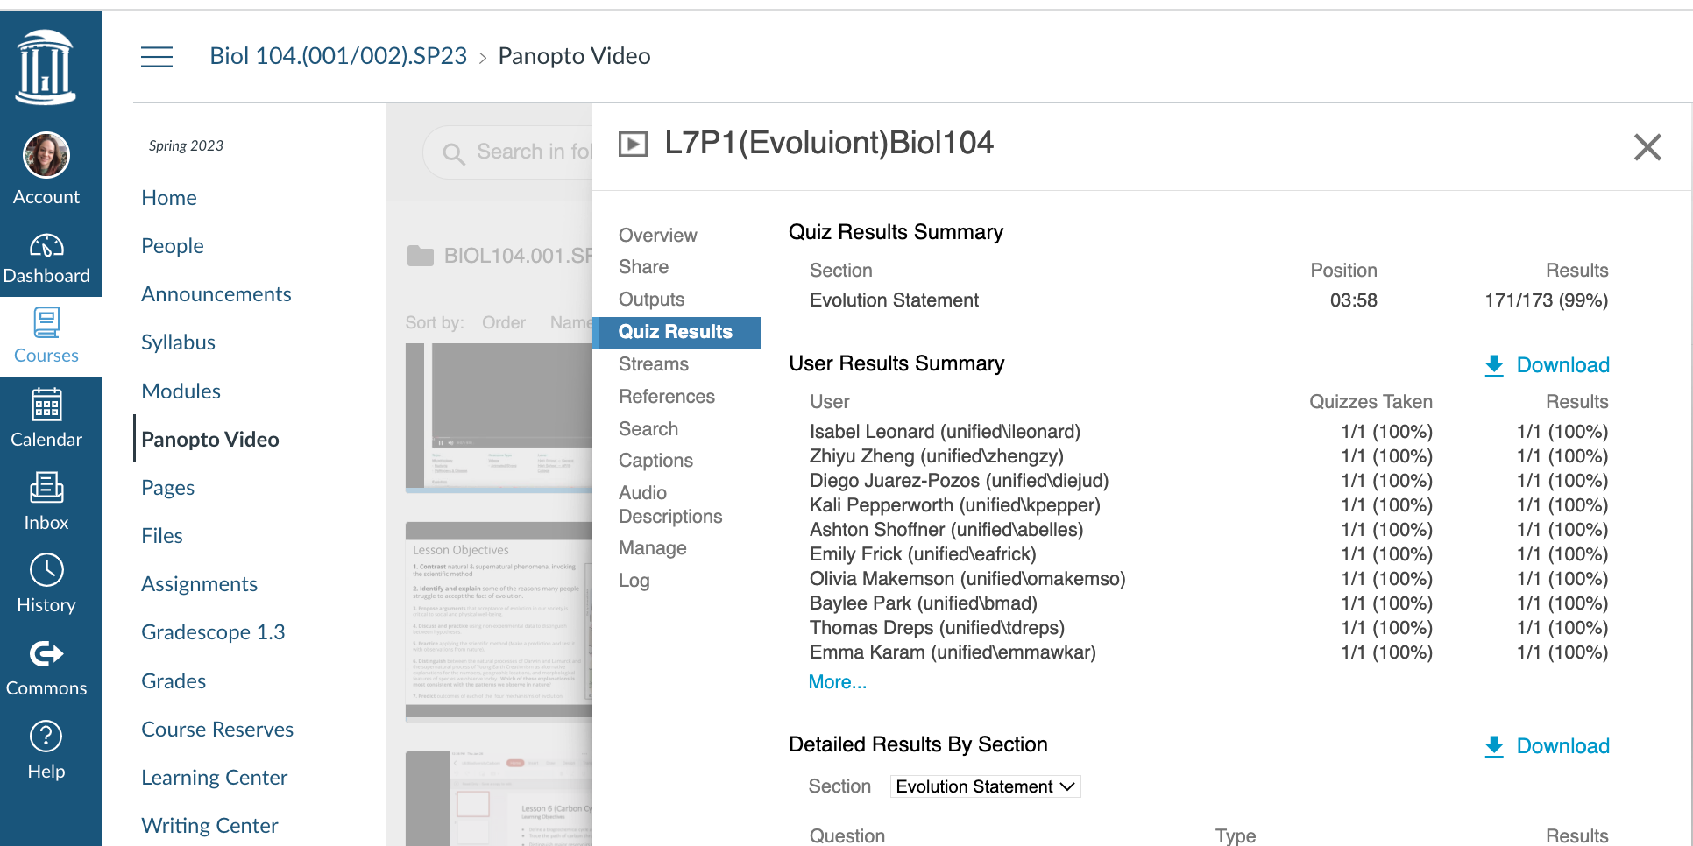
Strategy 1: Using Quizzes to Give Students real-time feedback on their facility with content or skills
Logistics: Want to See Results?
Video > Settings (Gear) > Quiz Results
From this tab, you can see Quiz Results Summary which shows the total number of correct answers and questions as well as the percentage correct for each quiz.
(student names covered for privacy)

Slide 5
Motivating Concern: Passive “Learning” for Asynchronous Lessons

Slide 6
Motivating Concern: Passive “Learning” for Asynchronous Lessons
Symptom of a larger issue: Misconception that education is a consumer product …

Slide 7
Motivating Concern: Passive “Learning” for Asynchronous Lessons
Symptom of a larger issue: Misconception that education is a consumer product…
…rather than
a collaborative creation for which they themselves are primarily responsible
“It is my job to teach, but it is your job to learn”

Slide 8
Motivating Concern: Passive “Learning” for Asynchronous Lessons
How can I combat this cultural misconception and continuously promote more realistic expectations around learning?
How can I help my students increase their self-awareness as learners?
What will motivate my students to fully engage, rather than “multitask”?

Slide 9
Watching the video = Learning
?

Slide 10
Watching the video = Learning
?

Slide 11
Watching the video = Learning
?

Slide 13
Strategy 2: Using Quizzes to nudge or re-norm behavior related to independent active learning
Dr. Z: Hit pause now on your video, so you can go ahead and do both of those things
Dr. Z: hopefully, you have paused.

Slide 14
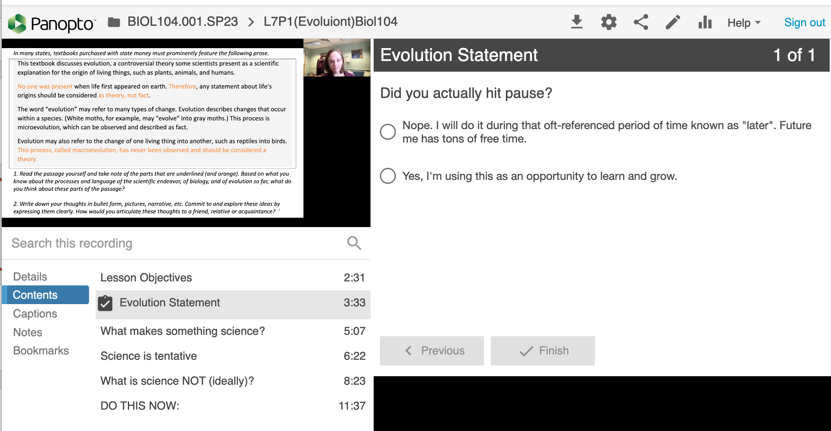
Strategy 2: Using Quizzes to nudge or re-norm behavior related to independent active learning (like a rumble strip on the highway for student who “fall asleep at the wheel”)

Slide 15
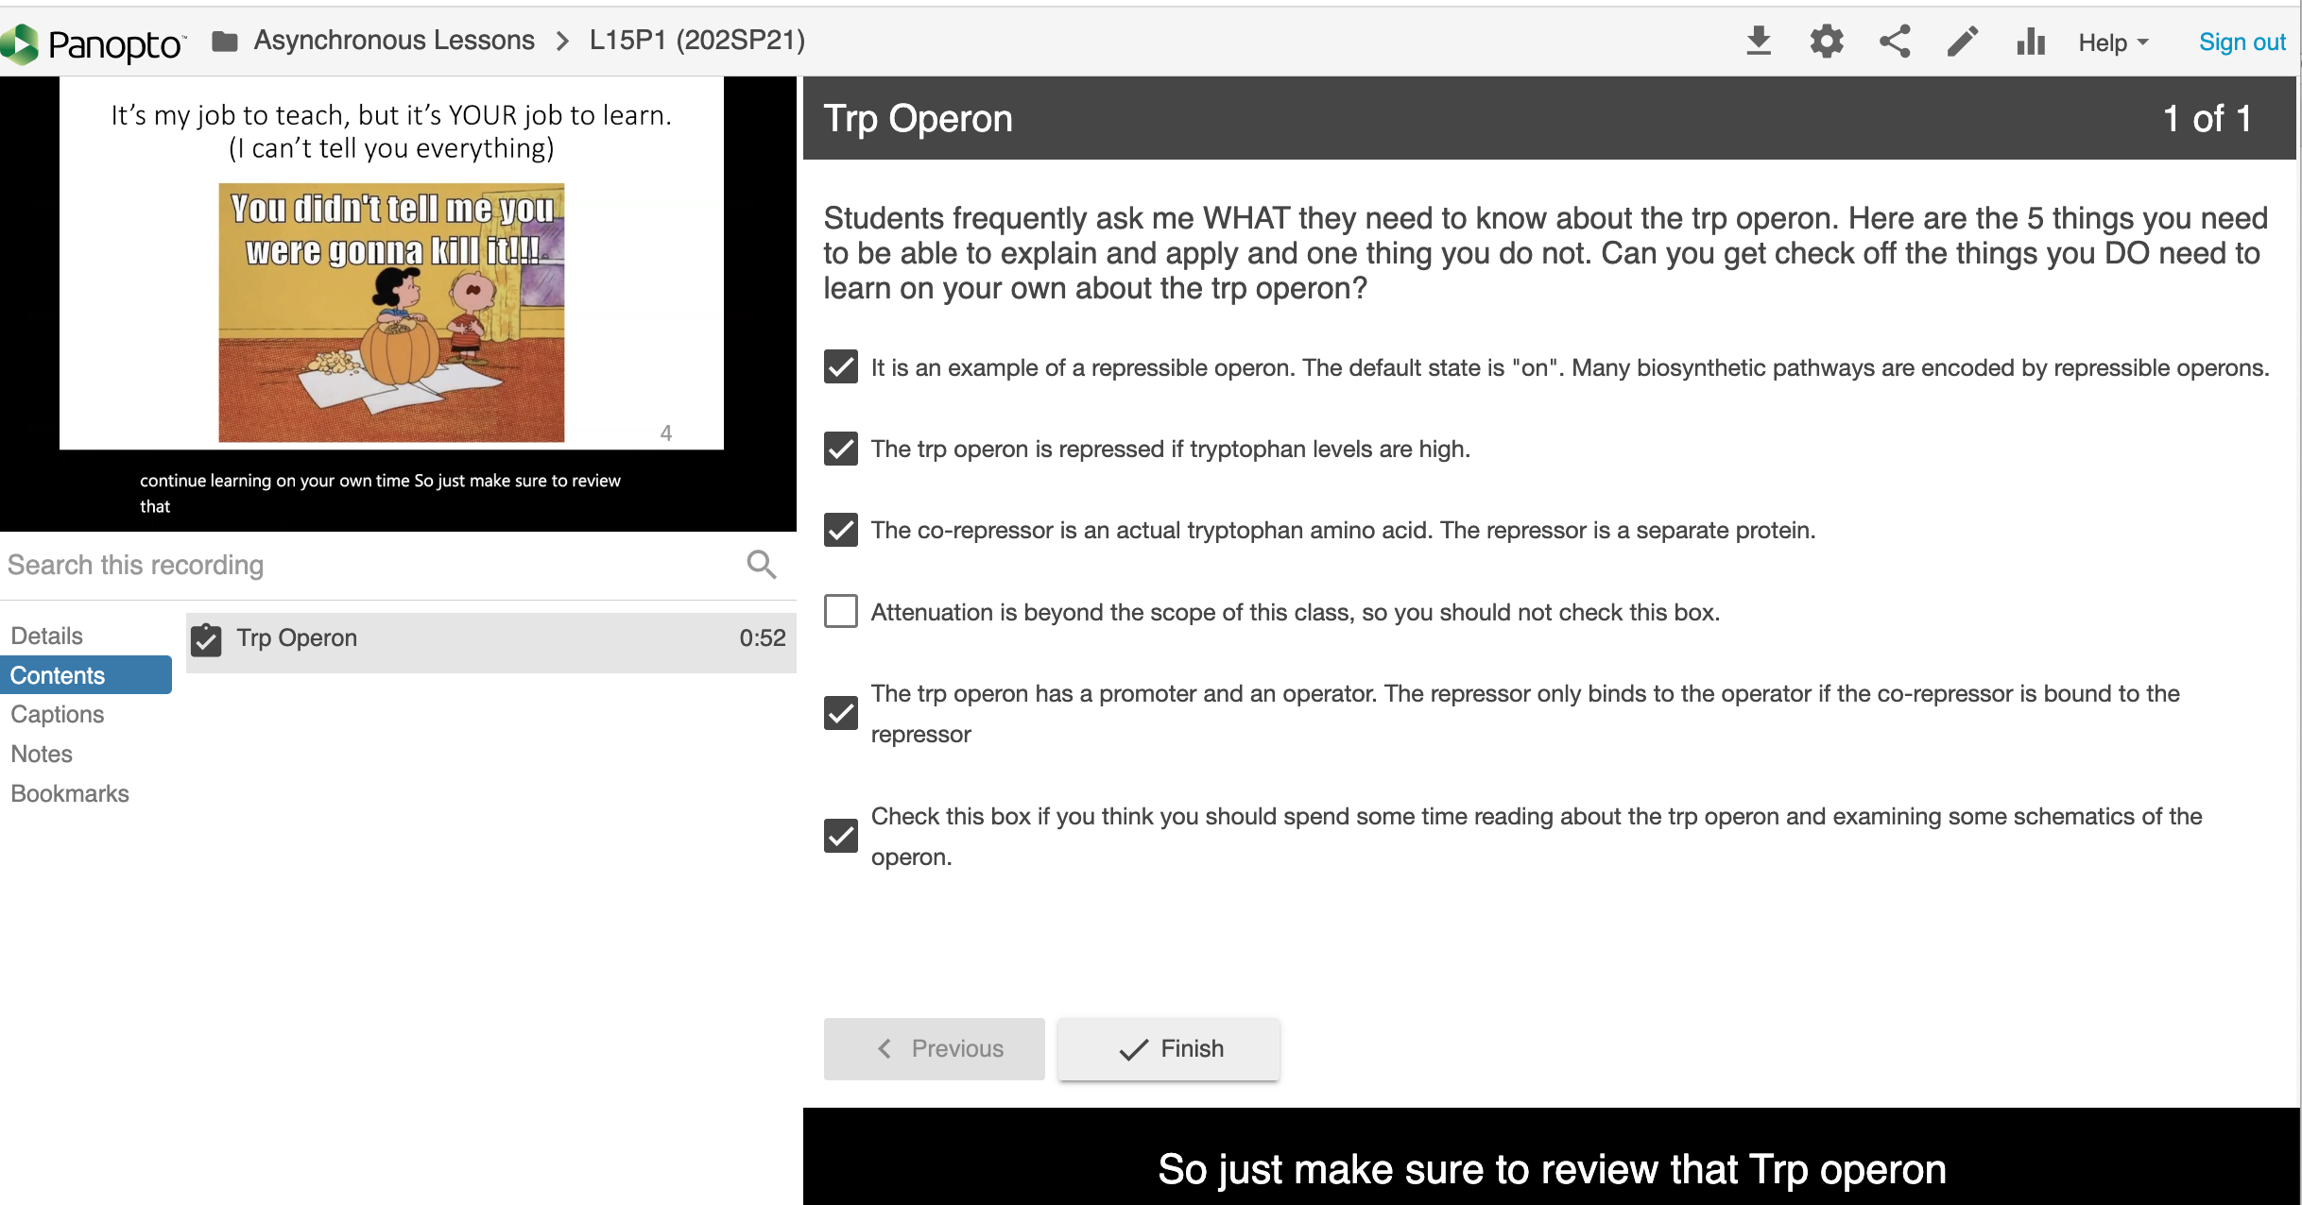
Strategy 3: Using Quizzes to Answer Content FAQs

Slide 16
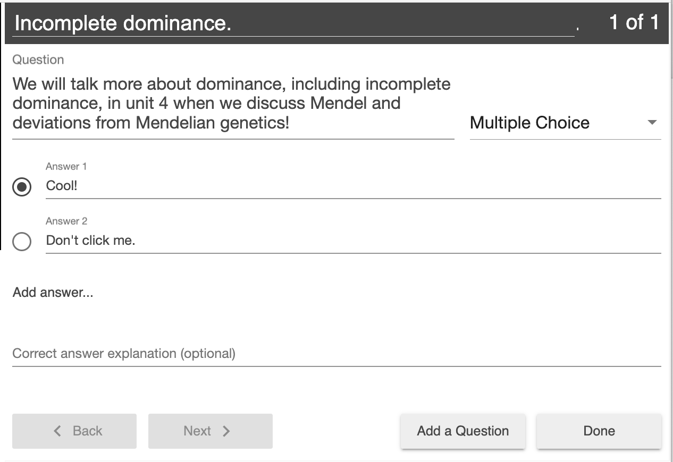
Strategy 4: Using Quizzes to add comments connecting content across lectures

Slide 17
Strategy 5: Using Quizzes to fix errors or add nuanced details

Slide 18
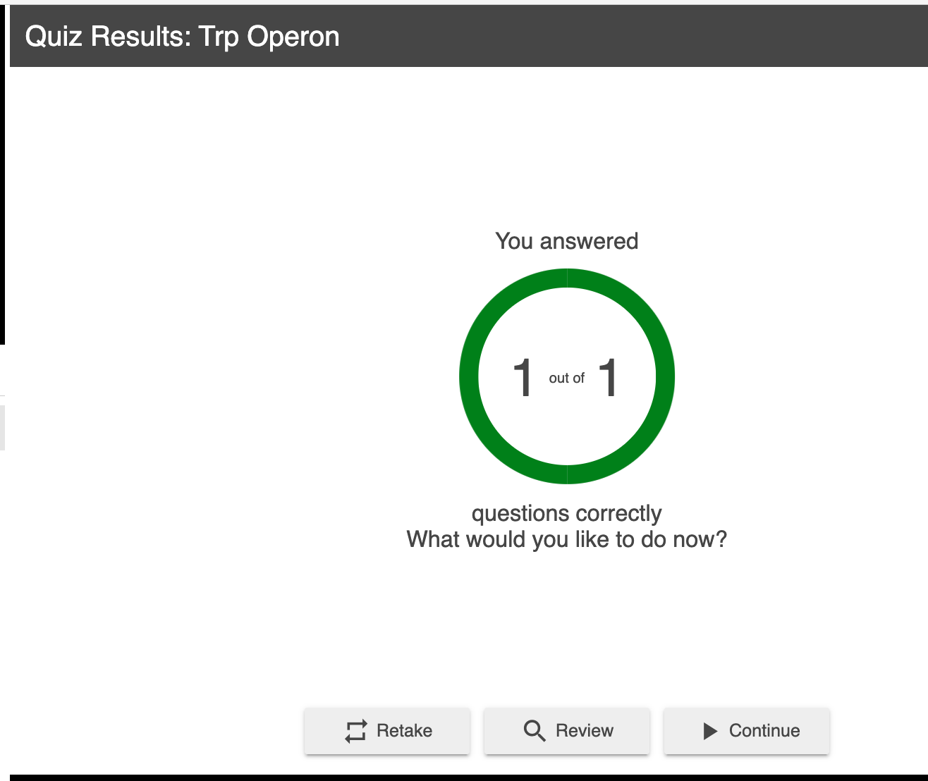
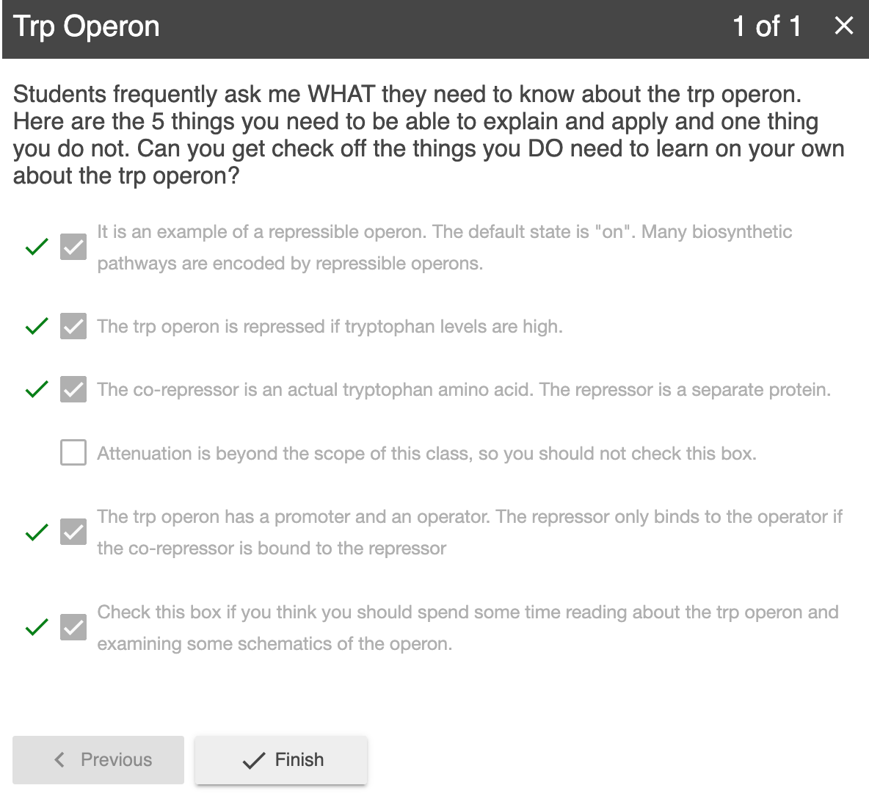
Logistics: (Re)-interacting with Quiz Content

Slide 19
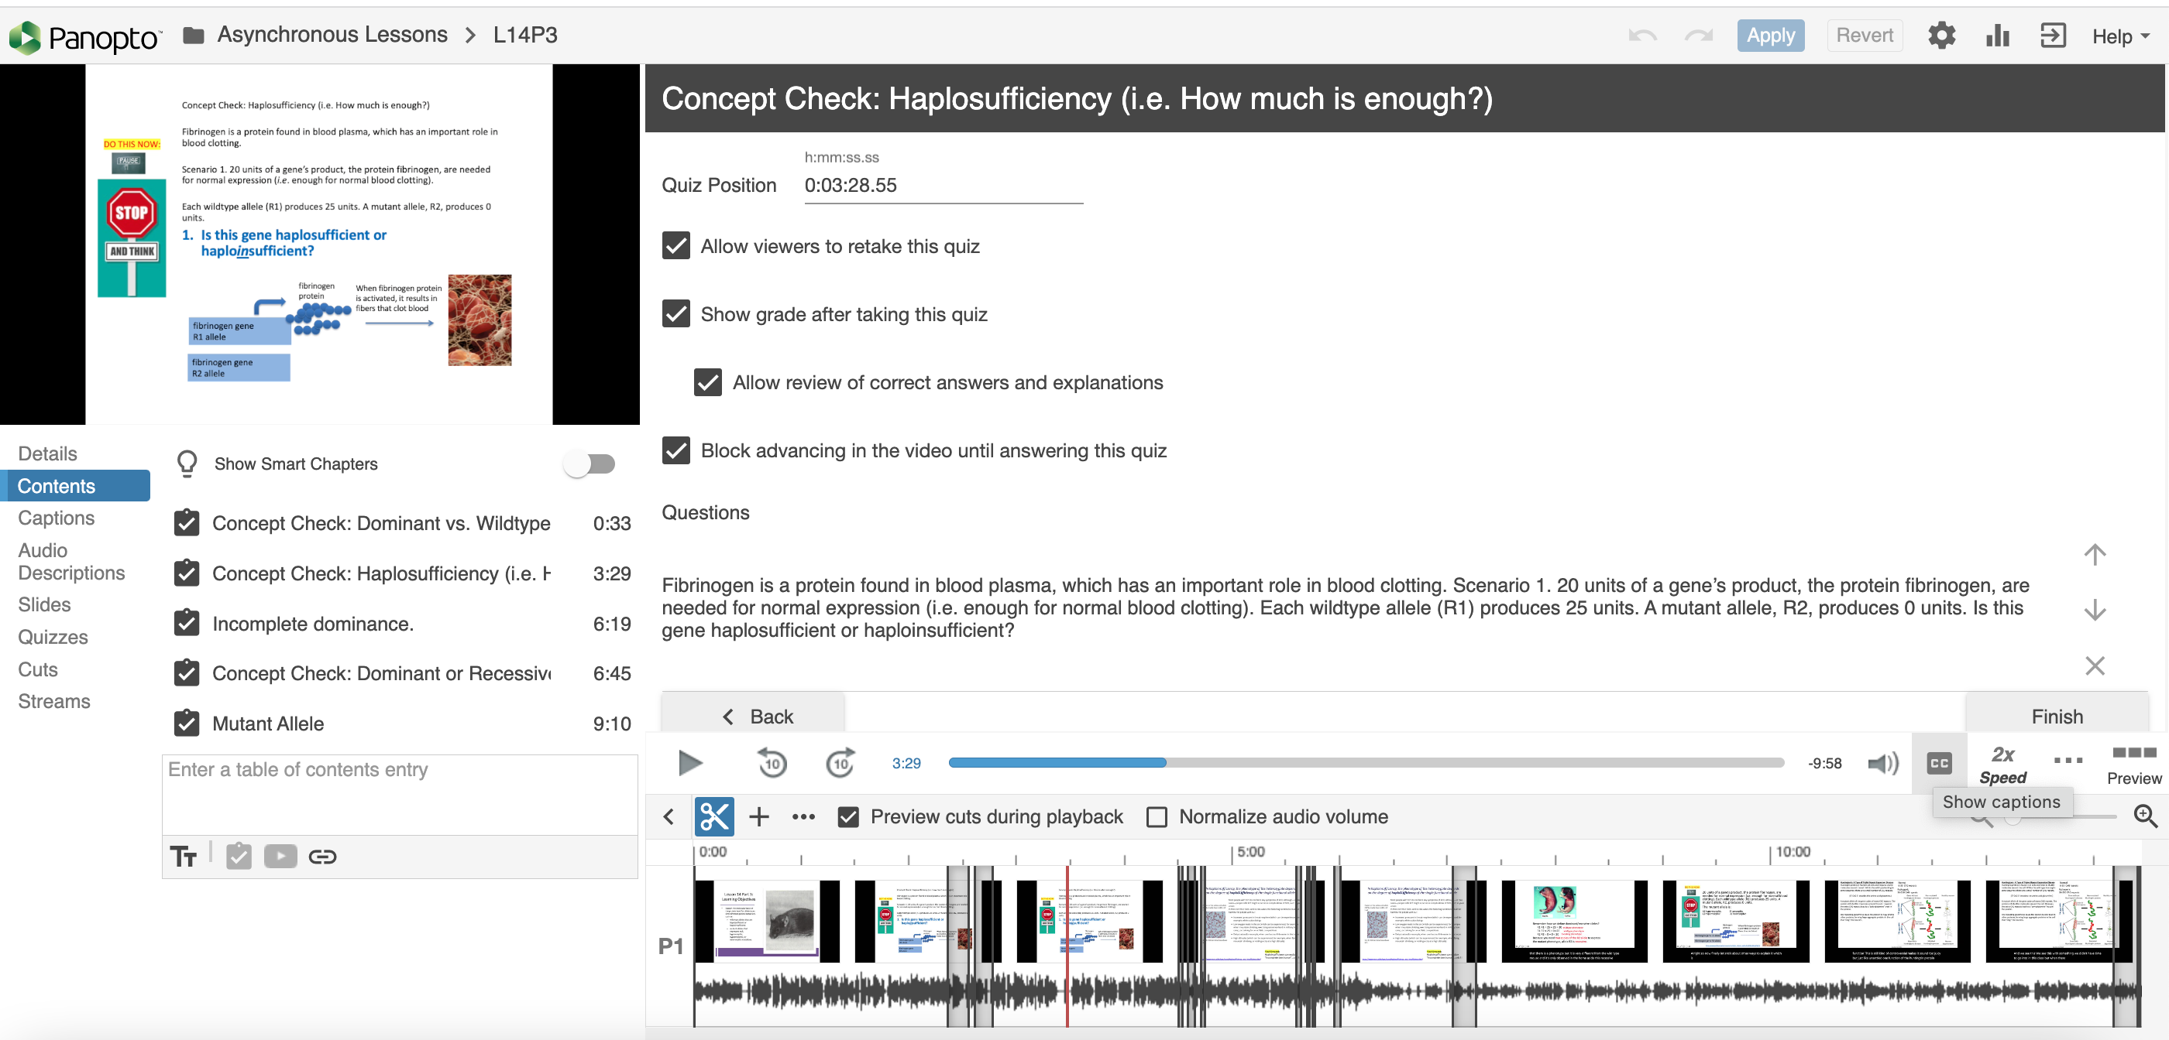
Logistics: Edit Settings and/or Adjust Time to Repurpose Quiz

